Slide 1
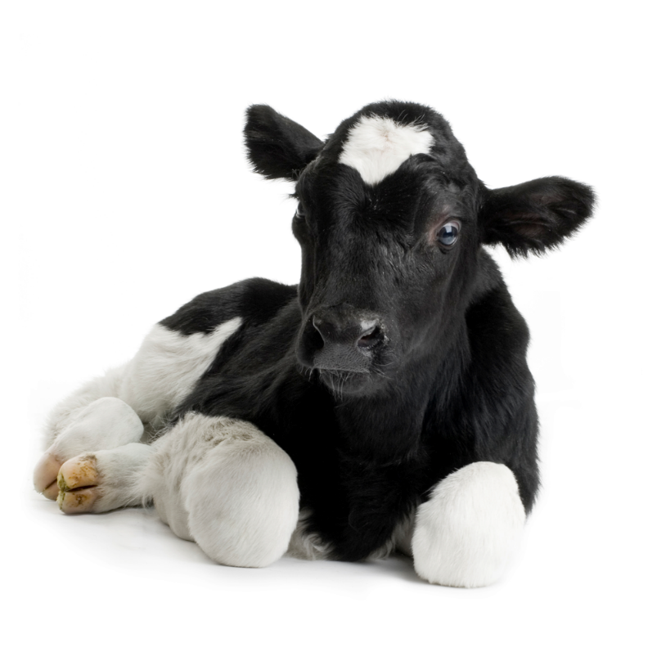
Insemination & Calving of Cattle
By C. Kohn
Agricultural Sciences
Waterford, WI
Source: www.thebullvine.com

Slide 2
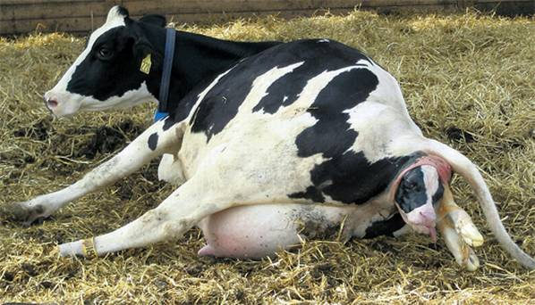
Timing of Breeding
One of the main causes of infertility in cattle is breeding cows at the wrong time.
Proper timing is a critical component of any fertility program on a farm.
Knowing when and how to breed a cow is critical in order to ensure that cows reproduce in a timely fashion.
Well-regulated reproduction is critical for a farm to be profitable.
A cow will go into estrus 2-10 weeks after calving.
Calving is when a cow gives birth to a calf.
The uterus of a cow requires 3-6 weeks to recover from the previous pregnancy.
This means that even if a cow goes into estrus shortly after calving, she may not be ready to be bred.
Source: www.independent.ie

Slide 3
When to Breed
The minimum time needed for a uterus to return to a normal state after calving is 45-60 days.
Fertility will also increase during this time, increasing the likelihood of conception after insemination.
Conception is when an egg is fertilized by sperm, whereas insemination is when sperm is deposited into the reproductive tract.
Fertilization is necessary for conception but conception does not always occur after insemination.
Fertility will peak 80-90 days after calving.
While there is an increased likelihood of conception from 45 to 80 days after calving, there are no gains from waiting beyond 80 days to breed a cow.
In general, cows should not be bred earlier than 60 days after calving and not after 80 days after calving.
Source: www.epa.gov

Slide 4
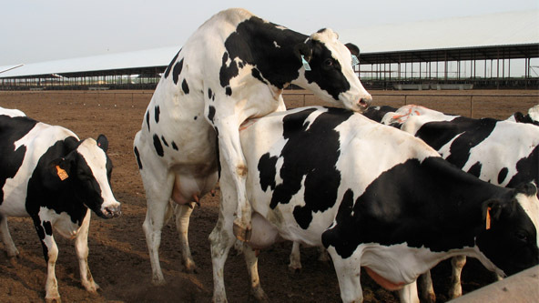
Detecting Estrus
Estrus detection is vital for a farm’s fertility program.
Signs of estrus include increased excitability and restlessness, mucous discharge from the vulva, a reddened and swollen vagina, and standing to be mounted by other cows (the most important sign).
On a farm, specific people should be responsible for detecting estrus.
Signs of estrus should be checked 3-4 times per day for at least 15 minutes per check in any given herd.
Estrus detection should be recorded in an individual cow’s records when spotted even if that cow is not going to be bred.
Source: web.altagenetics.com

Slide 5
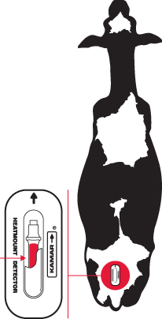
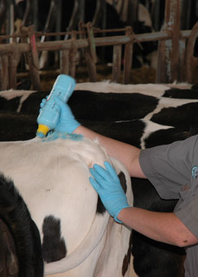
Estrus Detection Tools
Source: www.kamarinc.com
Estrus detection can be enhanced by a variety of tools. Some of these include:
Heat Expectancy Chart: charts are available to anticipate when the next estrus is likely to occur (based on a 21-day estrus cycle).
Mount Detection Aids (right): devices can be attached to the top of the tail of a cow that will indicate whether or not another has tried to mount her.
Tailhead Markings (right): if a cow is scheduled to go into heat, a producer may mark her tailhead with chalk, paint, or a specialized crayon. If the cow was mounted, this marking will wear off.
Heat Detector Animals: including a vasectomized bull or a testosterone-treated female can increase the likelihood of detecting a cow in heat as these animals will mount animals in heat even if they have only slight signs of estrus.
Pedometers: pedometers indicate how many steps a cow has taken; cows in estrus will have a higher step-count than other cows.
Source: www.ewdhic.org

Slide 6
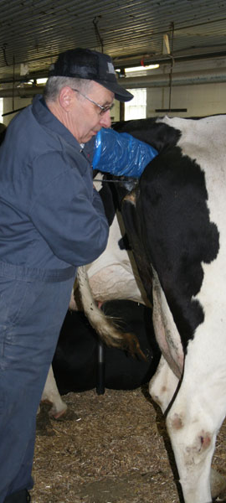
Insemination Timing
Insemination should occur 8 hours after peak estrus.
Fertility in a cow is highest toward the end of standing estrus (standing estrus is the specific point during estrus in which a cow will stand still when mounted).
Because it is not usually possible to know how long a cow has been in standing estrus, it is best to wait 8 hours to breed.
This is due to the fact that ovulation (release of the egg from the follicle) will occur 25-30 hours after estrus; the sperm also require time in the reproductive tract before they have the capacity to fertilize.
Waiting 8 hours after observing standing estrus ensures that the sperm will be available in the oviduct and will have the capacity to fertilize when the egg is released.
Source: www.radarproductions.org

Slide 7
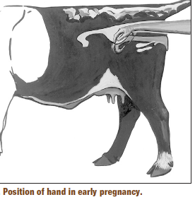
Confirmation of Pregnancy
Once a cow has been successfully inseminated, it is important to confirm that the cow is pregnant.
For most of the existence of farming, the only option for early detection of a cow’s pregnancy status was through rectal palpation.
Rectal palpation is when a veterinarian or technician palpates (or feels) for a corpus luteum, fetal membranes, placenta (the protective membrane “sack” that surrounds, protects, and nourishes the fetus), and/or a fetus.
An experienced practitioner can determine pregnancy 35 to 40 days after insemination in cattle.
Rectal palpation is an inexpensive and highly accurate method of detecting pregnancy at most stages of gestation.
Source: animalscience-old.tamu.edu

Slide 8
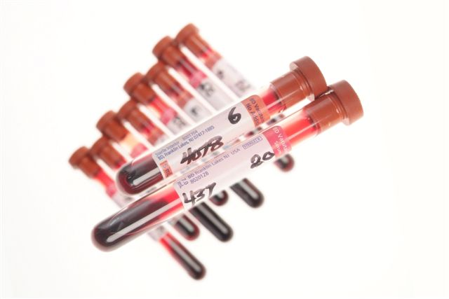
Detection of Pregnancy
The use of ultrasounds to detect pregnancy in cattle has grown significantly as portable, affordable units have become more prevalent.
Ultrasounds use high-frequency sound waves to look at organs and structures inside the body, or the fetus in pregnant females.
To determine pregnancy, a veterinarian will check for a placenta, the fetus, and/or a fetal heartbeat.
While ultrasounds are expensive and require training and experience, they can provide a non-invasive method for determining pregnancy and provide diagnostic details that palpation cannot. (particularly the gender of the calf)
To perform an ultrasound, a cow needs to be pregnant for at least 28 days.
Blood testing can also be used to determine pregnancy.
The placenta (protective membrane “sack” that surrounds, protects, and nourishes the fetus) will release a protein called pregnancy-associated glycoprotein (PAG).
This can be detected in the mother’s blood in 28-30 days after insemination.
Source: beefmagazine.com

Slide 9
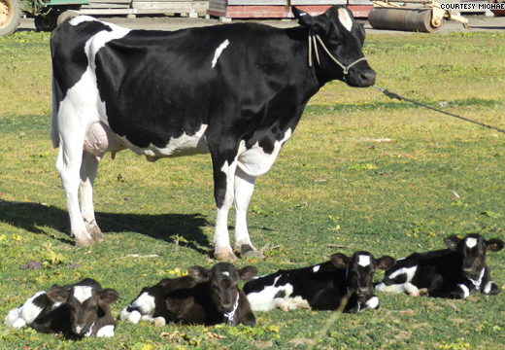
Detection of Pregnancy
The main advantage of blood testing and ultrasounds over rectal palpation is that they provide much earlier pregnancy confirmation.
While rectal palpation is inexpensive, it also requires the producer to wait an additional 1-2 weeks to detect pregnancy.
If a cow is determined to not be pregnant after palpation, a producer can restart her estrous cycle much sooner with blood testing or an ultrasound.
Rectal palpation and ultrasounds can also be used to diagnose twins.
In rectal palpation, twinning has occurred if there are multiple corpus lutea.
Twinning can visually be seen if using an ultrasounds.
While twins are valuable in some animals, they are a particular liability in dairy cattle because of the potential of having a freemartin as well as reduced size.
While a producer could abort the pregnancy in the cow with twins, this leads to lengthened time needed to rebreed the cow (and an increased time between gestations and milking cycles).
A cow that has twins is more likely to have calving problems, particularly a retained placenta, requiring increased care and observation after calving. The birth of twins also increases the likelihood of future twins than if she aborted.
Source: www.hlntv.com

Slide 10
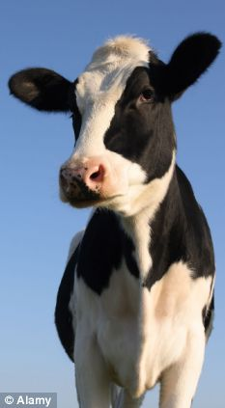
Drying Off
Gestation periods (the amount of time needed from conception to calving) vary with the age and breed of the cow and can also be affected by the sex of the calf and the number of calves the cow has carried.
Most cows will calve 276-292 days after insemination.
It is necessary to understand the signs and stages of calving to minimize calf deaths and cow losses.
Prior to calving, a cow should be dried off.
Drying-off is the process in which a cow stops being milked in preparation for calving.
The cow's udder and body both need time to restore their energy and nutrient reserves.
A cow’s dry period should be at least 40 days long, and ideally should last 50-70 days.
Cows with a dry period of 40 days or less will produce less milk during their next lactation.
A lactation is a period of milk production after calving.
The dry period should be determined by the cow’s expected calving date; for example, if a cow is expected to calve on July 1st, they should be dried up on May 1st.
Source: www.dailymail.co.uk

Slide 11
Dry Off
Preparation for dry off should begin at least two weeks prior to the dry-off date.
This is primarily accomplished by significantly changing the animal’s diet; the energy content of the cow’s feed should be reduced and the fiber content should be increased.
Eliminating grain and switching from alfalfa to grass hay is often effective.
The cow’s body will sense the reduction in energy and slowly produce less and less milk.
If after two weeks there are no problems, a cow will be milked for a final time and then not milked again until after calving.
Often a producer will also use a teat sealant to reduce the likelihood of an infection in the udder.
Dry cows should be checked often for mastitis (an infection of the udder).
Signs of mastitis can include heat, pain, redness and swelling of the udder; clumps, blood, watery discharge, and/or a smell in the milk; and possible fever and depression.
In severe cases, the udder will be cold and bluish; this is a sign of gangrenous mastitis, in which the tissue has begun to rot and partial amputation is necessary to save the life of the cow.
Antibiotics can be used to treat mastitis in many cases but the withdrawal time must be checked to ensure that the milk after calving will be saleable.

Slide 12
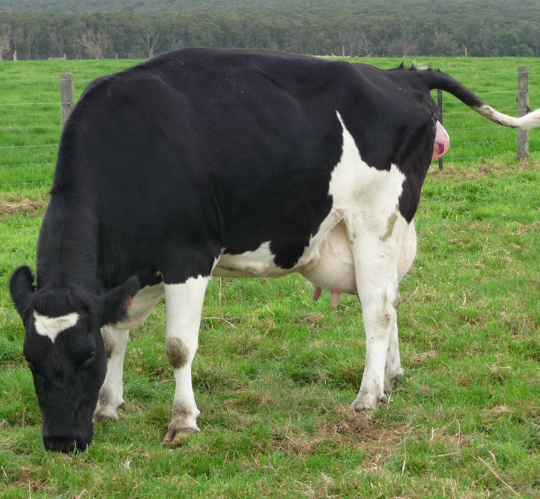
Dry Period
Dry cows should be kept in a clean, restful environment.
This is necessary for the cow to build up the bodily reserves necessary for calving and for milk production.
This is also necessary to minimize the likelihood of mastitis before or after calving as well as problems associated with calving.
Cows will undergo a series of changes during their dry period that indicate the start of calving.
Several weeks before calving, their udder will fill with colostrum (the antibody-rich thick milk that provides the calf with passive resistance before its own immune system is developed).
As calving becomes imminent, the vulva will swell.
The pelvic ligaments that supported the calf inside the uterus will relax, causing a slight arch between the tail and mid-back of the cow.
Mucus will be discharged from the cow’s vulva (similar to estrus).
https://milkmaidmarian.files.wordpress.com/2011/05/newbirth12.jpg

Slide 13
Signs of Calving
Immediately prior to calving, the cow’s water will break, causing amniotic fluid to spill out of the cow’s reproductive tract as the calf breaks through the placenta.
In normal calving, the legs and head of the calf will push through the cervix and into the vagina.
At this point the cow will likely be restless and switch between standing and lying down.
Most cows will take 1-2 hours to deliver the calf, while a heifer having her first calf may require 2-4 hours.
A cow should be observed during calving but not disturbed; it is not until the feet are visible that a farmer or veterinarian should assist if it is needed.
Most cows and heifers will calve normally with little need for assistance.
Unlike humans, most cows can deliver their young unassisted. About 6% of cows and 20% of heifers will need human assistance to deliver their calves.
Heifers need more assistance because they tend to be smaller and because they have not given birth before.
Animals should be examined if progress has stopped for more than 30 minutes or if calving lasts more than four hours.
The only exception to this rule is if the calf is backwards and is losing oxygen due to pressure on the umbilical cord.

Slide 14
Examining a Cow
Before starting a physical exam during a difficult calving, restrain the cow.
To do this, tie up the animal and restrain the tail.
Wash the anus, vulva, and surrounding area with soap and water.
Sterilize and lubricate your arms and/or wear a clean plastic long-sleeved glove. Do not use soap as lubricant (it will dry out and irritate the birth canal).
Form a cone with your hand and thumb and push your hand though the vulva into the vagina. (You can flatten your hand once in the vagina).
Determine the dilation of the cervix (how open it is) to ensure it will allow the calf to pass.
Next determine the position of the calf (it should be nose- and front-feet-first).
Be sure to take note of the stress level of the calf.
Determine if the calf is alive by pinching between the toes. The calf will reflectively draw the foot back if it is alive.
Also check the color of the tongue – the tongue should darken during the cow’s contractions and lighten between contractions. If the tongue stays dark, the calf is in distress.
If there is blood in the nose, mouth, or around the calf, it may also be in distress.

Slide 15
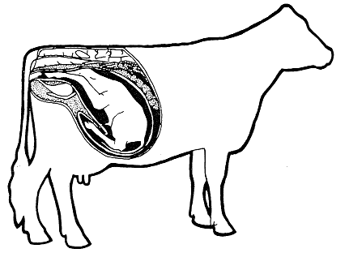
Abnormal Calving
Three situations that require the assistance of a veterinarian include:
You cannot determine the cause of delayed calving.
You are able to determine the problem but you cannot fix it yourself.
You think you can correct the problem but you have been trying for at least 30 minutes without any progress.
One of the more common causes of overly-long calving is an abnormal birthing position of the calf.
A calf should move out of the cow right-side-up with the nose and front feet point forward.
If a calf is upside down, it will need to be turned around while it is still inside of the cow.
If the calf is backwards, its hindlegs should be straightened so that they point out of the vagina and the calf should be delivered backwards.
If the head or a leg is bent backwards into the cow, the retained body part should be gently moved forward while the calf is still in the uterus.
Source: nongae.gsnu.ac.kr

Slide 16
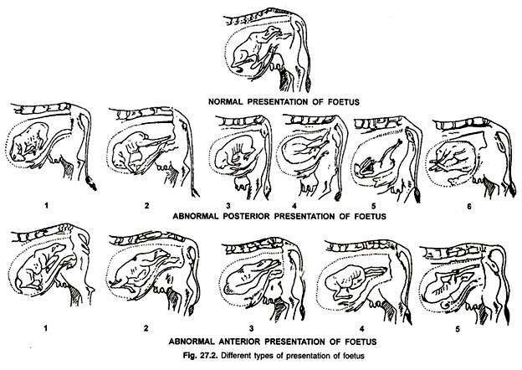
Source: www.yourarticlelibrary.com

Slide 17
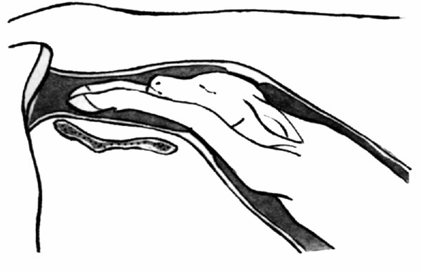
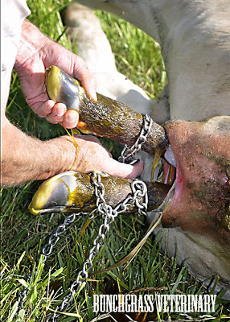
Assisting with Calving
There are times when a producer needs to assist with calving.
Most of the time this is not necessary; in fact, rushing the calving can injure the cow and should be avoided.
If it is necessary to assist with the calving, first wash the anus, vulva, and surrounding area with soap and water. Wash and lubricate your hands and arms.
Prepare two bucks of warm soapy water and keep near the cow. One is to wash the cow as needed and one is to wash your own arms and tools.
If you need to manually dilate the birth canal, insert both arms into the vulva and vagina and gently stretch your elbows outward.
Source: www.cvmbs.colostate.edu
Source: bunchgrassveterinaryblog.blogspot.com

Slide 18
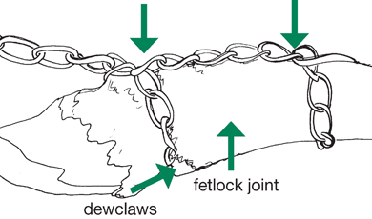
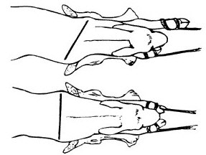
Obstetrical chains
Source: www.townandcountryvetclinics.com
Obstetrical chains are often necessary during difficult calvings.
These chains attach to the calves front legs to aid in pulling.
Chains should be attached using two loops; one loop should be above the fetlock (the joint lowest on the legs) and the other loop should be below the fetlock.
When pulling on the legs, pull one leg at a time to avoid wedging the shoulders in the birth canal.
Use a back and forth motion between the two legs until the calf’s head and shoulders are outside the birth canal.
Once at this point, turn the calf 90º so that it is one its side; this allows the calf’s hips to pass through the widest part of the canal more easily (the birth canal is wider from bottom to top than from side to side).
Source: www.thecattlesite.com

Slide 19
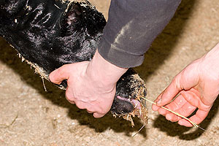
The newborn Calf
Once the calf is born, work quickly to make sure it gets oxygen.
Clear the nostrils of fluid and membranes; stimulate breathing by blowing into the nasal cavity or tickle it with straw.
Immediately dip the navel with an iodine solution to prevent an infection. Until the umbilical cord dries up and falls off, it will allow open entry for pathogens into the calf’s body if not dipped in iodine.
Ensure that the calf receives colostrum from the cow within an hour of birth. Antibody proteins can only be absorbed into the calf’s blood in the first few hours after being born and will begin to decrease after two hours from birth.
Source: calfcare.ca

Slide 20
Strain of calving and lactation
Calving and the start of a new lactation places an enormous amount of strain on the cow.
Ensure that the cow has a clean environment with clean straw or fresh pasture.
Avoid sawdust as this can easily lead to infection and disease.
Immediately after calving, the cow should be offered lukewarm water with electrolytes.
A cow should be observed closely a few weeks after calving as this is when reproductive and digestive disorders have the highest likelihood of occurring.
The placenta should be expelled within 12 hours of the delivery of the calf.
The cow will try to eat the placenta to regain the nutrients found within it; this should be avoided as it can lead to choking or digestive distress.
If the placenta is not expelled within 12 hours, it is considered a retained placenta and may require attention.
Source: www.gopixpic.com

Slide 21
Works Cited
Dairy Cattle Fertility & Sterility, by Hoard’s Dairyman.
http://beefrepro.unl.edu/pdfs/heatdetection.pdf
http://extension.psu.edu/animals/dairy/health/reproduction/insemination/ec402/estrous-detection-aids
http://animal.ifas.ufl.edu/ans3319/lab_notes/docs/lab_11_pregnancy_diagnosis_rectal.pdf
http://compepid.tuskegee.edu/syllabi/clinical/large/obstet/chapter4.html

