Slide 1

Introduction to Marketing
By C. Kohn
Agricultural Sciences
Waterford, WI

Slide 2
Marketing
Marketing is the term for the activities related to creating a message, communicating this message to audience delivering, and increasing the likelihood that producers are able to sell their product at a reasonable price and that consumers are able to obtain the products they need.
  Another definition: Marketing is the analyzing, organizing, planning and controlling of the firm’s resources, policies, and activities with a view to satisfying the needs and wants of chosen consumer/customer groups at a profit. (Kotler, Marketing Management, 1967)
Without marketing, everything would have to be sold in a sort of ‘farmers market’-style exchange.
  Marketing ensures that consumers are aware of products, that those products are sold at the appropriate price as determined by supply and demand, and that appropriate venues exist to sell the products.
  For example, if you go to a large store like a Walmart, it is easy for you as a consumer to find the goods and products that you intend to purchase as a result of the efforts of marketing.

Slide 3
Without marketing…
Without marketing, consumers would need to physically go to each producer of a good or service, negotiate a price, and even seek out information on products on your own.
  Without marketing, the producers of each good would have to negotiate each sale, manage each customer, negotiate each price, and determine how each good is delivered.
Marketing reduces the difficulty of buying and selling products.
  It does this by offering a systematic way
  to develop the product identity,
  determine an appropriate price,
  communicate the appropriate message,
  and provide the best venue for delivering
  that product (or service).

Slide 4
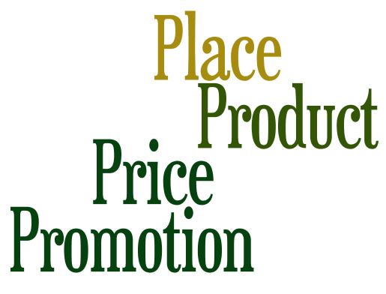
Marketing vs. Economics
Marketing is a related but separate field from economics.
  Economics is the study of how people make choices based on benefit and opportunity cost; marketing is the study of how to get people to make a specific choice by highlighting the benefits of a specific good or service.
Both center on the concepts of decision making, benefit, and opportunity costs.
  However, economics seeks to understand how these result in the decision made in the end.
  Marketing focuses on how to get a particular decision to be made to increase a profit.
Marketing helps to make economic decisions and processes happen more efficiently.
  If ‘decision making’ is the engine of an economy,
  then marketing is the oil that helps this engine run
  more smoothly and efficiently.
Marketing is about the Four P’s –
Product, Price, Place, and Promotion.

Slide 5
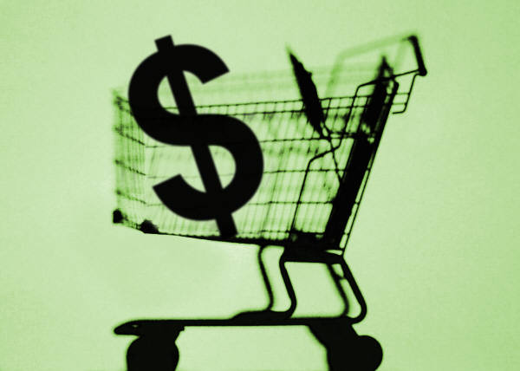
The Four P’s – Product
Product is the most important of the P’s.
  Product refers to the good or service you are actually offering to your customers.
  In order to make any sale, you need the product that best satisfies the needs of your target market.
    A target market is the group of people who will only buy your product if they receive the right message in the right way about the best product in the right place.
In reality, the Product is not just the actual good or service, but also the quality, features, options, services, warranties, and brand name.
  A product is really a bundle of items
  a customer will consider, not just the
  good or service itself.
  The product bundle needs to meet
  the specific needs of a specific group
  of people.

Slide 6
The Four P’s – Product
Product is not about having the “best” good or service; it is about have the best good or service for the specific group of people you are trying to convince.
  E.g. if your target market is the customer who is wealthy and already has a lot, you would focus on quality, luxury, and exclusiveness.
  If your target market is a price-conscious college student or parent of young children, you would focus on the maximal quality for a minimal price.
The product’s attributes promoted to the target market are not selected on a whim but instead are chosen after conducting extensive research and data analysis.
  This is also true for selecting your target market.
The product’s attributes should also be chosen with consideration for what a business can provide.
  For example, if a business is able to offer immediate delivery, this could be part of the bundle and may also influence who the target market will be.
  If the business cannot provide immediate delivery but can offer a strong personal sense of support and form strong relationships with the client, this would result in a very different product bundle and a very different target market.

Slide 7
The Four P’s – Price
Price refers to how much you charge for your product or service.
  Often people assume that the correct price is the lowest price for a product bundle.
    However, low prices can also be a signal of low quality and may send the wrong message.
    A low price may also not be the most important attribute of a product depending on who is a part of your target market.
  Your determined price should be reflective of the cost it takes to make your product as well as the desired profit margin.
    Your profit margin should be appropriate
    given the product you are trying to sell.
    A profit margin that is too low will make it
    impossible for a business to grow but one
    that is too high will prevent your product
    from being desirable.
    Consider what your target audience is
    willing to pay and relate it to your production cost.

Slide 8
The Four P’s – Price
Pricing strategies usually fall into one of the following categories:
  Competitive Price Points (or Cost-plus): in this strategy, you determine what you think is the ideal profit percentage (e.g. 20%) and add this much once the cost of production is determined.
    This method requires accurate record keeping but is otherwise a simple method to use.
  Value-based: this strategy involves setting the price based on the buyer’s perception of its value.
    The quality of the product, the prestige of the seller, and other intangible factors affect how the price
    is perceived.
    While this has the advantage of ensuring that
    the price meets the buyers’ expectations, it
    can be very difficult to accurately determine
    what the buyers expect the price to be.

Slide 9

The Four P’s – Price
  Competitive: this strategy involves keeping your price similar to your competitors (e.g. usually gas stations that are side by side will have the same price for gas).
    This can be as simple as identifying your competitor(s) and making price changes when they do (e.g. we’ll match any price).
    This could also refer to a bid process (such as a for a government) where the cheapest bid receives the contract.
  Going-rate: this is the pricing process in which the price is actually determined by the market (such as for a commodity) and not by the firm.
    For example, if you order lobster in a restaurant, the menu may list “Market Price” instead of a dollar amount.
  Skimming: the point of this strategy is to inflate your price to make it appeal to an affluent target market.
    The goal is to make your product seem
    exclusive and rare.
    As the market becomes saturated, you
    will likely be forced to lower your price.
Source: http://selinascommblog.files.wordpress.com/2011/09/amber8.jpg

Slide 10
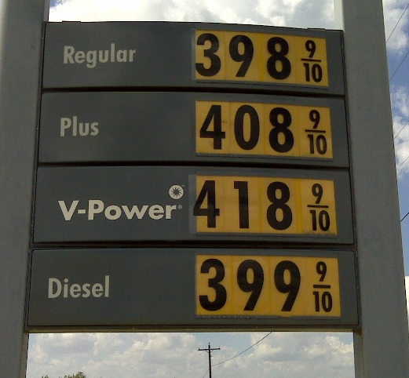
The Four P’s – Price
  Discount: this strategy involves offering your goods at the cheapest possible price but still make a profit.
    E.g. wholesalers and those who offer coupons are using a discount strategy.
  Loss-Leader: this strategy entails offering a product for a price so low that money is actually lost.
    The goal is to attract customers to the store to entice them to buy other products.
    This is why the price of Thanksgiving turkeys drops at Thanksgiving when demand is the highest – whoever has the cheapest turkeys also sells the rest of the Thanksgiving meal (the remaining items of which will be marked higher during that week).
  Psychological: this involves making the price
  look better than it actually is.
    For example, gas stations sell their gas at $3.49
    and 9/10 of a cent, not $3.50.
    Meat might sell for $4.99 per lb. instead of $5.00.
    This is usually used in combination with other price
    strategies.
Source: http://kalthoffonthefence.files.wordpress.com/2008/09/ken-gas-prices.jpg

Slide 11
The Four P’s – Place
“Place” refers to how you will distribute your product to customers.
  This could be a small store on Main Street, through a major retailer, exclusively online, etc.
  Businesses that create or assemble a product have two options: selling directly to consumers or selling to a vendor.
Direct sales to a customer involve door-to-door sales, mail order, e-commerce, or opening your own store.
  A major advantage is that you get to work with your customers face-to-face in order to build stronger customer relationships, allowing you to more easily detect changes in demand and allowing you to respond more nimbly.
    You also have complete control over your price, how your product is sold, and what you sell.
    Direct sales work especially well for products that are season (such as Christmas trees) or for goods that are limited in supply or have a limited customer range.
    The main disadvantage of direct sales is that you are completely responsible for reaching your customer base and maintaining a retail presence.

Slide 12
The Four P’s – Place
Retail Sales (selling through an intermediary) involves selling your product to a store who then sells it to the customer.
  The main advantage is that you have a much wider exposure to customers who will see your product just by coming to the store (as opposed to direct sales, where they are unlikely to find your product unless they are looking for it).
    Additionally, you do not have to worry about many of the details of retailing your product – you simply have to meet the demands of your retailer.
    If you can sell large amounts of your product and keep it at a consistent quality, retailing allows you to reach far more people with less need to focus on marketing and more ability to focus on the qualities and attributes of your product.
  However, with reseller sales you also lose a lot of control over your product.
    The retailer now becomes the one associated with your product and may even brand your product with their label.

Slide 13
The Four P’s – Place
Whether a product is sold directly or re-sold, the level of product coverage is an important consideration.
  Coverage refers to how the product is distributed.
  Intensive distribution means the product is sold in as many places as possible, usually at as low of a price as possible.
    This usually applies to big businesses and convenience products (such as chewing gum or processed food).
Selective distribution is meant to keep a product exclusive only to one or a couple of businesses.
  This often works best for upscale luxury items.
  This is also a good option for sellers who are trying to build stronger relationships with their customers because it allows for more control over how the product is perceived.
Exclusive distribution restricts sales to a single seller (possibly the product producer themselves).
  While this might make a product seem more prestigious and offers maximum control over the product’s appearance and quality, it also strictly limits the volume of sales.

Slide 14
The Four P’s – Place
Place isn’t just which store or location you sell from (if any), but also how the product is portrayed in a particular seller’s location.
  For example, the jeans in the window of American Eagle are clearly chosen for a reason and have a different sale potential than the jeans folded on the shelf.
  The cereal at eye-level in a grocery store has a different sale potential than the cereal on the very bottom shelf.

Slide 15
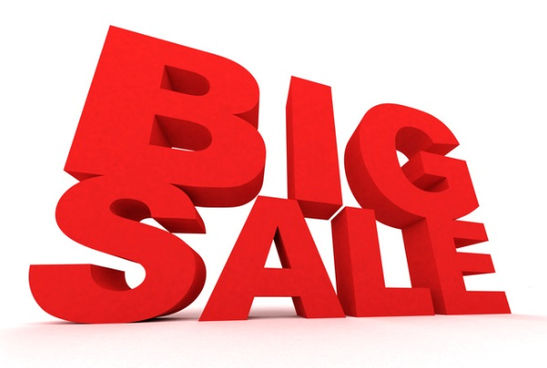
The Four P’s – Promotion
“Promotion” refers to the advertising and sales portion of marketing.
  Promotion is simply the methods you use to let people know that you have something for sale.
Promotion exists to get people to understand what your product entails, what benefits it provides, and why they should want to purchase it.
  Good promotion involves sending specific message with a clear meaning to a specific group of people who will only purchase your product if they receive the right message (your target audience).
Promotion may involve advertising, public
relations, personal sales, and sales
promotions(such as coupons or deals).

Slide 16
The Four P’s – Promotion
Advertising is likely the most noticeable component of promotion (or even all of marketing).
  It can exist through radio, television, print, or electronic media, or can be spread through word of mouth.
Public relations focuses on creating a favorable public image.
  This can involve being a helpful part of the community, providing open house days, showing the sustainability of a product, etc.
  News stories and press releases are often key in creating positive PR.
Personal sales focuses on how a salesperson interacts with customers.
  A good salesperson has a tailored message for each kind of customer and is effective in building lasting relationships with the people who sell a product.
Sales promotions include free samples, coupons, contests, incentives, loyalty programs, prizes, and rebates.
  Promotions can also include reaching customers through seminars, displays at public events, or through trade shows.

Slide 17
History of Marketing
Early people did not focus on efficiency; they produced what they needed without major consideration of how to do it more efficiently.
  As civilization grew and evolved, people focused less on producing everything they needed on their own and began to focus more on only producing the things they were best at producing.
  As jobs became split among people who could best perform them, people were able to produce every good more efficiently.
  This concept of specialization
  encouraged firms to hire specific
  people to focus on the product,
  pricing, promotion, and method
  of distribution.

Slide 18
History of Marketing
Phases of Marketing – marketing has evolved over time.
Simple Trade Era: in earlier times, everything was made by hand or harvested from the land.
  Exploration was the focus of most economic activity, commodities were the prime concern, and trade and bartering by individuals constituted most economic activity.
  Until the early or mid-1800s, marketing was as much about bartering and discovering new resources as anything else.
Production Era: around the start of the Industrial Revolution, the focus of marketing shifted to focus on the availability of options in the marketplace.
  Much of the focus was on creating the means to create new products.
  Because the ability to produce goods was very limited, marketing emphasized the existence of new products more so than how one product was better than another (because often there was only one maker of a product).

Slide 19
History of Marketing
Sales Era: Between 1920 and 1940, marketing shifted as competitors began producing products that were once only produced by one company.
  E.g. the Cokes of the world started competing with the Pepsi’s that didn’t exist at an earlier time.
  Companies had to work harder to convince their customers that their product was the better one to purchase.
Marketing Department Era: after WWII, the idea of the ‘marketing concept’ became a widely accepted component of doing business; this concept was that businesses existed for their customers (the customer is always right) and specific parts of the business were formed to focus exclusively on customer needs and satisfaction.
  Companies began to earnestly seek out the needs of their customers (instead of just creating a product and assuming it would be desired).
  This focus on customer wants led to an increased focus on marketing research, an increase in product options, and heightened levels of branding (new, improved, lemon-scented!)

Slide 20

History of Marketing
Marketing Company Era: by the 1960s, marketing became a larger part of the American consumers’ consciousness.
  Customers knew they could make demands and expect more from companies because of larger levels of affluence and greater competition among companies.
  Some companies, in an attempt to get ahead of their competition, eliminated their own marketing departments in favor of hiring entire companies who focused only on marketing and were able to hire the most talented marketers (think Don Draper of Mad Men).
  Entire businesses revolved around the goal of trying to research, understand, and reach customers.
Source: http://obatadictum.files.wordpress.com/2011/07/madmen.jpeg

Slide 21
Modern Marketing
Today marketing companies are obviously still in existence (which is why the Super Bowl isn’t just a football game anymore), but are now in a post-marketing company era.
  A sixth era has been titled the Relationship Marketing Era, which began in the 1990s.
    While the post-1960s marketing strategy was focused on realizing and meeting customer needs, this Relationship Marketing Era takes this a step further and seeks to build long-term, mutually beneficial relationships with customers.
  Rather than just having a one-way street of identifying customers’ needs and then offering products to satisfy those needs, this era seeks to include the customer as something of an equal, and uses this relationship to both build the brand of the product as well as keep the customer emotionally attached to the firm that produces the product.
    This was because customers were becoming less responsive to traditional marketing (such as ads and commercials) and marketing companies needed a new way to reach customers.

Slide 22

Modern Marketing
While product satisfaction used to result in predictable customer loyalty, by the 1990s, this was no longer the case.
  Marketing techniques became less focused on product attributes and more focused on customer feelings and experiences.
For examples, some companies now offering loyalty cards, with point values that can be redeemed for discounts, privileges, and other perks.
  Other companies began to offer ‘first class’-style memberships to their company (such as Amazon Prime or United Airlines MileagePlus Members) as a way to entice the customer to be more likely to do business with that company in the future.
  In addition, companies are more likely to offer direct contact with customers, seek their opinion prior to the release of products, and provide interactive feedbacks with live chatting with a representative.
Source: http://www.choicehotels.com/media/choicehotels/en/choice-privileges/gp/united_mileage_plus_3p_c_r.JPG

Slide 23
Modern Marketing
We are likely entering a seventh era of marketing, called the Social Marketing or Mobile Marketing Era.
  While this era is very recent, it is highlighted by a sense that in many ways the customer is as much a marketer of a product as a marketing company is, and has considerably more influence through social media than ever before.
  For example many customers now use reviews and ratings on shopping sites like Amazon.com to determine what product to purchase more so than marketing media.
This era is highlighted by three major changes to the marketing landscape:
  Enhanced Expectations: today’s consumers want more choices in less time for the lowest possible price in a manner that is socially- and environmentally-friendly to an extent not previously seen.
  Connected Experiences: consumers want to share their experiences with products and use others’ experiences to help inform their own purchases.
  Self-Marketing: consumers, by sharing their experiences, are doing as much to promote (or, in some cases, demote) products as the paid marketers of those products.

Slide 24

Modern Marketing
An example of a company that has adapted to these shifts is Amazon.
  Amazon has responded and even helped to create the expectation of almost-instant delivery of an enormous selection of products while providing an online, easy-access format for both seeking products and for obtaining user-information for each product in the form of reviews, ratings, and questions.
  By responding to/creating enhanced expectations, by connecting users to the product (through reviews and through membership services like Amazon Prime), and by allowing customers to take part in the marketing process, Amazon has become a major retailer of an endless array of products.
Source: http://www.nchannel.com/wp-content/uploads/2012/07/amazon-logo.jpg

Slide 25

Modern Marketing
The Social/Mobile Marketing Era has changed the selling of goods and services in the following way:
  First, it requires retailers to sell only the highest quality goods or services.
    Because customers are much more connected than they ever were before, they can quickly and easily share information about products.
    Any product that is defective or overpriced can be immediately called out by users using social media.
    A product that is reliable and high quality will receive its own form of marketing through consumer reviews free of cost to the producer.
  Second, marketing will be shaped with or without the firm’s efforts.
    A firm can choose to disregard their customers’ opinions (and risk getting a series of negative reviews), or they can work
    with customers to develop relationships that not only
    help to positively shape the customers’ reviews but also
    increase the likelihood that customers will return in the
    future.

Slide 26

Modern Marketing
  Brands will be more crucial than ever before.
    In marketing, a brand is the collective term for the expectations, memories, and relationships that together account for a consumer’s choice of one product over another.
    While many think of brands as being a logo or a package, a brand is much more than this (just like a cowboy is more than just someone wearing a cowboy hat).
      These experiences and expectations associated with a product are as important or more important as the package the product comes in.
    With the internet has come an explosion of information to process; well-designed brands help customers to navigate the enormous amount of choices available.
      If you don’t know what it is, or if you do but you wouldn’t choose it, or if you would choose it but you won’t recommend it to others, then there is no brand.
  Finally, new skills will be needed to navigate the options, and a business-owner or a marketer must constantly stay on top of new methods, new media programs, and new strategies for using new programs.
    Imagine if marketers today had
    only focused on Facebook and
    ignored Instagram and Twitter!
Source: blog.timesunion.com

Slide 27
Works Cited
Sources:
  http://www.ub.edu/economiaempresa/masteroficial/mim/wp-content/uploads/2013/02/RelatMar-Barcelona2.pdf
  http://dstevenwhite.com/2010/06/18/the-evolution-of-marketing/
  https://www.boundless.com/marketing/an-overview-of-marketing/introduction-to-marketing/products-placement-promotion-price/
  http://www.whatiseconomics.org/relationship-between-marketing-and-economics
  http://rishadt.wordpress.com/2013/09/22/the-dawn-of-a-new-era-in-marketing/
  https://www.extension.purdue.edu/extmedia/EC/EC-730.pdf

