Slide 1
Invasive Species
By C Kohn, Waterford WI

Slide 2
Imagine, for a moment…
Imagine, for a moment, that every hardwood deciduous tree in the community has died.
There are no trees lining the streets
The environmental center has had to be completely clear cut
The sides of streets are rural roads are lined with stacks of rotting, infested logs.
Seem unlikely?

Slide 3
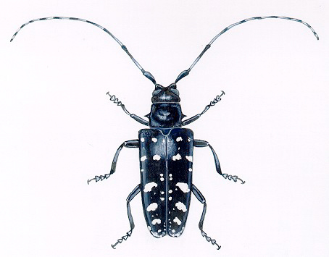
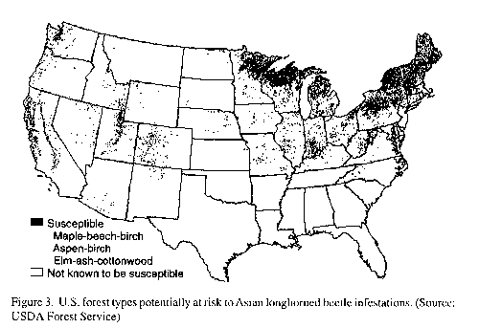
March 15, 1999
DEPARTMENT OF AGRICULTURE
Office of the Secretary
Declaration of Emergency
A serious outbreak of the Asian longhorned beetle is occurring in Illinois and New York. This insect, native to China and Japan, is a destructive pest hardwood trees.
If this pest moves into the hardwood forests of the United States, the nursery and forest products industry could experience severe economic losses.
Resources are insufficient to meet the estimated $5.5 million needed for the Federal Share.
Therefore…I declare that there is an emergency which threatens the forest and maple syrup industries of this country.
Dan Glickman, Secretary of Agriculture, United States of America

Slide 4
Gain one, lose many
According to the USDA, this one species had the potential to wipe out dozens, if not hundreds of species of hardwood trees across the nation.
How could the addition of one species cause so many others to die out?
Why don’t native species do this kind of damage?

Slide 5
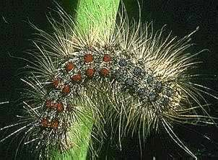
One among many
Another major threat includes the Gypsy Moth.
When GM densities reach very high levels, trees may become completely defoliated (lose their leaves).
Entire stands of trees can be lost with repeated years of leaf loss.

Slide 6
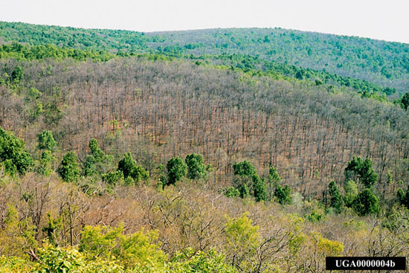
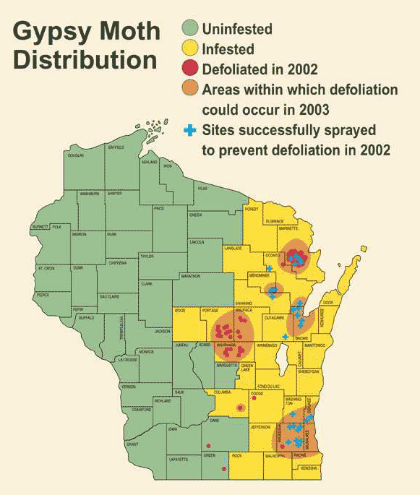
Gypsy Moth damage

Slide 7
The newest threat
The latest invasive insect to threaten Wisconsin forests is the Emerald Ash Borer (EAB).
The Emerald ash borer is an exotic beetle that was discovered in southeastern Michigan near Detroit in the summer of 2002.
The larvae (the immature stage) feed on the inner bark of ash trees, disrupting the tree's ability to transport water and nutrients.
It became established in Wisconsin in summer 2008

Slide 8
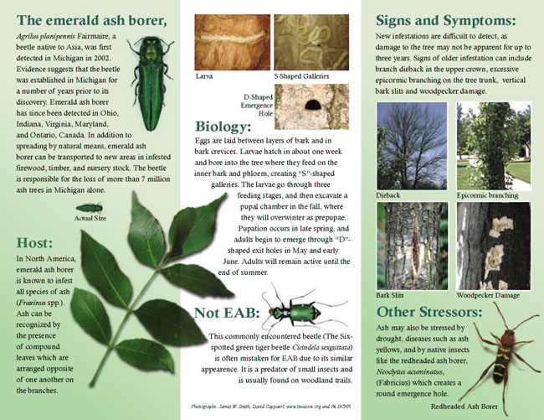

Slide 9
The Cost
Invasive insects cost municipalities, property owners, nursery operators, and forest products industries tens of millions of dollars each year.
Every year, Wisconsin forests are bombarded with more and more invasive species
Each is individually capable of destroying major portions of our state’s timber.
Without effort to fight these insects, Wisconsin could lose one of its most valuable natural resources.

Slide 10
Why?
Take a moment and hypothesize why and how this could happen.
How could a handful of different species of insects create this kind of devastating risk?
Why is it that we rarely hear about native insects causing this much damage?
What is different about these introduced insects?
How do we fight this kind of problem?
Is this a human-caused problem?

Slide 11
Definitions
Invasive species are living species (plants, animals, fungi, or microorganisms) that spread rapidly and cause harm to other species by preventing them from being able to obtain nutrition, reproduce, and/or perform natural functions at a normal rate.
Invasives – living species that disrupt & harm native species
Most invasive species come from another continent.
Native species are species that naturally inhabit an ecosystem.

Slide 12
Different Names, Same Problem
Invasives can go by many other names, including
Introduced species
Nonindigenous Species
Alien species
Exotic species
Weeds
Pests

Slide 13
Invasives: usually, but not always introduced
Most are brought in from other continents willingly or unwillingly.
However, some invasive species can be native to an area.
E.g. even though it is a native species, some biologists consider Whitetail deer to be invasive when their population surpasses a sustainable level
When there are too many deer, understory plants in forests begin to disappear.

Slide 14
Clarification #1
Often “invasive” and “introduced” are used interchangeably
While this is often true, it is not always true
Some introduced species can be very helpful or valuable.
98% of the US food supply comes from introduced plants and animals including…
Wheat Rice Cattle Poultry
Introduced species are not always bad. Introduced species only become invasive when they displace native species.
Wheat rarely displaces a native population w/o humans

Slide 15
Clarification #2
There is also a misconception that all introduced species become invasive.
In fact, most do not.
Of every 100 exotic species introduced to North America, only about 10 are able to survive without the planting or assistance of humans
E.g. rice does not spread from its field on its own
Of the 10 in 100 that can survive without humans, only about 1 of these will cause serious ecological problems.
So odds are that only 1% of introduced species become invasive

Slide 16
However…
However, this 1% causes more than its share of damage
US environmental damage from invasive species is estimated at $138 billion per year.
To give some perspective, this cost is more than twice the total value of Wisconsin’s entire agricultural industry
Zebra mussels alone have caused $3 billion in damage to the Great Lakes.
This equates to ~$100/yr lost for every man, woman, and child that live in a Great Lakes State because of one species!
NOAA: 35 million population; Cornell: $3 billion cost.

Slide 17
Successful Invaders
Invasive species usually have several of the following characteristics:
They grow rapidly and compete with other plants or animals
They produce large numbers of seeds/offspring at a young age
Their seeds/eggs can survive a long time before sprouting
They can travel long distances
They have few if any predators
Their native region has a climate similar to the affected area of the US
They have multiple reproductive strategies.
They have few, if any, specific needs

Slide 18
Invasives: Habitat Generalists
Invasive species are often “habitat generalists”
They can occupy a broad range of habitats
Because they can adapt to many kinds of habitats, they can spread to many parts of the country.
They can use or create food in many ways.
Invasives spread well because they don’t have specific needs…and many kinds of habitat can fill those needs.

Slide 19
Invasives Compete Well
Invasive species can obtain resources more quickly or efficiently than the native species in a habitat due to…
A lack of natural predators in their new habitat.
An ability to tolerate human disturbance
Rapid reproductive strategies
Rapid growth and development
Multiple feeding strategies
Few if any specific physical needs or requirements
If unchecked, invasive species have the potential to eradicate some or all native species and interrupt natural ecological processes.

Slide 20
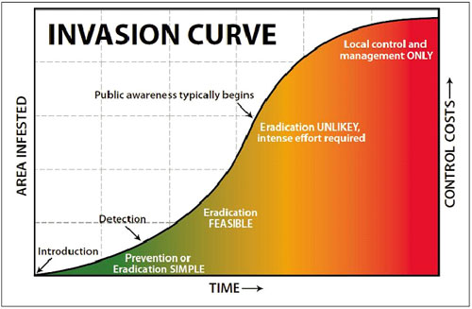
The biological invasion curve shows that prevention is the cheapest and most effective strategy.
It also shows that most awareness of an invasive species comes only after eradication is basically impossible.

Slide 21
Sometimes Invasives Have Help (from us!)
Humans aid the spread of invasives in many ways. Two key ways humans help invasives are…
Transportation
Habitat Disturbances
In every example in this presentation, the invasive species was brought to the US by human activity (shipping, rail, etc.)
Invasives very rarely occur unless they have help.

Slide 22
Habitat Succession and Disturbance
Transporting invasives allows them to gain access to ecosystems they were a never a part of.
Without transportation, invasives would never leave their native regions.
Besides transporting invasive species, humans can also aid them through habitat disturbance.
Habitat disturbances are when habitats experience a rapid event that changes the availability of resources such as light or nutrients.
Unlike succession which is the slow, sustainable change of habitats

Slide 23
Habitat Disturbances
Habitat Disturbances can be natural
For example, a fire, flood, or volcano is a natural occurrence that can completely change a habitat
Habitat Disturbances can also be manmade
E.g. building roads, agriculture, pollution, invasives, urban sprawl, etc.

Slide 24
Examples of Human Habitat Disturbances
When humans build roads, roadsides are first disturbed by the construction equipment that makes the road.
Later, disturbances occur from the repeated mowing and spraying of herbicides
This kind of activity makes native species less competitive.
Equipment, people, and introduced animals will help spread the seeds of invasive plants.
Because of mowing and herbicides, only grasses are able to survive. Any shrubs or trees and most flowers will be lost.
Invasive grasses become even more successful because they can more quickly recover from regular human disturbance.
More invasives will be continue to be introduced with continued human activity.
As invasive species become more prevalent, they “choke out” native plants and the native animals that need those plants.

Slide 25
Summary
Invasive species spread rapidly and cause harm to native species
Usually invasive species are introduced
However, very few introduced species become invasive because only 1% become established
US environmental damage from invasive species is estimated at $138 billion per year.

Slide 26
Summary (cont.)
Invasives spread well because they don’t have specific needs…and many kinds of habitat can fill those needs.
Invasive species can obtain resources more quickly or efficiently than the native species in a habitat
If unchecked, invasive species have the potential to eradicate some or all native species and interrupt natural ecological processes.

Slide 27
Summary (cont.)
The biological invasion curve shows that prevention is the cheapest and most effective strategy.
It also shows that most awareness of an invasive species comes only after eradication is basically impossible.

Slide 28
Summary (cont.)
Two key ways in which humans help invasive species are…
Transportation
Habitat Disturbances
Human activity moves species to locations where they never previously existed.
Habitat disturbance can give invasive species an increased ability to compete with native species or reduce native species’ competitiveness.

Slide 29
Review Concepts
Def. of an invasive species
Difference between introduced and invasive
Percent of introduced species that become invasive
Cost of invasive species per year
Characteristics of invasive species
What it means to be a habitat generalist
Why native species cannot usually compete with an invasive species
Examples of invasive species
Biological Invasion Curve
How humans aid invasive species
When are invasive species bad? When are they good?

