Slide 1
Marketing Strategies
By C. Kohn, Agricultural Sciences
Waterford, WI

Slide 2
Branding
Once you have analyzed your product, identified your target market, determined your position strategy, and established a price that will enable you to be competitive and profitable, you must consider how you will brand your product.
Branding is a way of creating an identity for your product.
It is how your customers will view your product.
The American Marketing Association defines a brand as the "name, term, design, symbol, or any other feature that identifies one seller's goods or service as distinct from those of other sellers."
An effective brand is recognizable, it communicates a clear message, and it helps promote customer loyalty.

Slide 3
Benefits of Branding
Effective branding has clear benefits. These include…
Differentiation -- A brand provides a clear and definitive reason for customers to buy your product.
If this reason does not exist, your product is a commodity and the only measure of value is price.
Small, value added businesses cannot compete on price successfully and need to incorporate some form of differentiation.
Conveys value -- Consumers perceive brand-name products as higher quality, more reliable and a better value than non-branded products.
Generally speaking, the number-one brand in a category can command a 10 percent price premium over the number-two brand, and a 40 percent premium over the store brand.
This price premium is known as a brand tax.
Consumers understand that a strong brand can reduce getting stuck with disappointing or faulty products.

Slide 4
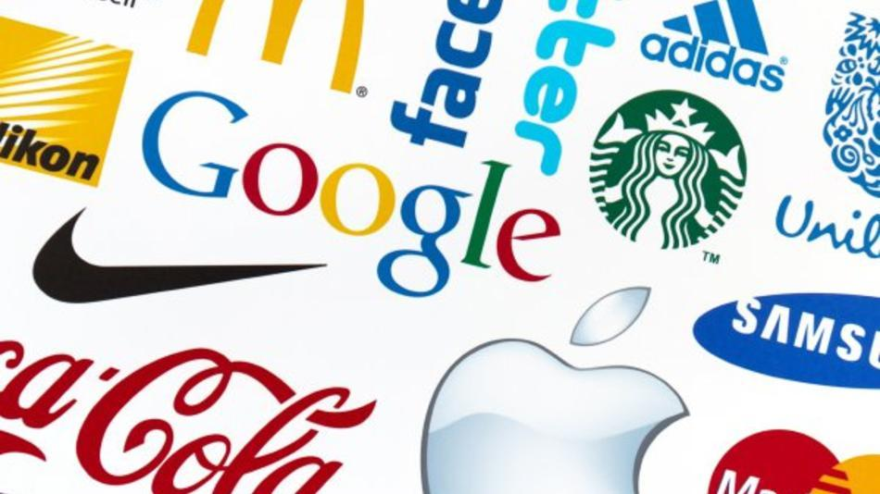
Benefits of Branding
Builds brand loyalty -- Brand loyalty is the recurring stream of profit generated by repeat and referral sales of a specific brand.
Repeat sales can be as much as 90 percent less expensive to a company than new customer development.
Builds pride -- Branded, recognizable products invoke a sense of pride in those associated with production, promotion, sale and distribution of those products.
Source: https://www.extension.iastate.edu/agdm/wholefarm/html/c5-50.html
Source: www.jprmarketing.co.uk

Slide 5
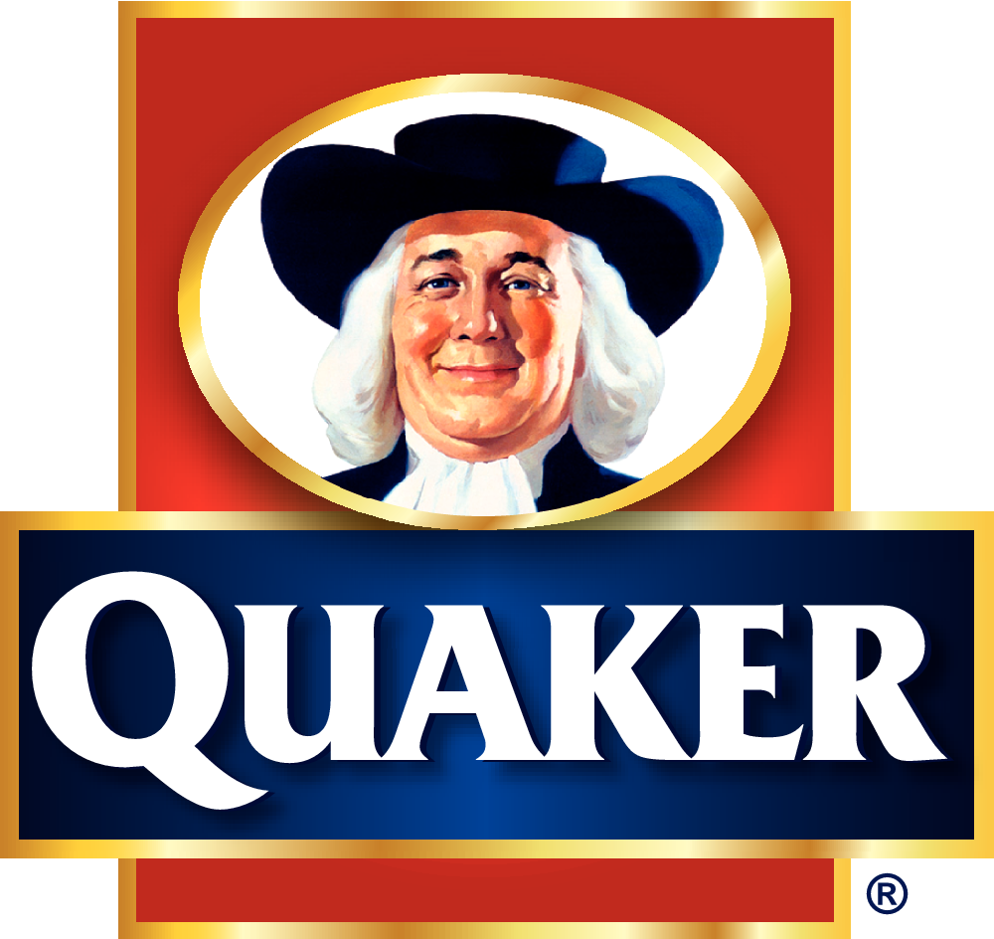
Objectives of Branding
Effective branding is guided by clear objectives, including…
Brands should represent something your customers want but do not receive from your competitors.
Brands should be consistent and designed to exist for long periods of time to maximize customer recognition.
Building a strong brand takes time.
Rule of thumb: the point at which you start to get bored with your own brand is when your customers first start to recognize it and what it stands for.
The Quaker Oatmeal guy has been mostly the same for 125 years – well-designed brands work for long periods of time because they were designed to do so.
Brands should be designed with your target market in mind – it should not be designed to please everyone.
Focus on appealing most to your target market segment.
Focused brands are more powerful and effective than diffused brands.
Source: www.therichest.com

Slide 6
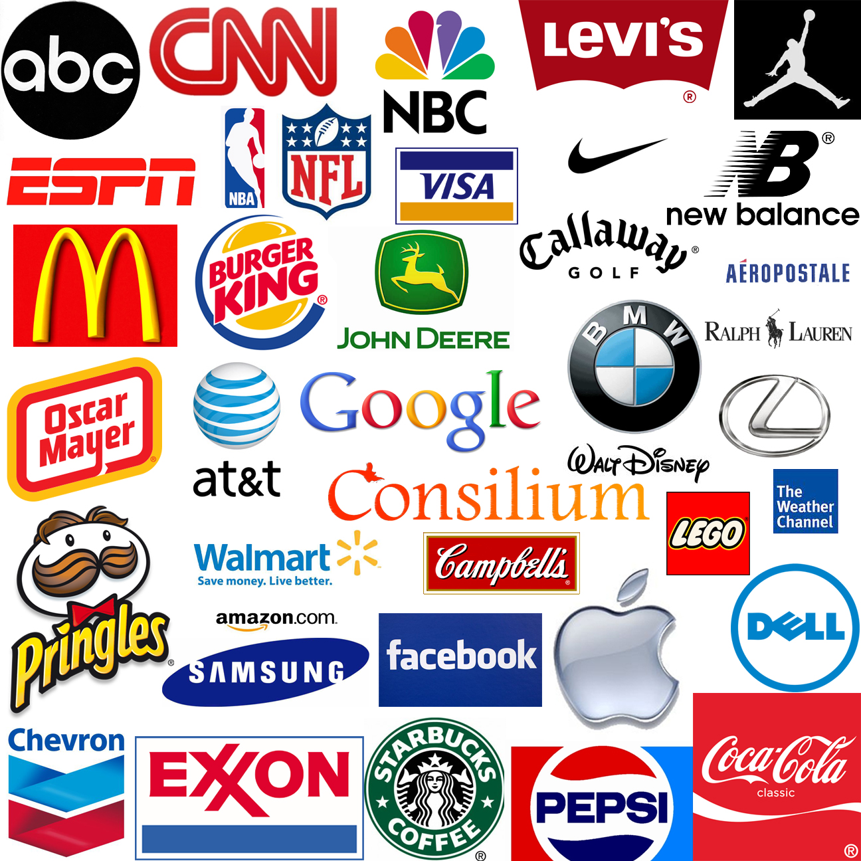
Objectives of Branding
Brands should be honest and represent what you can deliver.
If you’re not the most affordable, do not claim to be.
If you’re not the fastest, do not claim to be.
Only claim to be something you can consistently deliver on – the perception of your brand is as important as the quality of your product.
Brands are clear, simple, and to the point – complicated messages usually result in ineffective brands.
One big idea is best. Every message about your product should revolve around this message.
Details should be conveyed once the One Big Idea has attracted customer attention and encouraged the potential customer to visit your website, pick up your brand, pay attention to your commercial, skim your flyer, etc.
Brands should be distinct from those of the competitor but in a way that appeals to your target market.
You need to find a way to stand out, but you must do so in a way that conveys your key messages.
Brands should be designed to accomplish a measurable goal and the brand should be re-evaluated if this goal is not being met.
Source: www.topwallpapers10.com

Slide 7
Branding of Starbucks
Starbucks is a prime example of effective branding.
When Starbucks is mentioned, a few perceptions likely come to your mind: fancy coffee drinks, casual atmosphere, modern designs with earth tones, the green mermaid logo, etc.
Starbucks is often equated with quality (and, sometimes, high prices and luxury drinks).
If see a Starbucks coffee shop, you probably have pretty consistent expectations no matter where you would find that business (and you could find it on a street corner, in a hotel, in a Target, etc.).
The customer experience with Starbucks is consistent and conveys the same message no matter how the message is sent (by product, by an advertisement, by a location, etc.).
Source: derpastrology.tumblr.com

Slide 8
Considerations of Branding
Effective branding has three key considerations:
Brand position: how is your product or business perceived in comparison to your competitors?
A successfully positioned brand emphasizes how you are different AND better than your competitors.
This is often done by focusing on a competitor’s claims (and not their product’s attributes).
Brand equity: what benefits does your product provide beyond the product itself?
Brand equity is the value that is obtained from the consumer’s perception of the brand name of a particular product or service, and not the product itself.
This could include performance, social image, trustworthiness, general recognition, and its ability to be substituted by another product (or lack thereof).
Brand loyalty: how committed are your customers to buying your product and not a competitor’s?
Loyalty is not just repeated purchases but also a willingness to continue to purchase even in light of changes to your product or a competitor’s.
For example, if a competitor reduced their prices, would your customers continue to purchase your product? Why?

Slide 9
Business Branding
Creating a business brand begins with a vision statement.
A vision statement is a one-sentence description of what you want your company to become in the future based on the needs of your targeted market segment and your company’s unique abilities.
A vision statement tends to describe a) the unique benefits of your products and/or services, b) how doing business with your company is unique compared to others, and c) attributes that make your company stand out.
For example, Jet Blue’s vision statement is JetBlue Airways is dedicated to bringing humanity back to air travel.
Your vision statement should be based on your company’s position statement and position strategy – it should be designed to be specific to the unmet needs of your target market.
Source: www.frugalasianman.com

Slide 10
Business Branding
Next, a business brand should be guided by a company mission statement.
A mission statement defines the purpose of a company.
Mission statements for a business should address the following:
What are the specific market needs the company exists to address?
What does the company do to address these needs?
What are the guiding principles that define the company's approach?
Why do customers buy from you and not your competition?
Source: blog.hubspot.com
For example, The Walt Disney Company uses the following mission statement:
The mission of The Walt Disney Company is to be one of the world's leading producers and providers of entertainment and information. Using our portfolio of brands to differentiate our content, services and consumer products, we seek to develop the most creative, innovative and profitable entertainment experiences and related products in the world.
Your mission statement should be based on your company’s position statement and position strategy.
It should be designed to be specific to the unmet needs of your target market.

Slide 11
Business Branding
Other company branding considerations include:
Essence: what are the intangible emotions you want your target market to feel when they experience your brand?
Do you want to be perceived as luxurious? Magical? Safe? Exotic?
What one-word adjective best describes your company?
Personality: what human characteristics most apply to your company’s brand?
Apple is seen as youthful and hip, while IBM is old and stodgy.
If your company was a person, how would you want people at a party to perceive your company/person? Light-hearted? Professional? Straightforward? Innovative?
Consider what your target market would best respond to and adopt this as your company personality.

Slide 12
Product Branding
Creating a product brand begins with your market research.
You will need to consider the specific market segment that you are targeting, your position statement, and your position strategy.
These factors drive the creation of your brand and should be the primary factors when choosing the specifics that will comprise your brand.
Next, determine a name for your product. Some guidelines include…
Choose an appropriate name that is easily remembered and specific to the product.
Good product names are usually three words or less and would be appealing to the group of people you are targeting.
Be sure to check that your intended product name can be used legally (for example, you couldn’t call your product “Diet Coke” for obvious reasons).

Slide 13
Product Branding
Third, develop a slogan.
A slogan should be short (2-3 words), catchy, and easy to remember.
The slogan should also focus on the buyer – when designing a slogan, consider why they should buy the product, what they would like about the brand, or how your brand compares to the competition.
Finally, create logo.
Logos can be simple or elaborate, but they need to be consistently used on all promotional items and embody a concept you want your brand to represent.
Anything that represents your company should include your logo, including letterhead, websites, emails, business cards, etc.

Slide 14
Integrated Marketing Communications
Integrated Marketing Communications (IMC) is the term used to describe the entire program by which you communicate with your customers about a product or service by creating communicating objectives for specific target audiences and unifying all messages about a brand to these objectives.
IMC comes after branding – you need to know who you are and what your product will be before you begin communicating this information to your customers.
Every communication from your company about your product(s) should coordinate to present a unified message.
Every message about your product in every format should convey the same ideas expressed in your brand in in your position statement, vision statement, and mission statement.
IMC is not in itself a marketing plan; it is the promotional component of a marketing strategy.
This can include personal sales, advertising, public relations, customer service experiences, trade show presentations, and more.

Slide 15
Integrated Marketing Communications
IMC is literally every contact between a brand and its market.
This includes basic items such as advertising and promotion.
This also includes store presentation, packaging, events, product placement, and any representation of the brand.
IMC follows a five step process:
Step 1: identify and select the appropriate target audience.
Step 2: Determine how that audience makes product and brand decisions through marketing research.
Step 3: Determine how your brand will be positioned based on its unique selling points (USPs) and the needs of the target market.
Step 4: Set communication objectives and craft a distinct message based on your product and target market.
Step 5: Identify the media options that will optimize your ability to deliver the message about your USPs to your target audience.

Slide 16
Customers, Competitors, & Communication
Development of an IMC plan depends on three C’s – customers, competitors, and communication.
When analyzing customers for an IMC plan, they should be broken into four categories: 1) current customers; 2) former customers; 3) potential new customers; 4) competitor’s customers.
When considering competitors, make a list of all possible competing firms for your product and then analyze statements those companies make about themselves and their products through promotions and advertising.
It may be necessary to visit the competitor’s store, purchase their product, or talk to samples of their loyal customers to acquire a better understanding of how they acquire their customers.
Communications: this includes all communication not just to customers but also to potential customers, employees, and production partners.
Communication needs to stay unified and on message; mixed messages about a product will at best reduce the effectiveness of creating a product brand and likely cause a reduction in sales.

Slide 17
Customer Decision-Making
It is the job of IMC to ensure that all components needed for a consumer to respond are coordinated and effective.
A consumer follows specific steps before taking an action.
First, the consumer must be exposed to the product and become aware of it.
Next, the consumer must process this exposure and the information they have received.
This includes the consumer’s attention, learning, acceptance, and emotions.
A consumer must be consciously aware of the existence of a product, they must learn about its name and its details, accept that the message is valid and accurate, and have a positive emotional response as result.
Third, if the consumer has effectively processed the IMC message, it will have a desired effect.
This will cause the consumer to consider whether or not to purchase the product in question.
Finally, the consumer will take action.
The consumer must first decide to purchase a product, and then actually act on this decision.
Source: jimjansen.blogspot.com

Slide 18
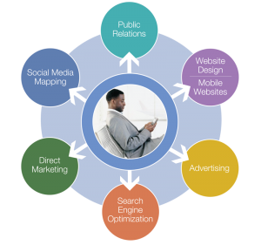
Advertising vs. Promotions
IMC can be broken into advertising, public relations, and customer service.
Advertising can be thought of as building brand awareness and positive brand attitudes.
Advertising is really just any mass attempt to persuade a large group of people about a product, service, or company.
It’s usually something involving a price tag.
Public relations is the creation and maintenance of a favorable public image of a brand.
Customer service is the collection of activities designed to support the individuals who purchase and use a product or service.
Source: rboablog.com

Slide 19
Types of Advertising
Retail advertising – these are products directly available to a customer.
These advertisements include price, service, location and house of service.
Examples include companies such as retailers and airlines.
End-product advertising – this is used by manufacturers to build consumer demand for a branded ingredient used within the manufacturing of products.
Examples include Splenda and OxyClean.
Direct Response advertising – this is advertising that includes a sense of urgency, a 1-800 number or website, and allows the consumer to buy directly.
These are the “call now, operators are standing by” kinds of ads.
Trade advertising – this is directed to wholesale and retail merchants and emphasizes profitability.
The manufacturer may offer an initial trial of the product, increased trade support (perhaps additional consumer advertising), and announce consumer promotions.
This advertising is focused on the profitability of selling a product, and usually is not directed at the eventual customers.

Slide 20
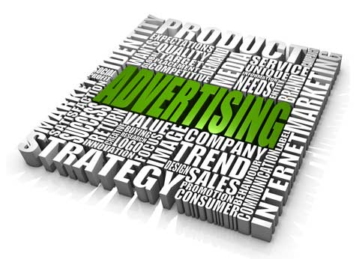
Types of Advertising
Industrial advertising – this is directed to the manufacturer of a product.
Examples include tires for autos and engines for planes.
Professional advertising – this is for a professional product and services to the consumer.
Examples include law, medicine, and dental companies.
Nonproduct advertising – this is the promotion of a cause or idea.
This can include environmental causes, political movements, gun control, animal rights (PETA), etc.
These ads are often controversial and emotional.
Source: www.thetrafficpolice.com

Slide 21
Developing an Advertising Plan
An advertising plan consists of the following elements:
Advertising goals: these should align with the goals of a positioning strategy and should relate specifically to communication.
Market segmentation: this should align to the target market chosen in the marketing plan.
A realistic budget with specific costs.
Product differentiation emphasizing the points of differentiation (or Unique Selling Points) that are specifically valuable to the chosen market segment.
The creative efforts, i.e. what will the advertising look, sound, and feel like?
The media to be used for the campaign – television, print, radio, internet, social, etc.

Slide 22
Factors that affect advertising
Volume of Sales: as sales increase, the percent that is spent on advertising decreases as the public becomes more informed.
Competitive environment: as competition increases among products in a category, the need to spend on advertising increases.
Philosophy of Advertising: some products need kinds of advertising that others don’t.
E.g. food advertising almost always needs images.
New Products: products newly available need heavy advertising.

Slide 23
Stages of Advertising
The strategy for advertising of a product depends on the stage of the product.
New products begin in the pioneering stage (a.k.a. introductory stage).
The intent is to introduce ideas and educate the consumer as to the new product/service.
Because of the need to create awareness, advertising expenses will be higher in this stage.
Usually the product is not profitable in this stage and upstart costs will need to be offset as the product’s sales begin to grow.
The next stage is the competitive stage.
Customers are more aware of the product in this stage but are not as aware of why this product is better for them compared to other competitive products.
Advertising reaches its maximum during this stage as the business seeks to convince its target market that its product is the best choice.

Slide 24
Stages of Advertising
The final stage is the retentive stage .
In this stage, a company seeks to retain its customers and build brand loyalty.
Little advertising is used in this stage and the focus of the IMC shifts to public relations and customer service.
Advertising cycles can be cyclical.
For example, if consumer demands or demographics change, a product may have to be re-branded to attract new types of customers.
In this case, the product would re-enter the pioneering phase.
Source: www.reanimationlibrary.org

Slide 25
Public Relations
Public relations is the combination of activities designed to create a positive image of a brand.
Public relations is NOT advertising – you cannot buy a person’s beliefs about you as a company or about your product.
Public relations is about shaping images – to enhance an existing reputation and/or create a new one.
Public Relations consists of persuasion, information, communication, third-party validation (someone else supporting your claims), public opinion, and public policy.
PR is really about managing the communication between the organization and the public in order to build a mutually beneficial relationship.
Common activities include speaking at conferences, winning industry awards, working with the press, and employee communication.

Slide 26
Public Relations Campaign
A public relations campaign consists of the following steps:
1. Create a plan.
Begin with the mission and vision statements for your company and with the positioning statement and strategy for your product.
PR Goals apply to three areas: reputation, relationships, and tasks.
Determine your specific needs, set measurable objectives, and create a step-by-step strategy to accomplish these objectives.
2. Campaign Research.
Conduct surveys to answer basic questions, such as how many people are aware of your company or product, what opinions they have of you, etc. before and after your PR efforts.
Your research should focus on the market segments you are trying to convince, and your messages should be tailored to these groups.
3. Media Research.
Determine what will be the most effective method for accomplishing your public relations goals and objectives.
While television and radio may be beyond the means of most small companies, many options exist within social media for PR objectives.

Slide 27
Public Relations Campaign
Facebook, Twitter, Instagram, and other social media sites are becoming vital components of many PR campaigns.
Remember that Public Relations also includes in-person contacts, presentations, and other non-electronic/non-print aspects.
Materials should be multi-faceted, combining multiple kinds of communication to transmit a unified message or idea.
4. Refine the plan.
Based on your needs and objectives as well as the result from your research and media options, refine your PR campaign to reflect this new information.
Be sure to understand your limitations and adjust your strategies to accomplish your objectives within these constraints.
5. Measure your effectiveness.
Regularly assess your efforts before and after a campaign to determine where your efforts are working and where changes need to occur.
A PR campaign is iterative, meaning you need to constantly reassess and re-apply tactics and techniques.
A PR campaign is never “done”; instead, it is constantly starting over with new needs and demands.

Slide 28
Customer Service
The final component of IMC is customer service.
While PR is the impression of a company and/or product created through mass persuasion efforts, customer service is the experiences of each individual as they come in contact with your company and/or product.
Good (or poor) customer service can affect the public relations efforts of a company or product, but ultimately customer service focuses on the single person (not the large audience).
Customer service is the process of…
Satisfying the customer in whatever way the customer defines as meeting his or her need in a manner specific to a product.
Having that service delivered with efficiency, empathy, and compassion.
Empathy is the ability to understand how and why a customer would respond emotionally to specific circumstances.
E.g. if a customer received the incorrect product, someone good at customer service would respond in such a way that the customer feels like they are cared for appropriately and the extent of their inconvenience was understood.

Slide 29
Components of Customer Service
Customer service usually consists of answering questions, addressing customer needs, taking customer orders, and resolving complaints or problems.
Customer service deals with both customer expectations (what a customer wants before a transaction), and customer perceptions (the quality of service during and after a transaction).
Good customer service usually consists of the following attributes: 1) taking initiative, 2) prompt responsiveness, 3) building relationships, 4) sensitivity, 5) objectivity, 6) resilience to stress and obstacles, 7) problem-solving ability, and 8) positivity.
Source: www.cardinal-services.com

Slide 30
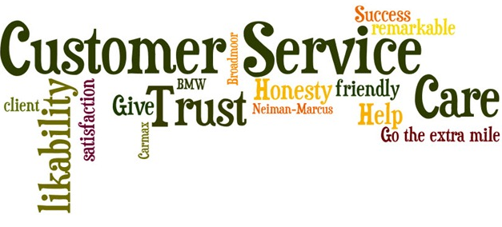
Customer Service
Customer loyalty is dependent on the following company attributes:
Its employees ask questions to better understand a customer.
The company is honest about its products and services.
This includes the fact that the quality of the product is consistent.
A company will fix all problems it can.
A company learns from the competition and becomes better.
All promises are kept.
A customer only needs to go to one place to get all needed help.
The culture is friendly, helpful, professional, and consistent.
When it comes to customer service, customers tend to have four general needs:
Need to be understood.
Need to feel welcome.
Need to feel important.
Need for support and comfort.
Source: www.phoenixrealestateguy.com

Slide 31
Works Cited
http://cmamarketing.info/2010/12/top-10-branding-mistakes-2/
http://blog.hubspot.com/blog/tabid/6307/bid/34238/The-Marketer-s-Guide-to-Developing-a-Strong-Brand-Identity.aspx?UTM_source=outbrainwidget&obref=obinsite
http://campus.udayton.edu/~jrs/intro/ppt/brand%20strategy.pdf
http://www.polaris-inc.com/assets/pdfs/9_principles_of_branding.pdf
http://blog.hubspot.com/blog/tabid/6307/bid/34238/The-Marketer-s-Guide-to-Developing-a-Strong-Brand-Identity.aspx?UTM_source=outbrainwidget&obref=obinsite
http://blog.hubspot.com/blog/tabid/6307/bid/34238/The-Marketer-s-Guide-to-Developing-a-Strong-Brand-Identity.aspx?UTM_source=outbrainwidget&obref=obinsite
http://academic.brooklyn.cuny.edu/economic/friedman/ADVDMKTopic5.doc.
http://webcache.googleusercontent.com/search?q=cache:yxhwtjVfSekJ:cst.ridgewater.edu/jeffpolman/CST2845/resources/ppts/Ch1-4.ppt+&cd=3&hl=en&ct=clnk&gl=us

