Slide 1
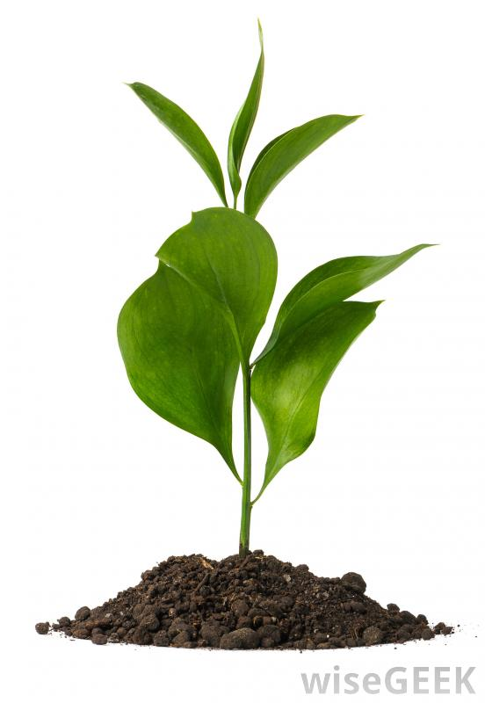
Plant Adaptations
C. Kohn
Agricultural Sciences
Waterford WI

Slide 2
Overview
Plants are extremely important to the natural world and to people.
Plants are the basis of the food chain; without plants, there could be no other organisms.
Without plants, all other organisms would be unable to acquire many of the nutrients and elements needed for life, including carbon, nitrogen, and oxygen.
All energy in living organisms begins with the sugars produced by plants.
Plants have developed many adaptations which can be utilized by agriculturalists to develop more productive crops.
To understand how to improve crop efficiency, you have to understand the adaptations of plants.
Plants usually have three basic parts – the roots, the stems, and the leaves
Source: www.wisegeek.org

Slide 3
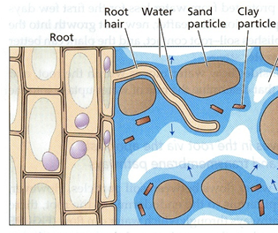
Parts of the Plant – Roots
Roots
Roots are how a plant absorb the water and minerals that it needs.
Roots also anchor the plant in the soil, allowing it to stay in one place.
Some plants also use their roots to store their food.
Roots have hairs that increase their ability to absorb water.
Root hairs are where much of water and mineral absorption take place.
Source: www.tankonyvtar.hu

Slide 4
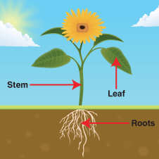
Stems
Stems keep the plant upright.
Plants use solutes (such as sodium and potassium) to pull water into the cell.
The movement of water into the cell creates pressure (known as turgor pressure), which keeps a plant upright.
Large plants also use lignin to keep themselves upright.
Lignin is the protein found in woody plants that gives them their rigidity.
Lignin reinforces the cell wall to make it rigid enough to support the large weight of trees and other woody plants.
The stem also serves as a sort of highway for moving substances between the roots and the leaves.
Source: londontigers.wikispaces.com

Slide 5
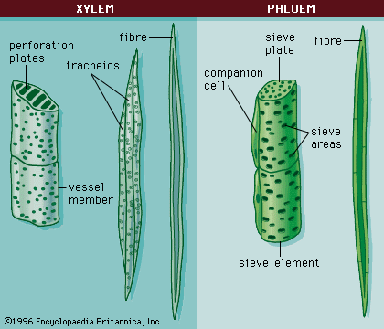
Xylem and Phloem
Two key kinds of tissue are found in large quantities in the stem.
These are xylem and phloem cells.
Xylem cells are the cells that move water up through a plant.
Xylem cells are like hollow tubes.
As water evaporates from openings in the leaves, it pulls the water up the tubes created by xylem.
Water moves like a long rope of molecules. As one molecule evaporates, all water moves upward.
Phloem cells move the food of the plant (e.g. sap).
Phloem cells have pores at their ends that allow fluids to pass.
Phloem cells enable the sugars produced in photosynthesis to reach the cells of the plant that cannot photosynthesize.
These include the roots and the interior of the stem.
Source: bioweb.uwlax.edu

Slide 6
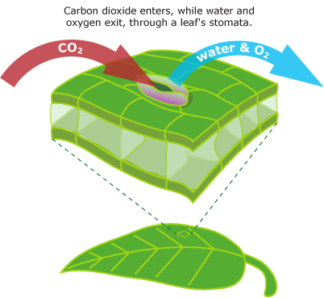
Leaves
Leaves
Leaves produce the food of the plant through photosynthesis.
Leaves can also serve as storage areas for food and water in some plants.
Leaves have openings called stomata made of specialized cells.
Stomata are the “windows” in the surface of the leaf that can open and close.
They allow water to evaporate from the leaf and allow CO₂ to reach the photosynthesizing cells.
Source: evolution.berkeley.edu

Slide 7
Plant Function
In order for a plant to function, it must be able to get water from the soil into the roots and to the leaves.
It also has to get sugars from the leaves down to the roots and stem.
Finally, a plant must be able to acquire carbon dioxide for photosynthesis and oxygen for cellular respiration.
To accomplish these tasks, plants have developed unique adaptations.
While plants do not have a heart or muscles to move substances, plants are able to move large quantities of things such as water, gases, and sugar.

Slide 8
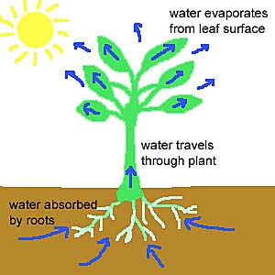
Functions of Plants – Water Uptake
Roots absorb water from the soil using sodium and potassium.
Water is attracted to these minerals like a magnet is attracted to metal.
As long as there is enough moisture in the soil and as long as the root cells have enough sodium and potassium, the roots will absorb water.
Once the water is absorbed by the roots, it is pulled through the plant as water in the leaves is pulled out by transpiration.
Transpiration is the evaporation of water from the leaves of plants.
Transpiration pulls water out of the leaf, causing water in the xylem throughout the rest of the plant to move upwards from the roots.
Transpiration also allows a plant to regulate its temperature.
As water evaporates from the leaves, the plant cools down.
Source: alkiraenvironmentalscience.wikispaces.com

Slide 9
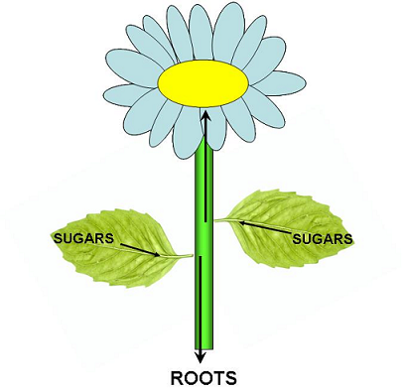
Plant Internal Transport
As cells photosynthesize, they release their sugars into the phloem cells of the plant
This allows these sugars to move down to other cells where they are needed.
While some sugar produced in the cells of the leaves are used by the mitochondria of the leaves, other sugars are sent to the phloem.
Phloem cells are part of the veins in the leaves of plants.
These veins move the sugars to the stem and root cells.
Leaf veins also contain xylem cells that move water up to the cells of the leaves.
Source: www.msu.edu

Slide 10
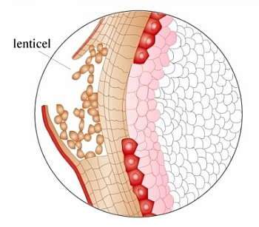
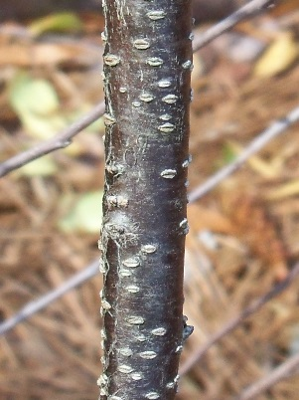
Gas Exchange
Gas Exchange: during photosynthesis, leaf cells will release oxygen and absorb carbon dioxide from the air.
When a plant needs CO₂, it will open the stomata.
If a plant does not need CO₂, or if it is losing water too quickly, it will close the stomata.
In dry or windy conditions, a plant may lose water too quickly, causing it to close its stomata.
This can impair the rates of photosynthesis for some plants because if the stomata are closed, the plant cannot acquire CO_{­2}.
Some plants, especially woody plants, have structures called lenticels.
Lenticels are raised pores on the stems of woody plants that allow them to get oxygen to the internal cells as they respire.
Source: (left) sciencecity.oupchina.com.hk (right) carolinachildrensgarden.blogspot.com

Slide 11
Plant Adaptations
Plants have evolved to have multiple strategies for acquiring and using CO₂ in different conditions.
Most plants are considered “C3 Plants”.
“C3” refers to the fact that two 3-carbon molecules are produced during the Calvin Cycle.
About 85% of plants are C3 plants, including most cereal grains such as wheat, rice, soybeans, and oats.
While most plants are C3 plants, these kinds of plants have a major disadvantage.
In hot, dry conditions the rate of photosynthesis of these plants will slow or stop as plants cut off their supply of CO₂ by closing their stomata.
If C3 plants do not close their stomata, they risk losing too much water.

Slide 12
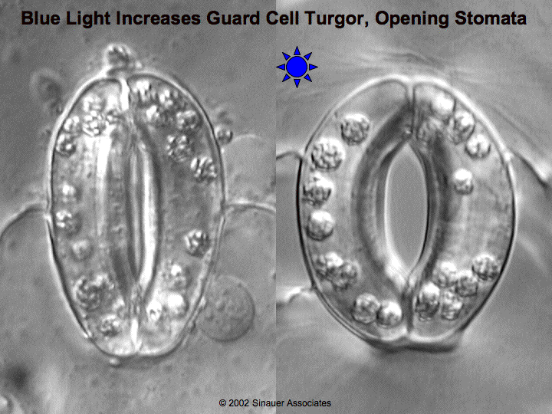
Rubisco and Low CO₂
Rates of photosynthesis in C3 plants will decrease in hot weather because of two reasons.
First, if a plant is losing water, it will close its stomata.
With its stomata closed, a plant cannot absorb CO₂.
Secondly, when CO₂ concentrations in the plant cells drop below 50 ppm, the plant starts grabbing oxygen instead of CO_{2.}
An enzyme called Rubisco normally takes CO₂ from the air and joins it to RuBP.
However, in low CO₂ conditions, the Rubisco grabs oxygen instead of CO_{­2­.}
When CO₂ levels inside a plant’s cells are low due to closed stomata, a plant will burn sugar instead of producing it.

Slide 13
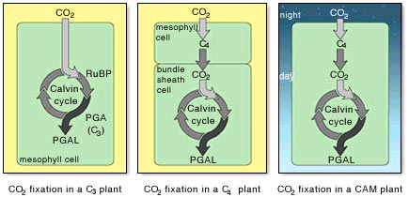
C4 Plants
Some plants have adapted to avoid low CO₂ levels that can result when they close their stomata.
These plants are called C4 plants.
Examples of C4 plants include corn and sugar cane.
In C4 plants, CO₂ is absorbed by specialized cells with a thin wall.
Inside these specialized cells, the C4 plants convert the CO­₂ into malic acid or other carbon- based molecules.
This enables the C4 plant to store carbon for later use.
Malic acid is a 4-carbon compound.
This is why these plants are known as C4 plants.
Source: www.mhhe.com

Slide 14
C4 Plants & Malic Acid
Because C4 plants can “store” carbon in the form of malic acid, it also means that C4 plants can close the stomata in their leaves to prevent water loss without affecting the Calvin Cycle.
A C3 plant will stop photosynthesizing in hot, dry weather because it has to close its stomata, cutting off its CO₂ supply.
A C4 plant will also close its stomata in hot, dry weather, but it can continue to photosynthesize because of its stored malic acid.
C4 plants often are more efficient in hot dry conditions because they are able to continue to photosynthesize when light levels are greatest.
When the C4 plant needs carbon for the Calvin Cycle, the newly-created malic acid is pumped into the chloroplast.
The malic acid provides the carbon needed in order to produce G3P.
Even if it is hot and dry, C4 plants can continue to produce sugars even if their stomata are closed.

Slide 15
C3 vs. C4 plants
The downside of being a C4 plant is that it takes a lot of ATP to pump the 4-carbon malic acid into the chloroplast.
In hot, dry, sunny climates, C4 plants will have the advantage.
However, C3 plants will out-perform C4 plants when it is wet or cool.
As long as C3 plants do not have to close their stomata, they will have access to plentiful levels of CO­₂­ and will outperform a C4 plant.
However, once conditions force a C3 plant to close their stomata, C4 plants have the advantage.

Slide 16
CAM Plants
CAM plants are special plants that are similar to C4 plants and are usually found only in extremely hot and dry environments (such as deserts).
Cacti and pineapples are common examples of CAM plants.
Plants that live in extremely hot and dry environments face a tough challenge because water is scarce and it evaporates quickly.
A normal C3 plant could never survive in a desert because it wouldn’t be able to acquire enough water.
A C4 plant would have to open its stomata at some point during the day, resulting in large water losses.
CAM plants are similar to C4 plants except that they only open their stomata at night to take in CO₂
At night, CAM plants use CO₂ to form the four-carbon malic acid.
During the day the plants close their stomata to prevent water loss.
The malic acid formed at night is then converted into CO₂ to be used in the Calvin Cycle during the day.
Because their stomata are only open at night, CAM plants use far less water than C4 plants.
Source: www.mhhe.com

Slide 17
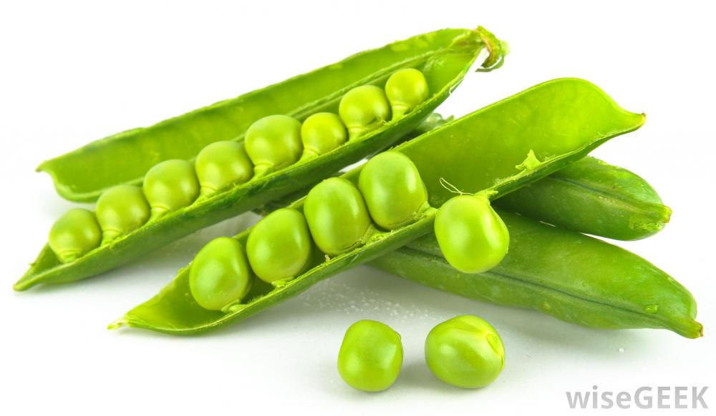
Other Adaptations
In addition to changes in photosynthesis, some plants have developed other adaptations to become more productive.
One example of this are legumes.
Legumes are plants that have bacteria their roots that allow them to take nitrogen out of the air for use in proteins and other plant molecules.
Legumes include soybeans, alfalfa, clover, and peas.
About 80% of the air is made of nitrogen, but this form of nitrogen is not usable by most organisms.
Nitrogen is one of the most important elements for living organisms, and living organisms can die from nitrogen deficiency.
Nitrogen is needed for the formation of amino acids, genetic material, ATP, and other important molecules.
In order to be used by living organisms, nitrogen must be converted into ammonia (NH₃).
Only once it has been converted to ammonia can nitrogen be used by living organisms.
Source: http://www.wisegeek.org/what-is-the-difference-between-a-nut-and-a-legume.htm

Slide 18
Nitrogen Fixation
Bacteria in the roots of legumes allow these plants to perform nitrogen fixation.
Nitrogen fixation is the process in which unusable N₂ in the atmosphere is converted into the usable ammonia (NH₃).
The bacteria live in the roots of legumes in small structures called nodules.
The bacteria fix the nitrogen by converting it into NH₃.
The plant then absorbs the NH₃ into the cells of its roots and transports this throughout the plant.
The bacteria gain sugars from the plant in exchange for the nitrogen it converts.
Farmers can use legumes like soybeans and alfalfa to make their soil more fertile and reduce fertilizer usage.
Alfalfa can fix up to 500 lbs. of nitrogen per acre!
While very little nitrogen is added to the soil while the plant is alive, the nitrogen will be added to the soil when plant dies and the roots and leaves decompose.
Source: www.marquette.edu

Slide 19
More Adaptations
Plants can have a variety of other adaptations, including:
A thick waxy coating on their surface to reduce water loss.
Sunken stomata to reduce water loss.
Hairy leaves to reflect excess light.
Succulent leaves to store extra water.
Bulbs and tubers to safely store food underground.
Needles, thorns, and spines to avoid predation.
Modified stems called tendrils that can grasp objects by wrapping around them.
Source: http://barrettmath.edu.glogster.com/plant-adaptations/

