Slide 1
Protein Regulation & Mutations
By C. Kohn
Agricultural Sciences
Waterford, WI

Slide 2
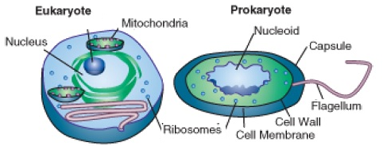
Gene REgulation
In human cells there are over 20,000 genes that are expressed as proteins.
In any cell, there are at least a thousand genes that are transcribed and translated into proteins.
For all species, some proteins need to be produced continuously, while some proteins are only needed at sporadic and unpredictable times.
Regulation by cells of what proteins are produced and when is a vital and complicated task that depends on a variety of factors at all levels of protein production.
Prokaryotic cells (those without organelles) and eukaryotic cells (those with organelles) both have to tightly regulate their production of proteins.
Each has evolved different strategies to regulate the production of the thousands of proteins and the genes that encode them.
Source: www.assignmenthelp.net

Slide 3
Prokaryotic Regulation
Bacteria depend on their environment to provide them with direct access to needed substances, such as the sugars they use for cellular respiration.
Because of this, it makes sense to undergo transcription and translation of proteins for the metabolism of these substances only when these substances are available.
Production of these proteins when they are not needed would waste large amounts of cellular energy.
Regulation of protein production in prokaryotic bacterial cells mostly depends on regulatory proteins that bind to specific DNA sequences.
These proteins, called transcription factors, prevent or enable the transcription of a specific sequence of DNA into mRNA during transcription.
Source: cnx.org

Slide 4
Lac Operon
For example, one of the most widely studied examples of transcription- and translation-regulation is the breakdown of lactose sugar by E. coli bacteria.
All the genes needed for producing the proteins used to break down lactose are located next to each other on the chromosome in E. coli cells.
A cluster of closely-grouped genes on a chromosome that are all related to a single function is called an operon.
The genes of E. coli that are used to break down lactose are grouped into an operon called the lac operon.
Source: biomoocnews.blogspot.com

Slide 5
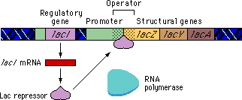
The Lac Operon Six
There are six genes on the E. coli lac operon.
A repressor gene (lacl): this gene codes for a protein that binds to the lac operon and stops the production of the proteins these genes code for.
A promoter gene: this is the section of the lac operon that polymerase would attach to produce the mRNA copy during transcription.
An operator gene: if the repressor protein binds to this section of the lac operon, polymerase cannot produce the lac operon proteins.
Beta-galactosidase (lacZ): this is the protein that breaks down lactose into glucose and galactose so that it can be used for ATP production.
Beta-galactoside permease (lacY): codes for the protein that pumps lactose into the E. coli cell.
Beta-galactoside transacetylase (lacA): has a known function but is not essential to the function of these genes/proteins. (i.e. don’t worry about it).
Source: http://www.schenectady.k12.ny.us/putman/biology/data/lacoperon/protein.html

Slide 6
Regulation of Protein Production
If lactose is not available, the repressor protein will bind to the genes in the lac operon and prevent the polymerase enzyme from making mRNA copies.
This prevents the lac operon genes from producing these proteins when they are not needed (see (X) below).
When lactose sugar is present, these sugar molecules will bind to the repressor proteins (see (Y) below).
This stops the repressor protein from blocking the lac operon genes.
The presence/absence of lactose determines whether or not the repressor binds to the operon, which determines if these proteins are produced.
By transcribing the lac operon genes only when lactose is present (and by preventing transcription of the lac operon genes when lactose is absent), these proteins are made only when they can be used.
Source: biomoocnews.blogspot.com

Slide 7
Eukaryotic Protein Regulation
Eukaryotic cells regulate protein production in ways that are similar to prokaryotic cells.
However, because eukaryotic cells are more complex, they have a greater dependence on even more regulatory processes to ensure that the right proteins are made at the right time.
Transcription factors play a greater role in eukaryotic protein regulation than they do in prokaryotes.
Often multiple transcription factor proteins need to interact to control when a protein is produced, and also control the rate of protein production.
By using multiple transcription factors, these regulatory processes function less like an on/off switch and more like a dimmer switch.
Besides transcription factors, eukaryotic cells also depend upon histones, mRNA packaging, and mRNA degradation enzymes to regulate protein production (next slide).

Slide 8
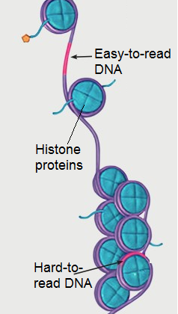
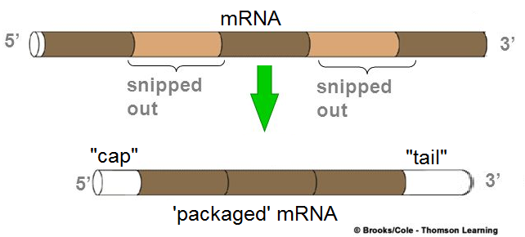
Eukaryotic Regulation
Source: www.pbs.org
Histones are proteins that are used to condense DNA into tight bundles.
Histones are like spools for thread-like DNA; the DNA is wrapped tightly around a histone to package it into a chromosome.
The more that DNA is packed and wound by histones, the less accessible it is for transcription/translation.
mRNA Packaging: once mRNA is produced, it must be ‘packaged’ before begin sent to the cytosol.
The addition of modifications such as a ‘cap’ to help the ribosome bind to the mRNA, and a ‘tail’ to stabilize the mRNA affect the rate at which the mRNA is transcribed and translated into a protein (see lower right).
Degradation of mRNA:
Protein enzymes are used to degrade mRNA after it has been translated by a ribosome.
If mRNA is degraded too quickly, it may be destroyed before it can be transcribed by a ribosome.
Source: slideplayer.com

Slide 9
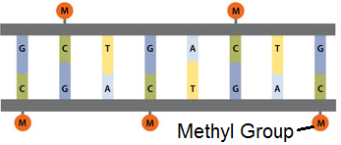
Methylation
In order to have cells with different functions, multi-celled organisms must turn on genes in some cells and turn off those same genes in other cells.
Except for sperm and egg cells, all cells of an organism contain the same DNA. However, different types of cells must perform different functions.
For this to be possible, cells must be able to control which genes are expressed.
One of the most common methods for turning genes on or off in eukaryotic cells is called methylation.
Methylation is a form of chemical regulation of DNA in which small methyl molecules (CH₃) are attached to DNA to prevent it from undergoing transcription and translation.
Usually these CH₃ molecules are attached to the 5th carbon on the sugar molecule of cytosine (the “C” base) in DNA.
Methylated DNA is DNA that has been ‘silenced’ or ‘turned off’ and cannot be used to produce a protein.
As cells become specialized to perform a specific job, the DNA that is not needed for their ultimate function is methylated to prevent those genes from being expressed.
Source: www.sigmaaldrich.com

Slide 10
Epigenetics
As a newly-fertilized egg divides and develops, it’s DNA becomes increasingly methylated as the cells become specialized tissue.
This methylation turns off the genes that aren’t needed for a given kind of cell to function. This is crucial for the transition of fertilized eggs into a fully-developed individual with specialized tissues.
DNA Methylation is also important for epigenetic changes.
Epigenetics refers to how signals from the environment change how an organism’s DNA becomes expressed.
While the DNA itself is not changed, epigenetics does affect which genes are expressed (and which are not) through methylation and other processes.
For example, the environmental factors that you are exposed to today affect the rate and type of epigenetic changes that occur in your egg or sperm cells.
This in turn affects the DNA that you pass on to your offspring and the phenotypic traits that your children would express.
It is very likely that something as simple as the foods you consume daily may affect the traits expressed by your future children. It is even probable that a mother’s diet or the presence of nutritional deficiencies at the time of conception can alter a baby's genes permanently.

Slide 11
Methylation & Disease
DNA methylation is highly important in ensuring that a cell produces the right proteins at the right times in the right amounts.
While DNA methylation is currently still being studied (and much must still be discovered about this topic), it is becoming increasingly clear that methylation of DNA is critical for proper cell function.
For example, the DNA in cancer cells has been shown to have abnormal rates of methylation compared to normal cells.
Cancer is a disease caused by uncontrolled cell division that usually results in the growth of a tumor.
Changes to the rate of methylation in DNA may be a possible cause of cancer.
For example, if DNA is over-methylated, this could prevent the production of some proteins that are needed to suppress the formation of cancerous cells.
Source: www.ks.uiuc.edu

Slide 12
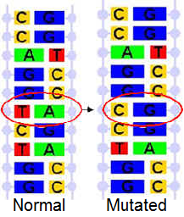
Cancer and Mutations
Problems such as cancer and most genetic diseases are commonly due to mutations.
A mutation occurs when DNA undergoes a permanent but unintentional change through the loss, addition, or switching of at least one nucleotide base.
There are two categories of mutations.
Hereditary mutations are present from the very beginning of an organism’s life; these mutations are found in every cell and occur due to changes in the sperm or eggs of one or both parents.
Acquired mutations occur sometime during the life of an organism and are not necessarily found in every cell. These changes often occur because of environmental factors.
Source:: sites.ffclrp.usp.br

Slide 13
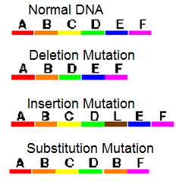
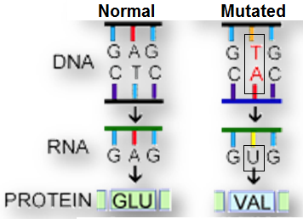
Kinds of Mutations
There are three kinds of mutations.
A deletion mutation is when a base is removed from a gene.
An insertion mutation is when a base is added to a gene where it did not exist before.
A substitution mutation is where one base is replaced by another base.
Mutations are usually very harmful to an organism.
A mutation can change every level of protein assembly and organization.
For example, if a gene undergoes a substitution mutation, the mRNA copy of DNA will also have one base that changes.
Source: evolution.berkeley.edu

Slide 14
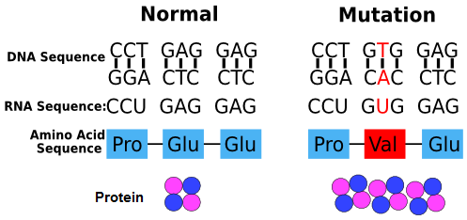
Transcription and Translation
When a mutated copy of mRNA goes through a ribosome, the codon containing that substitution will then code for a different amino acid.
Because of this changed codon, tRNA will deliver a different amino acid, resulting in a changed polypeptide.
Because the type and order of amino acids has changed, the shape of the polypeptide will change.
Because the shape of the polypeptide subunit of the protein has changed, the entire protein's shape will change.
Because the protein's shape has changed, the function of that protein will also change (or be lost).
Source: study.com

Slide 15
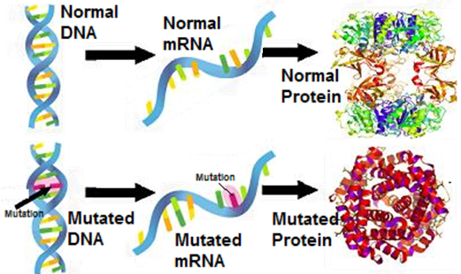
Switching Bases
In most cases, what was a functional protein will become a dysfunctional protein simply because one base in the DNA gene was changed for a different base.
Because the DNA has change, its mRNA copies will also change, resulting in changes to the order of amino acids and the shape/structure of the protein.
This often results in impaired function and may even prevent the cell or entire organism from functioning at all.
If every cell contains the mutated DNA, the entire organism may be unable to function because of a change to one base (out of billions of bases in the DNA of that organism).
Source: www.sec.gov

Slide 16
Frameshift Mutations
While a substitution mutation changes only one codon in the mRNA (and only one amino acid in the protein), a deletion or an insertion mutation will usually change many codons and many amino acids in the protein.
Because mRNA is always read in groups of three bases, adding or removing a base will change every single group of three downstream from that change.
Because an insertion or a deletion insertion changes every codon that occurs after the mutation, these mutations are known as frameshift mutations.
For example, imagine that a portion of a gene is: AAA - GGG - CCC - UUU .
Now imagine an extra C is inserted in the first codon.
Now the gene will be read as: ACA - AGG - GCC - CUU - U.... and so on.
Every codon changed after the C was inserted because every base was "shifted down" one space.

Slide 17
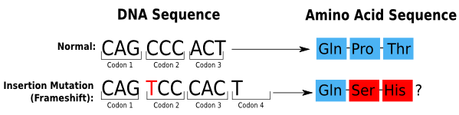
Frameshift Mutations
Because every codon shifts after this mutation, every codon now codes for a completely different amino acid.
Because every amino acid changes after the mutation, the new polypeptide will have completely different combinations of charges, hydrophobicity, hydrogen bonding, and cysteines.
As a result, the shape of the polypeptide (and the protein it helps to make) will be completely different.
Whereas the substitution mutation only caused one codon and one amino acid to change (and had a limited impact on how the shape of the protein changed), a frameshift mutation (insertion or deletion) will have catastrophic impacts on the final shape of the protein.
Source: study.com

Slide 18
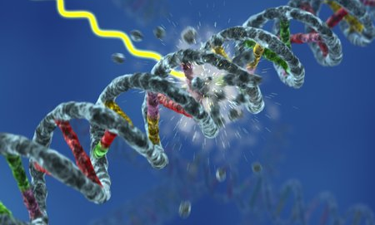
Mutagens
A substance that causes a mutation is called a mutagen.
There are many, many kinds of mutagens that exist.
UV radiation from the sun, substances in cigarette smoke and automobile exhaust, and even burnt hamburger can all cause mutations.
Sometimes mutations just occur randomly.
Polymerase can make an error when copying DNA, or a base can even just 'fall out' of the strand of DNA.
Usually mutations are very bad.
Any changes to the shape and function of a protein are usually disastrous, as each cell depends on the highly-complex interaction between tens of thousands of different proteins.
Changing the function of even one protein would be like having just one car cross the center line of a busy highway - it wouldn't take long for a disastrous accident to occur.
Source: zorknot.com

Slide 19
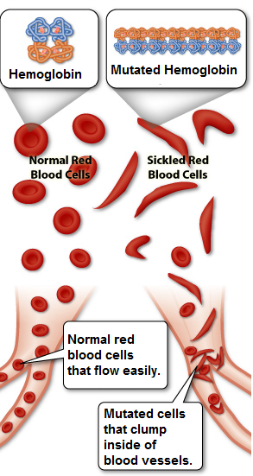
Genetic Diseases
Genetic diseases such as cancer, cystic fibrosis, Tay-sachs disease, and more are due to harmful mutations that are inherited by an individual.
For example, sickle cell anemia is a genetic disease in which the red blood cells change from a donut-like shape to a crescent-moon shape.
This disease results from a single substitution mutation in the hemoglobin gene in which an A in the DNA is replaced by a T.
As a result of this single changed base, the red blood cells of infected individuals become rigid and sticky and get stuck in small blood vessels, which causes blocked blood flow to parts of the body.
Without blood flow, these affected parts cannot get oxygen, resulting in pain and physical damage.
Source: learn.genetics.utah.edu

Slide 20
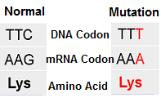
Good mutations
However, not all mutations are bad.
Some mutations have no impact whatsoever. These are called silent mutations.
For example, if a substitution mutation occurs but the resulting codon codes for an amino acid that is similar (or even the same) as the original amino acid, there may be no change to the final shape of the polypeptide chain or the final protein that is made.
Or, the protein that results may change, but the changed function may not significantly impair the function of the cell or the organism.
For example, some people have connected earlobes due to a mutation that they inherited from their parents.
However, whether or not you have connected earlobes doesn't really affect your ability to function, survive, or get a date for prom.
Source: study.com

Slide 21
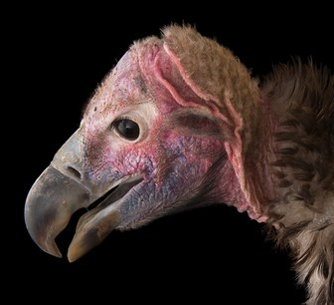
Good Mutations
Sometimes, very rarely, a mutation can even be a good thing.
For example, modern vultures all carry a mutation for the protein that regulates the production of feathers on their heads.
Due to a mutation to the gene for this regulatory protein, the protein cannot function and the vultures with this mutation lost the feathers on their head.
However, this turns out to be a really good thing for the vultures because it reduces the amount of dead animal carcass that sticks to their heads.
This reduces their likelihood of contracting diseases and improves their ability to reproduce if they have this mutation.
Because the vultures with this mutation are less likely to get sick and more likely to reproduce, over time the bald-headed vultures outcompeted the non-bald vultures and today all vultures carry this mutated gene.
Source: www.joelsartore.com

Slide 22
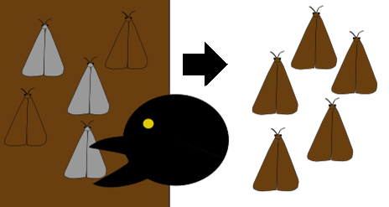
Genetic diversity
The very fact that there are millions of different kinds of living species is due to the fact that very rarely, a random change will occur to DNA that actually helps that individual survive and reproduce.
If the individual can pass this random beneficial mutation to their offspring, those offspring who inherit the mutation will be more likely to reproduce and the mutation may become more prevalent in the population.
Over long periods of time, this mutation many become so prevalent that the entire species is changed.
If enough of these beneficial changes accumulate in the individuals of this species, an entirely new species may form as a result.
Source: study.com

Slide 23
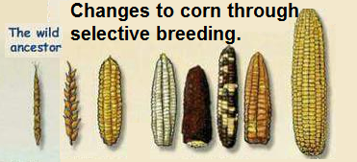
Mutations and breeding
Mutations are also at the basis of the breeding decisions that enable improved agricultural productivity to occur.
In order to improve the productivity of plants and animals, agriculturalists have to select for traits that will enable this higher productivity.
Improvements to these traits ultimately result from random beneficial mutations that can be passed down to each generation.
By knowing how to identify these traits and by selecting for individuals who possess these traits, agriculturalists can continuously improve the productivity of plants and animals.
Over time, agriculturalists may be successful enough to create a specific group of individuals of a species that can reliably possess desirable traits and characteristics.
Source: fred-de-vries.blogspot.com

Slide 24
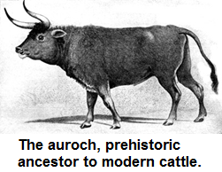
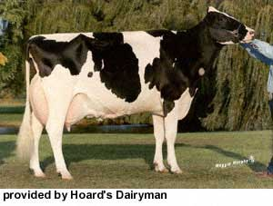
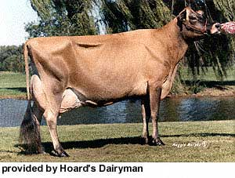
Breeds
Source: www.petermaas.nl
A group of individuals within a species that predictably possesses a known set of desired characteristics is called a breed.
For example, in dairy cattle the black and white Holstein breed produces the greatest quantity of milk.
The light brown Jersey cattle produce the richest milk that is highest in butterfat.
These traits for these breeds resulted from decades or centuries of mating only the cattle that demonstrated these specific traits.
While the traits occurred because of random beneficial mutations, they became prevalent in these domesticated breeds because of the selective breeding of only the animals that possessed the desired traits.

