Slide 1

Reproductive Hormones
By C. Kohn
Agricultural Sciences
Waterford, WI

Slide 2
Reproductive Hormones
Regular changes will occur in a cow’s reproductive tract due to constantly cycling hormone levels.
  The estrous cycle consists of cycling hormonal levels that cause physiologic and behavioral changes in order to mature and release an egg and enable fertilization of that egg.
  In cattle, this estrous cycle lasts 18-21 days.
  During the estrus cycle, hormones control signs of heat, the release of the egg from the ovary, maintain pregnancy, and regulate almost all aspects of reproduction.
    Note: “estrus” is when a cow goes into heat; “estrous” refers to the cycle.
Hormones are chemical messengers that are transported by the bloodstream from an endocrine gland to a target tissue.
  An endocrine gland is the particular gland that releases a specific hormone.
  There is no one organ that is the “endocrine gland”. Any tissue that releases the hormone in question is the endocrine gland.
  A target tissue is the tissue that has receptors and can be activated by a specific hormone.
  Similarly, there are many kinds of target tissues in the body depending on which hormone is the focus. Any tissue that has a receptor for a particular hormone is the target tissue.

Slide 3
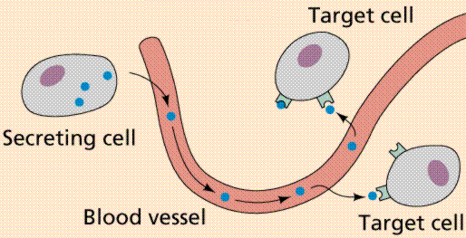
Endocrine Gland, Target Tissues
The organ that is the endocrine organ and the organ that is the target tissue is different depending on which hormone is in question.
  For example, for both the Follicle Stimulating Hormone (FSH) and the Luteinizing Hormone (LH), the endocrine gland that releases them is the pituitary gland in the brain, and the target tissue is the ovary.
  However, for estrogen and progesterone, the endocrine gland that releases them is the ovary.
  Estrogen has many different target tissues including the pituitary gland, oviduct, uterus, cervix, vagina, and vulva.
  Progesterone also has multiple target tissues, including the pituitary and the uterus.
Source: www2.estrellamountain.edu

Slide 4
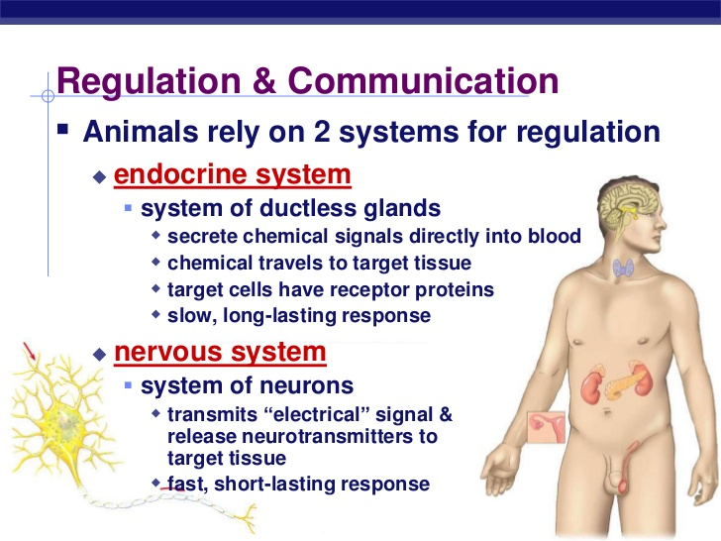
Signaling Systems
The endocrine system is comprised of all of the glands and target tissues that secrete or are responsive to hormones.
  The endocrine system and the nervous system are the two signaling systems of the body.
  The nervous system involves immediate, short-term signaling and uses electrical signals in
  neurons and nerves to
  create a response.
  The endocrine system
  usually involves long-
  term, slow reactions
  using chemical signals
  from endocrine glands
  that are carried by the
  blood to target tissues.
Source; www.slideshare.net

Slide 5
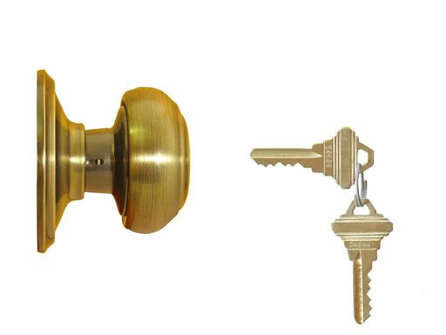
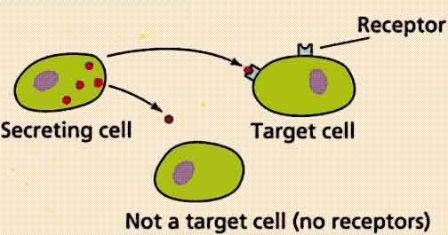
Lock and Key
Hormones and target tissues work similarly to a lock and a key.
  When a hormone is released into the blood, it will be carried throughout the body.
  If an organ’s tissue has receptors for that organ, and if that organ can bind to the receptors on that tissue, it will induce a response.
  For example, when estrogen is released from the ovary, it will travel throughout the entire body, coming in contact with every kind of tissue.
  However, only the brain and reproductive tract have receptors for this hormone, and so only these organs can serve as target tissues for estrogen (even though all other organs will also come in contact with estrogen).
  Just like a key can only open a lock in which it fits, a hormone can only affect a tissue that has receptors for it.
Source: jonbarron.org

Slide 6
Hormones
Both plants and animals produce a wide array of hormones, and these hormones regulate many different aspects of plants and animals.
  Besides reproduction in animals, hormones can also control bodily growth (e.g. somatotropin), glucose uptake (e.g. insulin), kidney function (e.g. vasopressin), heart rate and blood pressure (e.g. epinephrine), and inflammation (e.g. histamines).
Animal hormones can be placed into one of two categories:
  Endocrine hormones are those that
  travel throughout the body in the
  blood.
  Paracrine hormones are released
  by a cell and only acts on cells
  immediately around that cell.
Hormones in animals can be
produced from four different
classes based on their sources.
  These classes include amine
  hormones ,peptide hormones,
  protein hormones, and steroid
  hormones.
  See the table to the right →

Slide 7
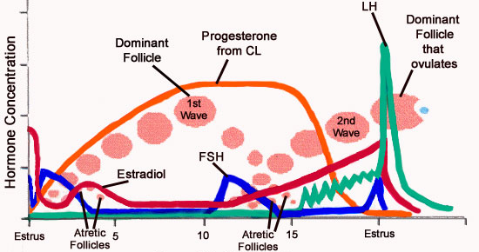
Major reproductive hormones
Reproduction in cattle is controlled by multiple hormones produced by multiple endocrine glands.
  All of the major reproductive hormones in cattle are endocrine hormones and will travel throughout the body in the blood.
  Each reproductive hormone plays a significant role in ensuring that an egg is matured and released, that the reproductive tissues enable ovulation, fertilization, and the growth of a fertilized egg, and that a cow’s behavior changes in order to enable and promote fertilization.
  The major reproductive hormones include estradiol, GnRH, LH, FSH, Progesterone, and PGF_{2α}.
Source: research.vet.upenn.edu

Slide 8
Estradiol & GnRH
Estradiol is a type of estrogen hormone that is released by the follicle cells on the ovary.
  Estradiol’s primary job is to induce behavioral changes in the cow (get her “in the mood” for reproduction) while also inducing the major physiological changes associated with estrus (heat).
  These physiological changes include the muscular activity in the myometrium of the uterus (which helps propel sperm towards the oviduct), induced mucus production into the vagina for lubrication and to flush out bacteria, and swelling and redness in the vulva.
  Behavioral changes induced by estradiol include willingness to be mounted by other cows, bellowing, nudging, erect ears, nervousness, and many other signs.
  Estradiol also causes the release of GnRH.
GnRH (or Gonadotropin Releasing Hormone), stimulates the release of FSH and LH.
  This is pretty much the only job of GnRH, but the release of FSH and LH also creates the cascade of changes necessary for ovulation.
  This makes GnRH a very important hormone for the estrous cycle.

Slide 9
FSH & LH
FSH (or Follicle Stimulating Hormone) is released from the pituitary gland in the brain once GnRH is released.
  FSH, as its name implies, stimulates the growth and development of a follicle in which an egg will mature.
  Without FSH, there would be no signal for a follicle to develop, and the eggs in the ovary would never undergo oogenesis and finish maturation.
  A dose of artificially-high levels of FSH can induce super-ovulation, or the production of more mature follicles than usual, for some reproductive therapies.
LH (or Luteinizing Hormone) is also released from the pituitary gland in the brain once GnRH is released.
  LH is necessary for a follicle to rupture and release an egg.
  Upon the release of an egg, LH enables the development of the corpus luteum on the surface of the ovary from the ruptured follicle.
  The corpus luteum is a yellow, Cheerio-shaped structure that forms on the ovary at the site of the ruptured follicle and is necessary for the release of hormones that support the egg after ovulation.
  Without LH, a mature egg would not be released and could not be fertilized. Even if an egg could be released, without the formation of the corpus luteum, the reproductive tract could not support or nourish the egg.

Slide 10
Progesterone & PGF_{2α}
Progesterone is a hormone released by the corpus luteum and is necessary for pregnancy.
  Progesterone prevents the cow from going into heat during pregnancy and prevents the development of new follicles by regulating the release of FSH and LH.
  Progesterone stimulates the production of the uterine lining.
  Progesterone also causes a thick mucus plug to form in the cervix; this prevents bacteria or viruses from getting into the uterus.
PGF_{2α} (pronounced “P-G-F-TWO-ALPHA”) is released by the endometrium in the uterus if the egg was not fertilized and ends the estrous cycle.
  PGF_{2α} causes the corpus luteum to regress and stops it from releasing progesterone.
  This enables the cow to degrade the uterine lining, which will be broken down and absorbed back into the body along with the unfertilized egg.
  PGF_{2α} is necessary to ensure that a cow can get pregnant again if she is not fertilized during the current estrous cycle.
  In a pregnant cow, the embryo will block the release of PGF_{2α}, ensuring that the pregnancy can continue and that progesterone can continue to be released.

Slide 11
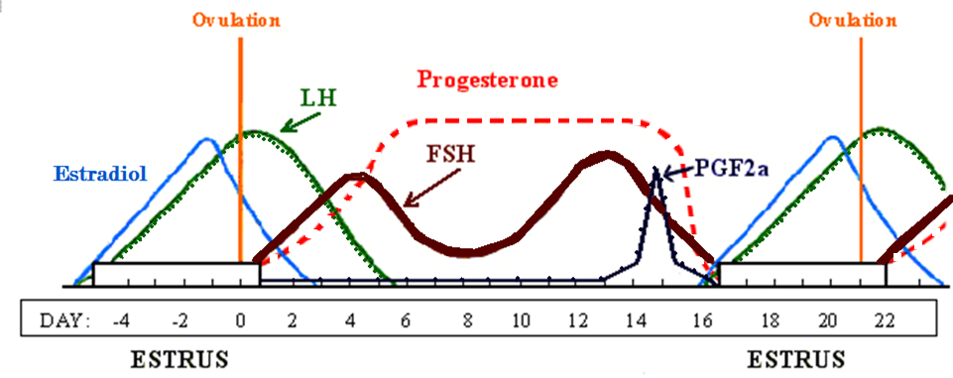

This graphic shows how hormone levels fluctuate over the course of the estrus cycle.
  Just prior to ovulation, estradiol will peak, causing the signs and behaviors associated with estrus.
  After ovulation, LH will surge, causing ovulation and the formation of the corpus luteum.
  FSH is the next to surge, causing the formation of a new follicle. FSH will peak once more during the cycle to form the preovulatory follicle.
  Progresterone will plateau as the corpus luteum matures.
  PGF_{2α} will then peak (if the egg was not fertilized), ending the estrous cycle by regressing the corpus luteum and ending the release of progesterone. Estradiol will begin to peak prior to estrus beginning.
Hint: think ELF PP

Slide 12
4 Periods of Activity
The 21-day estrous cycle in cattle is highlighted by four distinct periods of activity.
Estrus (Day 0), is when the cow will experience peak behavioral and physiological changes due to the effects of peaking levels of estradiol.
  During this time, the cow will stand to be mounted, and her reproductive tract will have an open cervix and oviducts in order to ensure fertilization can happen.
  Estrus will also stimulate the release GnRH, triggering the cascade of hormones necessary for the rest of the estrous cycle to occur.
  The reproductive tract will be very receptive to sperm, and will have muscle contractions to move sperm from the uterus into the oviducts.
Metestrus (Days 1-4): as the estradiol levels decrease, LH and FSH levels will peak, causing ovulation.
  As the egg is released from the follicle, the follicle will gradually turn into a corpus luteum.
  The egg, regardless of if it was fertilized or not, will remain in the oviduct until the corpus luteum is matured.
  Increased FSH levels will trigger the growth of new follicles.

Slide 13
4 Periods of Activity
Diestrus (Days 5-17): progesterone levels will peak as the corpus luteum becomes fully formed.
  All other hormone levels will remain relatively low with the exception of a brief peak in FSH to cause the growth of a preovulatory follicle.
  A preovulatory follicle is necessary so that a follicle will be ready to be matured in future ovulations.
  If the egg is not fertilized, the corpus luteum will regress at the end of diestrus.
Proestrus (Days 17-21; a.k.a. period of maternal recognition): if the egg was successfully fertilized, the embryo will block the release of PGF_{2α}, and progesterone will continue to be released from the corpus luteum.
  However, if the egg was not fertilized, PGF_{2α} will be released by the uterus.
  This will cause the regression of the corpus luteum, reducing the progesterone levels in order to prepare the reproductive tract for the next estrous cycle.
  A new follicle will become enlarged and estradiol levels will increase in preparation for the next estrus.

Slide 14
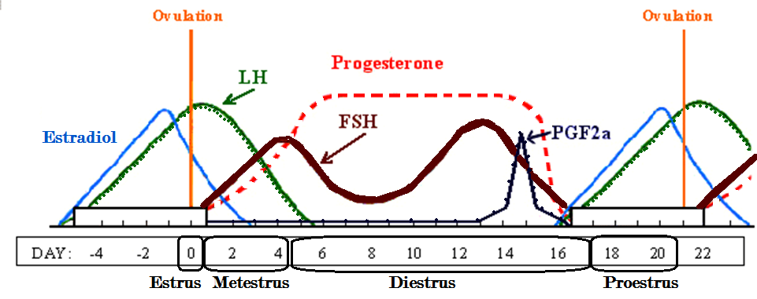
This graphic also shows how the changing hormone levels correspond to the four stages of the estrous cycle (the stage is underlined; hormones are bold).
  Estrus occurs at day 0 just after the peak in estradiol but before the peak in LH.
  Ovulation starts metestrus, and ovulation is caused by the LH surge.
  The plateau of peak progesterone levels marks the diestrus phase.
  Proestrus occurs after the surge in PGF_{2α}, when progesterone levels drop and estradiol levels rise for the next estrus (if the egg was not fertilized.

Slide 15

Artificial Hormone Therapies
Knowledge of reproductive hormones has resulted in the creation of numerous pharmaceuticals that aid in regulating, adjusting, or terminating the estrus cycle
  This can be of great advantage to the producer because it allows them to control when and how the estrus cycle occurs in order to minimize losses without adversely affecting the health of the cow.
All treatments must be thoroughly researched and extensively tested to determine whether or not they are safe for administration to animals and must show that they cause no harmful effects
in humans who consume products
from those animals
  All of these products available for
  sale must be FDA approved.

Slide 16
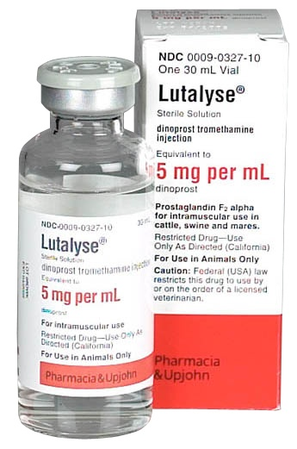
Lutalyse
PGF_{2α} can be administered as an injection to regulated and restart a cow’s estrous cycle.
  Lutalyse is a common veterinary pharmaceutical brand name of PGF_{2α}.
If an animal is known to be open (i.e. her ovulated egg was not successfully inseminated), a shot of Lutalyse will end the cycle and start a new one.
  Lutalyse/ PGF_{2α} will cause the death of
  the corpus luteum, resulting in reduced
  progesterone production.
  This injection will cause most treated animals to go into heat within 2-5 days.
Lutalyse does not work with an anestrous animal (a cow that does not go into heat).
  This is because an anestrous cow will not have a corpus luteum that PGF_{2α} could regress.
Source: www.pygmygoat.info

Slide 17

Ovsynch
If a producer misses a cow in heat, or if the heats are not easily detectable, profits can quickly be lost if the cow is not bred in a timely fashion.
  Reproductive failure is one of the most significant factors that limit animal productivity and profitability and result in millions of dollars in lost profits annually.
  While a shot of Lutalyse/ PGF_{2α} will end a current estrous cycle, it does not allow a producer to easily predict or schedule the next occurrence of estrus.
Research at UW-Madison led to the creation of Ovsynch, a hormone therapy treatment to synchronize ovulation and allow for predictable, timed inseminations.
  In short, we can use this treatment to make a
  cow go into heat at a specific time that is
  known in advance and can be scheduled.
  For cows for which it is difficult to detect
  a heat naturally, this treatment can ensure
  that their insemination and conception rates
  are similar to those of other cows.
Source: www.hoards.com

Slide 18
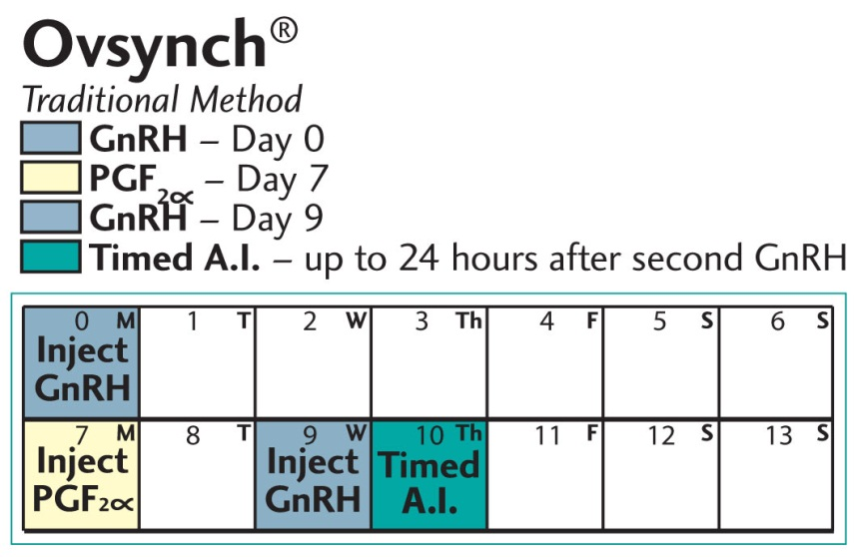
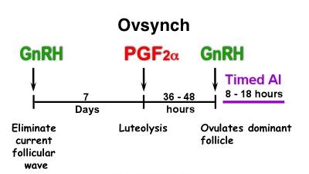
Ovsynch
Ovsynch uses two hormones: PGF_{2α} and GnRH .
  Two shots of GnRH and one shot of PGF_{2α} are administered as part of this therapy.
  The GnRH shots are necessary for the release of FSH (to stimulate the production of a follicle and mature an egg) and LH (to cause ovulation of that egg and stimulate the formation of a corpus luteum).
  The PGF_{2α} is necessary to end the existing estrous cycle.
The Ovsynch protocol occurs in four stages:
  Day 0 - Stage 1: GnRH injection to create a new follicle.
  Day 7 - Stage 2: PGF_{2α} injection to end the current estrus cycle and regress the
  corpus luteum.
  Day 9 – Stage 3: Second GnRH
  injection to cause the new follicle
  to ovulate and release the egg.
    All cows will ovulate 24-32 hours
    after the second GnRH injection.
  Day 10 – Insemination.
Source: genex.crinet.com
Source: www.ansci.wisc.edu

Slide 19
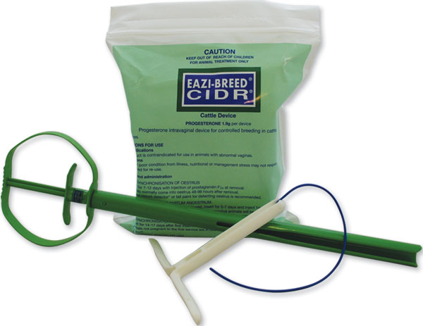
CIDR - Source: ansci.wisc.edu
CIDRs (Controlled Internal Drug Release; pronounced See-durhs) are an intravaginal progesterone insert used in the beef cattle, dairy cattle, goat and sheep industries.
  The progesterone is released at a controlled rate into the bloodstream after insertion.
CIDRs are an option for producers with the following breeding problems:
  Inefficient heat detection or inability to detect heat in an animal.
  Cows with likelihoods of insemination using traditional methods.
  Cows and heifers in the wrong stage of their estrus cycles to initiate breeding.
  Heifers that aren’t having an estrus cycle even if they are the appropriate age.
In all species, CIDRs are used to synchronize the
estrus cycle of one or more animals.
  This can be highly beneficial in large herds because with
  the synchronization of estrus, groups of cows and
  heifers can be bred at the same time in a narrow
  window of time.
Source: northsbreedingsolutions.com.au

Slide 20
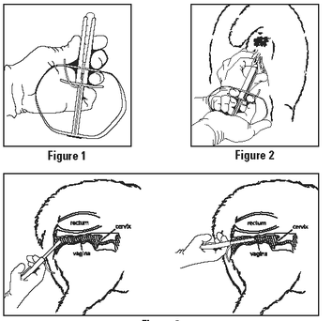
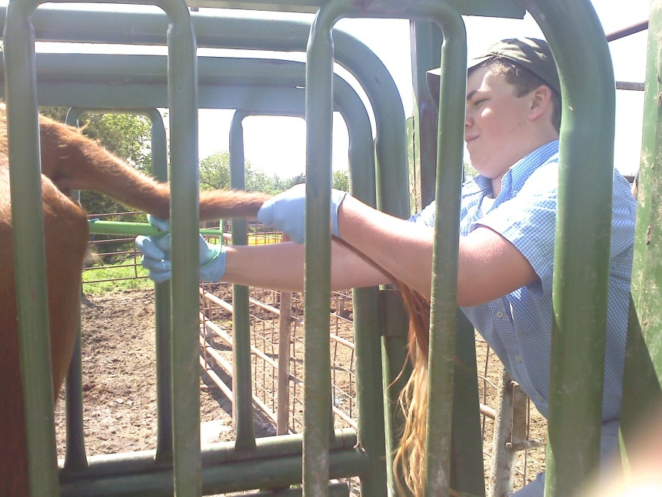
How CIDR Works
CIDRs are a t-shaped rode coated with progesterone.
  Progesterone will prevent the animal from going into heat.
  While the CIDR remains in the animal, that animal will be unable to have an estrous cycle or go into heat.
  CIDRs are usually left in place for 7 days.
  This extends the diestrus phase for an extra week, synchronizing the estrous cycles of all treated animals.
When the CIDR is removed at
the end of the treatment period,
the progesterone production also
immediately stops.
  This enables ovulation to occur.
  Because the CIDR implants are usually all removed at the same time, all of the animals in the herd that were implanted will go into heat around the same time.
  This enables a producer to inseminate an entire herd all at once.
Source: drugs.com
Source: ladyofag.wordpress.com

Slide 21
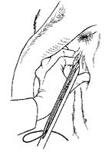
CIDR Protocols
CIDRs are usually paired with other hormonal treatments to maximize the likelihood of insemination.
  In all cattle treated with a CIDR implant, a GnRH injection is usually given at the same time the CIDR is administered.
  This will cause the release of FSH will stimulate the production of a new follicle and mature egg.
  When the CIDR is removed 7 days later, an injection of PGF_{2α} is also given.
  This will cause the end of the existing cycle, ensuring that the cow will go into heat roughly 60 hours later.
CIDR treatments may cause a slightly
increased risk of vaginal infection.
  For this reason it is very important that producers administering the treatment take additional
  protocols to ensure sterility.
  This includes the use of latex or nitrile gloves and
  a clean treatment area.
  CIDR inserts should never be used more than once
  unless effectively treated to ensure their sterility.
Source: www.atozvetsupply.com

Slide 22
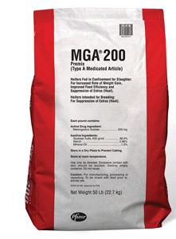
MGA
Producers can also control the estrous cycle of cattle through feeding practices.
  One of the more widely used practices is the use of melengestrol acetate (or MGA).
  MGA suppresses estrus and prevents ovulation in cows and heifers.
  MGA is often fed with grain or protein in the cow’s diet.
  48 hours after MGA is removed from their diet, cattle will begin to go into estrus.
MGA is often paired with other hormonal treatments to increase its efficacy. Three common combinations include:
  MGA + PGF_{2α}: in this combination, PGF_{2α} is administered 19 days after MGA is stopped, ensuring that all or most cattle into heat at the same time one estrus cycle after MGA is stopped.
  MGA Select (MGA + GnRH + PGF_{2α}): in this combination,
  MGA is combined with a treatment similar to Ovsynch to
  further increase the likelihood of insemination.
  7-11 Synch: in this treatment, MGA is only fed for seven
  days; PGF_{2α} is administered on the last day of MGA
  feeding. A shot of GnRH is given four days after the last
  MGA feeding. PGF_{2α} is given seven days after this.
    This allows for a shortened estrus cycle while still allowing for
    a follicle and mature egg to develop.
Source: www.zoetisus.com

Slide 23
Works Cited
http://www.selectsires.com/resources/fertilitydocs/reproductive_anatomy.pdf
http://www.dcrcouncil.org/media/Public/Back%20to%20the%20Basics_Explaining%20the%20Estrous%20Cycle.pdf
http://www.ansci.wisc.edu/jjp1/ansci_repro/lec/lec9/lec9out.html
http://beef.unl.edu/learning/estrussynch.shtml
http://beefrepro.unl.edu/pdfs/estrouscycle.pdf
http://www.uwyo.edu/wjm/repro/estrous.htm
http://www.vivo.colostate.edu/hbooks/pathphys/endocrine/hypopit/lhfsh.html
http://beefmagazine.com/mag/beef_understanding_cidr
http://beefmagazine.com/mag/beef_using_mga

