Slide 1
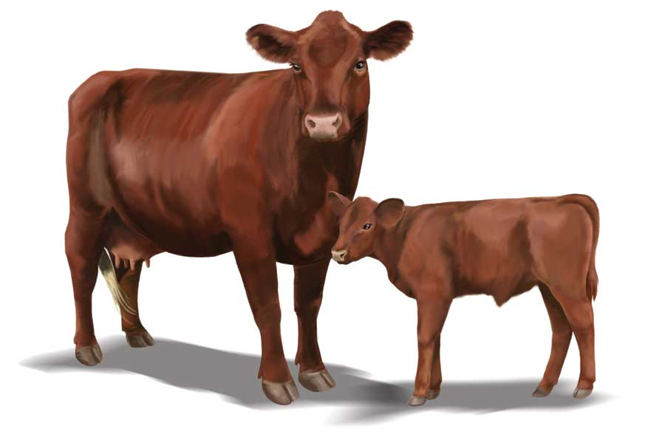
You are a scientist sometime in the near-to-distant future. At this point in the future, we understand what every single gene does in the genome of cattle and can change their cells in almost any way. Your task is to change the cellular mechanisms of cattle in 4 different ways so that they produce more ATP. The expectation is that if we can make cattle cells increase their ATP production in four different ways, they will produce meat and milk much more efficiently. As a group on a dry erase board, develop four ways in which you could change the cells of cattle to make them produce more ATP. Be prepared to explain how these changes will enable more ATP to be produced by these cells. Consult your notes if needed.

