Slide 1
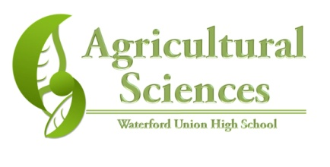
Ruminant Physiology
By C. Kohn
Department of Agricultural Sciences
Waterford, WI

Slide 2

Intro – A Grassy Buffet
Imagine for a moment that you are trapped on a small deserted island with little other than grass and a freshwater spring.
  There are no animals whatsoever, or plants other than the grass itself.
Could you survive for very long?
Could a cow survive
for very long?
TPS Why is there a
difference?

Slide 3
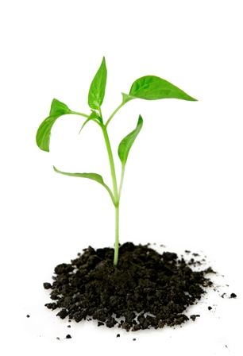
Nutrition & Energy
In nature, all living organisms must be able to acquire the molecules from which their cells are built and energy in which to operate their cells.
Plants, because of photosynthesis, can acquire all of their energy needs from the sun, water, and air through photosynthetic sugar
production.
  Animals, because they lack chloroplasts in their cells, cannot do this.

Slide 4
Classes of Animals
Four primary groups of digestive tracts exist among animals to process the energy captured in plants (or in other animals that eat those plants):
  Monogastrics (humans, pigs, dogs): one simple stomach that secretes acid
  Avian (birds): consists of a crop (where food is stored and soaked), a proventriculus stomach (similar to monogastrics) and a gizzard, in which grit or stones act like our teeth do to pummel food into smaller sizes.
  Ruminant (cattle, deer): a multi-chambered stomach ferments dense forage into a more digestible substance before absorption.
  Post-gastric fermenters/pseudo-ruminants (horse, rabbits): bacteria in the cecum (large intestine) ferment and break down any plant material not digested in the stomach.

Slide 5
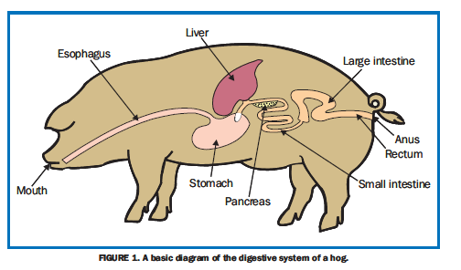
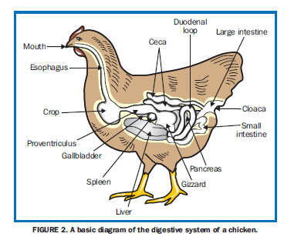
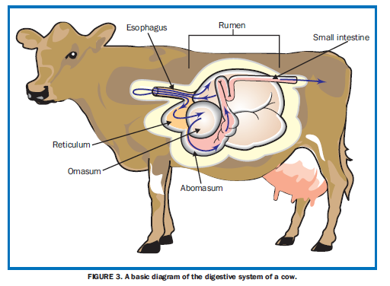
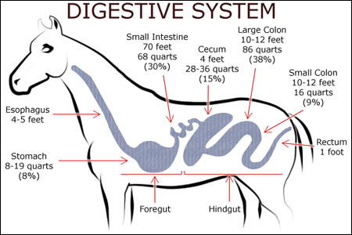

Slide 6
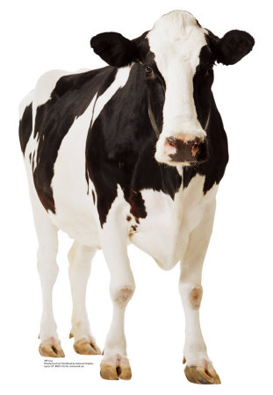
Ruminants
The breakdown of plant structures requires special dietary adaptations to break apart the cellulose of the plant cell wall.
  Cellulose: the tough, fibrous molecule from which the essential parts of plant cells are made
Ruminants have the ability to break down cellulose because of their four-chambered stomach.
  These four chambers in cattle are the rumen, reticulum, omasum, and abomasum.

Slide 7
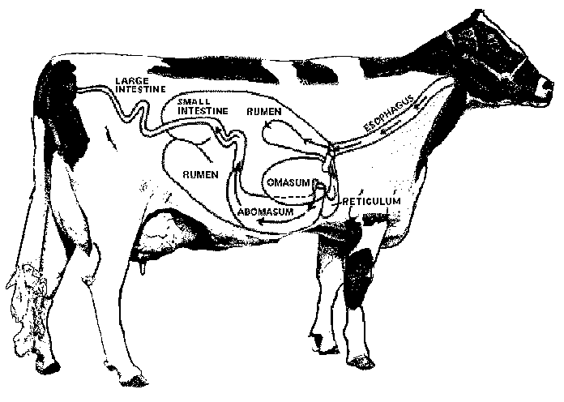
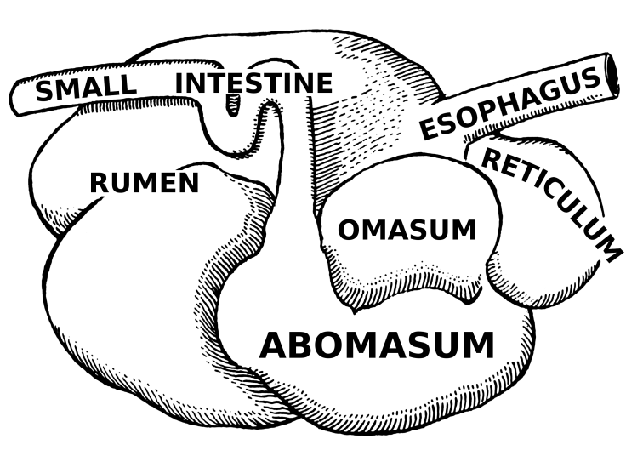

Slide 8
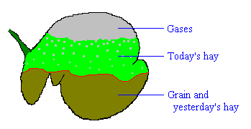
Ingestion
After being ingested, forage will pass down a cow’s esophagus into their rumen, the first of the stomachs of a cow.
  The rumen is a sort of living microbial fermentation vat.
  Inside microbes live in an ideal environment where oxygen, pH, temperature, and food are all closely regulated.
Fermented feed is either
absorbed by the rumen itself
or is moved further along
the digestive tract for more
digestion and absorption
downstream.

Slide 9
Inside the Rumen
Ruminants are evolved to consume roughage (grasses, alfalfa, corn silage), and the rumen is custom made to handle this material…and lots of it!
An adult cow will also produce 100-150 liters of saliva per day to help digest the consumed forage. The saliva…
  Supplies the fluid needed to ferment the forage and…
  Helps maintain the rumen pH to ensure the survival of rumen microbes.

Slide 10
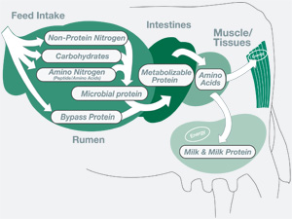
Inside the Rumen
The flow of forage through the rumen is very slow; time is needed for the forage to ferment and for microbes to break down the plant matter further
  Because of this, it takes over a day for consumed feed to move on to the next chambers.
As plant matter is broken down, it will sink to the bottom where it can move on to the next chamber of the cow’s stomach.
  Ruminal contractions constantly
  flush lighter solids back into the
  rumen.

Slide 11
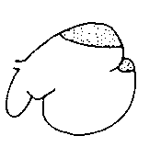
Rumen Contractions
A cycle of contractions occurs 1 to 3 times per minute.
  The highest frequency is seen during feeding, and the lowest when the animal is resting.
Two types of contractions are:
  Primary contractions originate in the lower front and pass around the rumen.
    Parts of the rumen will contract while other sacs are resting.
  Secondary contractions occur in only some parts of the rumen.
Contractions are necessary to ensure proper
digestion by mixing the partially digested/fermented feed..
  If a ruminant is injured or sick, or if the rumen
  becomes too acidic, contractions can slow or
  cease, slowing or stopping digestion.
      Source: Colorado State Univ

Slide 12
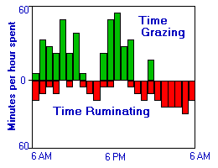
Cud Chewing
Cows are known for chewing their cud.
  This is actually regurgitation of partially-digested feed so that it can be further reduced in size to aid microbial fermentation.
The cud, or bolus, is carried to the mouth by the esophagus.
  To do this, the esophagus must reverse its contractions.
  After it is fully chewed, the bolus is re-swallowed into the rumen.
While a cow is chewing her cud, she must also release the enormous quantities of gas that build up as a result of fermentation.
  Failure to do so can result in bloating, a
  severe and potentially fatal condition
  for a ruminant that can interfere with
  breathing and cause suffocation.

Slide 13
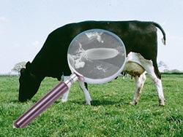
Rumen Microbes
What makes ruminant digestion of cellulose possible is the diverse population of microbes that inhabit this structure.
These microbes interact and support one another, passing along partially digested forage.
  The waste of some microbes becomes the food other others
These microbes are what actually
digest the forage
  They produce the cellulase enzyme
  that breaks down the cellulose in
  the plant cell walls.

Slide 14
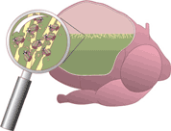
Microbial Services
Rumen microbes provide 4 key services to a cow:
  1. Amino acid production: all animals must consume the amino acids their own bodies can’t make in order to build proteins. Rumen microbes make these essential amino acids and supply them to the cow’s body.
  2. Protein production: some proteins cannot be made from plant sources. Microbes can utilize sources of proteins that cows cannot (such as the urea created from protein digestion) to produce more protein for the cow’s body.
  3. Synthesis of B-vitamins: without
  microbes, cattle would be deficient
  in all but two of the B vitamins.
  4. Break-down of cellulose – rumen
  microbes produce the cellulase
  enzyme needed to break down
  cellulose into digestible glucose.

Slide 15
Microbial Fermentation
Almost all feed ingested by the cow is actually used to feed the microbes in its rumen.
  The cow itself gets the waste byproducts from the microbes after they ferment the forage.
Fermentation occurs under anaerobic (w/o oxygen) conditions
  Because of this, the sugars freed when cellulose is broken apart become fermented into Volatile Fatty Acids, or VFAs.
  If microbes were exposed to oxygen, they would completely break down the forage into CO2
VFA’s provide the majority of the energy needs of an herbivore.

Slide 16
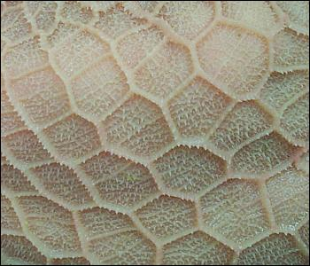
The Reticulum
The reticulum is a tough, lower
portion of the rumen and is
considered the second chamber
of a cow’s stomach.
The reticulum ‘catches’ foreign objects and prevents them from causing further harm downstream of the rumen.
It has a tough, honey-comb
structure that is puncture-
resistant.

Slide 17
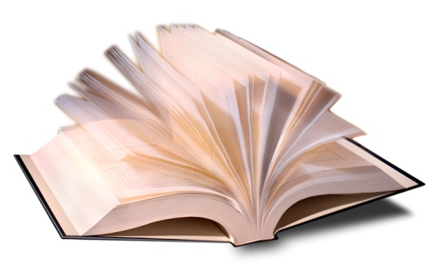
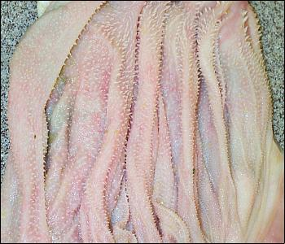
The Omasum
After day-old forage is fermented in the rumen, it moves on to the third chamber, the omasum.
  The omasum resembles pages of an open book.
The rumen will inject a soupy mixture of partially digested forage and microbes into this structure.
It’s main job is absorption of
water, volatile fatty acids, and
other nutrients.
  The folds trap digested particles
  to maximize absorption.

Slide 18
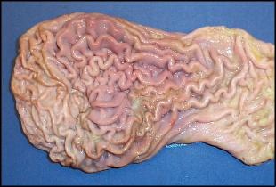
The Abomasum
The abomasum of a cow is the fourth chamber and the “true” stomach.
  It operates much like our own stomachs.
  It secretes acid and digestive enzymes
What makes a cow’s abomasum unique is that it must handle far more bacteria than human stomachs.
  This is because of the soupy forage/microbe mixture that is passed on from the rumen.
  To handle this large quantity of
  bacteria, the abomasum secretes
  lysozyme, an enzyme that breaks
  down bacterial cell walls.

Slide 19
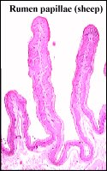
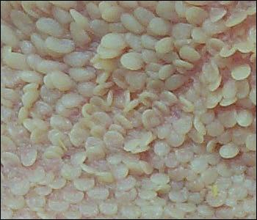
Absorption
The main product of rumen fermentation of forage are volatile fatty acids, or VFAs.
VFAs are continously absorbed by the walls
of the rumen.
  This is necessary because VFAs are a
  primary source of energy
  This is also vital as well because
  failure to absorb VFAs would lower
  the pH of the rumen and kill the microbe
  populations, stopping forage fermentation
To absorb VFAs, the walls of the rumen
are lined with papillae, small projections
of skin that increase surface area to
increase absorption.

Slide 20
After the Abomasum
After the abomasum, plant matter will enter the small intestine
  There it is exposed to enzymes from the pancreas and intestinal walls, and to bile from the liver.
Any unabsorbed protein, starch, sugars, and fats will be digested and absorbed here.
  From this structure, they will
  enter the bloodstream.

Slide 21
After the Abomasum
Following the small intestine and absorption into the blood stream, any remaining plant matter will pass into the large intestine.
  This is the second site of fermentation (after the rumen) with some VFA production,
  It is also where excess water is reabsorbed.
Water must be reabsorbed
after digestion in order to
keep the body of the ruminant
hydrated.
  Inflammation of the walls of
  the large intestine can quickly
  lead to dehydration and
  possible death.

Slide 22
It’s Good to be a Ruminant
Ruminants have several advantages over monogastrics:
  Ruminants can acquire almost all of their dietary needs from a small range of sources.
  Dietary energy is provided by the VFAs released by fermenting microbes.
  Except for A, D, and E, all the vitamins needed by a ruminant are synthesized by the microbes in their rumen.
    Vitamins A and E are found in hay and pasture, and vitamin D is created via exposure to sunlight.
  Needed amino acids and proteins are also synthesized by rumen microbes from the fermented forage. .
The downside of being a ruminant? More can go wrong…

Slide 23
Additional Resources
For a great visual of a dissected tract, click here.
For a short video, click here.

