Slide 1
Spaying & Neutering
By C. Kohn
Agricultural Sciences
Waterford, WI

Slide 2
Intro
Spaying and neutering is a good choice for a dog or cat because…
It prevents the addition of millions of unwanted (and often neglected or abused) dogs and cats.
It reduces the risk of testicular cancer and prostate disease in males.
In prevents pyometra (puss-filled uterus) and reduces rates of breast cancer in females.
The sooner spaying or neutering is performed, the less likely the animal will have complications.
This is a choice that should be made for most pets and should be made as soon as is healthy to do so.

Slide 3
Better Pets
Neutered or spayed animals also tend to make better pets because…
They are less likely to roam due to sexual arousal.
They are less likely to be noisy due to sexual arousal.
They are less likely to be lost, injured, or killed due to roaming.
They are less likely to have costly medical problems if they are spayed and neutered.
An unneutered male dog is more likely to be aggressive and bite.
Unneutered males are also more likely to mount furniture or human legs.
Unneutered male cats may have strong-smelling urine.
Unspayed female cats go into heat every 3 weeks.
During this 4-5 day period, the cat may meow loudly and will urinate more frequently.
Unspayed female dogs may excrete discharge for up to a week.
Unspayed or unneutered pets will also attract other stray pets.
This could pose a safety-risk to both the pets and people in your house.

Slide 4
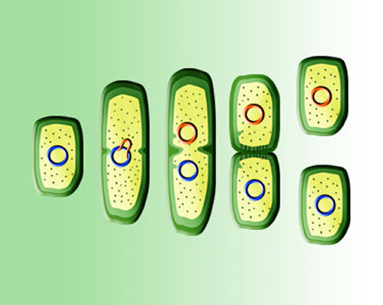
Reproduction
So why do the reproductive organs exist if they cause so many problems?
Understanding the benefits of spaying and neutering begins with an understanding of the reproductive organs.
There are species that can reproduce asexually.
Asexual reproduction is defined as producing offspring without a mate.
For example, bacteria can reproduce through cellular fission (right).
In cellular fission, the bacterial cell doubles its genetic material and then splits in half.
Your own cells go through this same process during cell mitosis.
Cell mitosis is when your cells double their DNA and divide into two identical cells.
Source: isite.lps.org

Slide 5
Asexual Reproduction
Some multi-celled organisms can reproduce asexually as well.
For example, the hydra (a relative of the jellyfish) can produce “buds” that grow to become exact copies of the parent when they mature.
Sharks have also been known to reproduce by parthenogenesis, a process in which they produce eggs without being fertilized by a mate.
Many plants can also be reproduced by process such as grafting or leaf cutting, in which a second plant is produced that has the same exact genetic material as the original plant.
On the surface, asexual reproduction can seem advantageous.
Some species exhaust large amounts of energy to attract a mate.
For example, some male mammals like deer or rams may waste large amounts of energy fighting each other for a mate.
Other species may struggle more to survive because of their sexual adaptations.
For example, male peacocks are more prone to predation because of their elaborate feathers.
Sexual reproduction can also increase the risk of disease transmission and parasites.

Slide 6
Benefits of Sexual REproduction
So what benefits does sexual reproduction actually have?
Why go through all the trouble of sexual reproduction if some species can just clone themselves?
The major advantage of sexual reproduction is genetic diversity.
Through sexual reproduction, a species is more likely to survive diseases and other threats.
Genetic diversity also enables new traits and adaptations to emerge over time.
It is only through genetic diversity and changes to the gene pool that species are able to evolve as their environment changes.

Slide 7
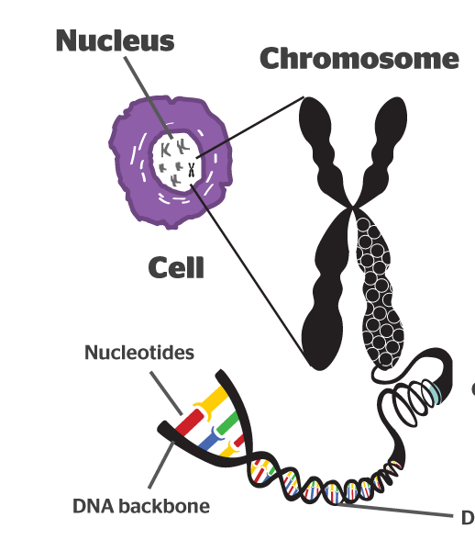
Chromosomes
Almost all eukaryotic cells (like those found in vertebrates and other evolved organisms) are diploid.
Diploid means that those cells have two copies of each chromosome.
A chromosome is a tightly packed bundle of DNA.
Each chromosome in each cell contains a portion of the genes of that organism.
Different species have different numbers of chromosomes.
Humans have 23 pairs of chromosomes. Cats have 19 pairs of chromosomes. Dogs have 39 pairs of chromosomes.
Ordinarily, DNA is not packed into chromosomes.
DNA needs to be accessible so that the genes can be accessible for transcription and translation.
When DNA is packed into chromosomes, these genes are not accessible.
However, during mitosis (when a cell divides to make two cells) the DNA is doubled and packed into chromosomes.
This enables the DNA to be evenly divided between the two new cells.
Source: b4fa.org

Slide 8
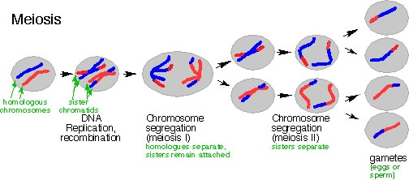
Gametes
The only cells in eukaryotic organisms that are not diploid are the sex cells (also called gametes).
The gametes are the sperm and egg cells.
Each gamete has half the number of chromosomes that the rest of the body’s cells have.
This is because sperm and egg cells have only one copy of every chromosome (haploid) instead of the usual two copies (diploid).
This is necessary in order to prevent the number of chromosomes from doubling with each new generation.
Meiosis is the process in which the sex cells (sperm and eggs) are created.
First, we will focus on how the simpler sperm cells are created.
The process of creating sperm cells is called spermatogenesis.
In males, several hundred million sperm are made every day.
Source: ptbestaribiology.blogspot.com

Slide 9
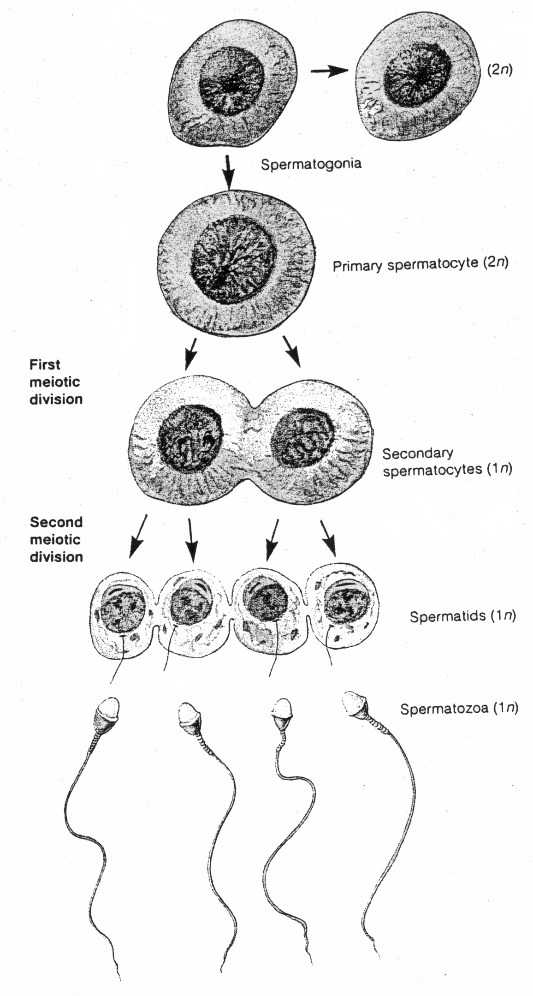
Germ Cells
Spermatogonia are the specialized cells in the testes from which sperm cells are made.
Spermatogonia are unspecialized, diploid bodily cells that are transformed by the process of meiosis into the specialized haploid cells we know as sperm.
Spermatogonia are germ cells.
Germ cells are the kinds of cells that eventually become gametes (sperm or eggs).
Meiosis of sperm has two stages: Meiosis I and Meiosis II.
In Meiosis I, the number of chromosomes are doubled, and genetic material is “shuffled” to increased genetic diversity.
This shuffled DNA is then split between two diploid cells.
In Meiosis II, the two new diploid cells are split in half, resulting in four haploid cells.
These are the cells that become sperm cells.
Source: rushartsbiology.wikispaces.com

Slide 10
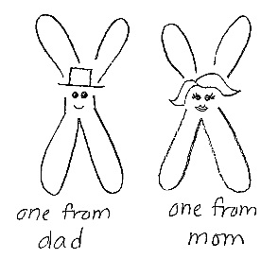
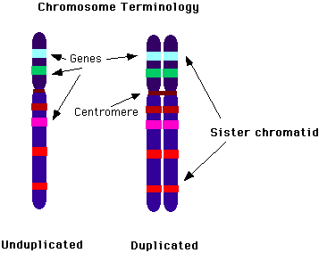
Meiosis
Before meiosis of the spermatogonia begins, all DNA is packed chromosomes.
The number of chromosomes has also been doubled from two copies to four copies of each chromosome.
Each spermatogonium germ cell begins with one chromosome inherited from the father and one chromosome inherited from the mother.
After the doubling of the DNA, there will now be two maternal chromosomes and two paternal chromosomes.
A chromosome normally looks like a long narrow coil of DNA.
Once the DNA has been doubled, it causes the chromosome to look like an X.
Source: www.beatricebiologist.com
Source; staff.jccc.net

Slide 11
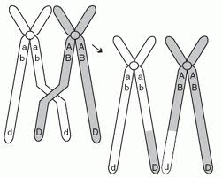
Crossing Over
During Meiosis I, each pair of chromosomes lines up next to its “partner”.
e.g. Chromosome 1 lines up to the other Chromosome 1; Chromosome 2 lines up by the other Chromosome 2, and so on.
The term for two copies of the same chromosome is homologous chromosomes.
When all homologous chromosomes have lined up next to each other, a process called crossing over begins.
Crossing over is the process in which homologous chromosomes exchange segments.
This is necessary to greatly increase the potential genetic diversity of the offspring.
Instead of passing on a maternal or a paternal chromosome, crossing over enables a parent to pass on a mixture of the DNA that has been inherited.
This allows for more genetic diversity than if chromosomes were passed on “un-mixed”.
Source: www.sciencegeek.net

Slide 12
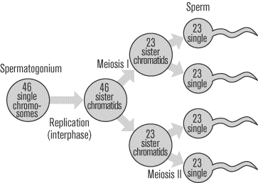
Meiosis II
After crossing over occurs, the homologous chromosomes split so that each copy is on opposite sides of the cell.
The cell splits in half, creating two cells.
Each of the two new cells has two copies of every chromosome.
In Meiosis II, the two cells each split in half again.
The two cells that had two copies of each chromosome have now become four cells that have one copy of each chromosome.
These four cells with the one copy of each chromosome are now transformed to become the tailed, swimming cells we recognize as sperm.
Source: www.sparknotes.com

Slide 13
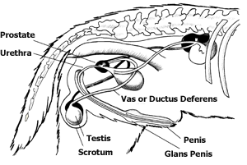
Path of Sperm
Once the sperm cells form, they must travel through the entire male reproductive tract in order to leave the male’s body and fertilize the female.
Sperm cells are formed in the testicles.
Testicles are the male reproductive organs; they are held outside the body in a sack called the scrotum.
The testicles have to be kept outside the body because the sperm have to be kept at a temperature slightly lower than body temperature.
If the sperm get too warm, the enzymes needed for sperm motility (i.e. swimming) start to denature.
Source: www.peteducation.com

Slide 14
Seminiferous Tubules & Epididymis
The testicles are made of coiled tubes called seminiferous tubules.
These tubules are where the meiosis occurs that produces the sperm cells from the germ cells.
The seminiferous tubules coil and meet the next step in their path outward: the epididymis.
The epididymis is where sperm is matured and stored until it is ready to be ejaculated.
During intercourse, the sperm is moved into the vas deferens, a long narrow tube that moves the sperm towards the prostate gland.
The prostate gland adds additional fluids that nourish, support, and protect the sperm cells.
The sperm cells with the fluids from the glands of the reproductive tract form semen.
Source: www.peteducation.com

Slide 15
Urethra and Penis
From the prostate, the sperm cells and fluids enter the urethra, which runs to and through the penis of the dog.
At the base of the penis is a structure called the glans penis.
This fills with blood and holds the male’s penis in the female’s vagina during intercourse.
A dog’s penis is also unique in that it has a bone inside; this bone maintains the shape of the penis and keeps it pointed in the right direction during mating.
The dog’s penis is enclosed inside its body by a sheath of skin called the prepuce.
Source: www.peteducation.com

Slide 16
Intercourse & Ejaculation
During intercourse, the semen will be ejaculated from the penis into the female’s vagina.
The semen will have to pass through the vagina and cervix into the uterus.
From the uterus, the semen will travel into the fallopian tube (or oviduct) of the female.
It is in the oviducts that fertilization occurs.
Source: www.peteducation.com

Slide 17
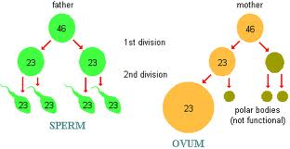
Meiosis in Females
Meiosis in females for egg cells differs in a number of ways from meiosis in males for sperm cells.
First, a limited number of germ cells (called oocytes) go through Meiosis I before the female is even born.
This process is halted at Meiosis I until the individual reaches sexual maturation.
Meiosis II then occurs slowly, cell by cell, over the course of the life of the individual until the supply of germ cells has been exhausted.
This means that the eggs produced by a 10 year old dog or cat are actually older than 10 years
This is why genetic abnormalities are more common in the offspring of older individuals than in younger.
Source: campus.udayton.edu

Slide 18
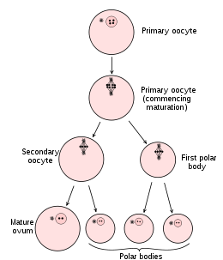
Polar Bodies
Secondly, the eggs that are produced must be much larger than the sperm cells that fertilize them.
This is because the egg cell also becomes the first cell of the newly formed individual.
If the egg were produced in the same way that the sperm are produced, the egg would be ¼ the size it needs to be.
Because the egg cell needs to be larger, the meiosis only produces one egg at a time.
During Meiosis I, the doubled-chromosomes are split between a cell and a polar body.
Most of the cytoplasm goes to the cell to keep it larger.
Half the DNA and just a small amount of cytoplasm go to the other, smaller cell (the polar body).
Source: celldivisionandreproduction.weebly.com

Slide 19
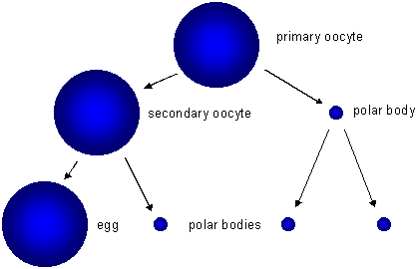
Polar Bodies
Polar bodies ensure that the cell that eventually becomes the egg is as large as possible by allowing most of the cytoplasm to go to that cell.
The polar body usually breaks apart and is broken down by the individual’s body.
During Meiosis II, the cell with two chromosomes again splits, this time forming a second polar body and the haploid egg cell.
Just as before, this second polar body will be absorbed by the body of the individual.
The egg cell will be released from the ovary into the fallopian tube of the female reproductive tract for fertilization.
Source: faculty.clintoncc.suny.edu

Slide 20
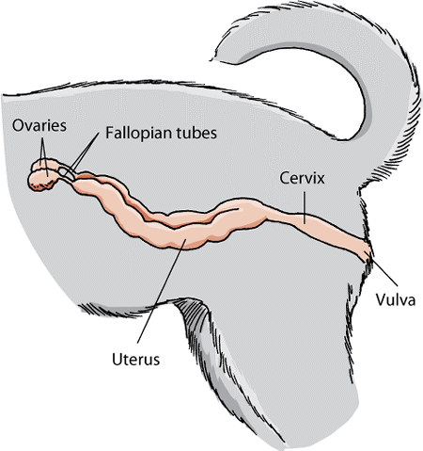
Female Reproductive Tracts
A female dog’s reproductive tract is more similar to that of a human female than male dogs are to human males.
The female dog’s reproductive tract consists of ovaries, where the eggs are produced.
Eggs are released from the ovaries into the fallopian tubes (or oviducts), where fertilization takes place.
If fertilized, the egg (now called a zygote) will move into the uterus and implant onto the uterine wall.
The uterus is blocked from the outside environment by a tough structure called the cervix.
The cervix forms a barrier between the uterus and the vagina.
The vagina is where semen is deposited from the male’s penis during intercourse.
The vagina is protected from the outside by the vulva, which forms the final barrier between the reproductive tract and the outside environment.
Source: www.merckmanuals.com

Slide 21
Estrus
In addition to the production of eggs, the ovaries are also the site of production of many of the hormones needed for reproduction.
Female hormone levels are what control the heat cycles of a female.
Dogs between 5 and 18 months will enter their first heat cycle when puberty begins.
Every six to nine months, the female dog will have heat cycles consisting of the following stages:
Proestrus
Estrus
Diestrus
Anestrus

Slide 22
Estrus Phases
Proestrus: the vagina will begin to produce discharge.
Males will become interested in the females, but the females will be unreceptive to them.
Estrus: this is the active breeding stage.
Bleeding from the vagina is usually finished by this point.
The newly-formed egg is released from the ovary during this stage, and the female will allow herself to be mounted by a male.
During intercourse, the female’s vagina will enclose itself around the male’s glans penis, causing the male and female to be physically held together.
Diestrus: this period lasts from when the female is no longer receptive to males until the end of pregnancy (or up to 80 days if pregnancy did not occur).
During this time, the uterine wall prepares itself for a fertilized egg.
Anestrus: this is the period between heat cycles.
No significant physical activity in the reproductive tract occurs.

Slide 23
Neutering
Spaying and neutering ensure that a pet cannot reproduce without affecting its ability to perform other necessary physiological function.
Spaying and neutering procedures are designed to be minimally invasive while ensuring that the pet has the maximum quality of life possible.
Most pets are able to be fully functional after a spaying or neutering operation with little or no impact on their daily life.
Neutering of male pets is a very simple procedure.
Most neutering procedures can be completed within a day or less.

Slide 24
Neutering Process
A neutering process begins with a blood test to ensure there will be no problems that would affect the procedure.
Next, the dog undergoes anesthesia to ensure it will not feel any pain.
Once asleep, a tube is placed down the dog’s throat to ensure that the animal can breathe throughout the operation.
The tube will deliver both oxygen and a predetermined amount of anesthesia to keep the animal under throughout the operation.
The scrotum is shaved and scrubbed to prevent infection.
An incision is made in front of the scrotum, and both testes are removed through the incision.
The cords leading to the testes are tied off surgically, and the wound is sutured.
A pain reliever will be injected at the site of operation, and the animal will be brought out of anesthesia.
Under normal circumstances, the animal will be able to go home that same day.

Slide 25
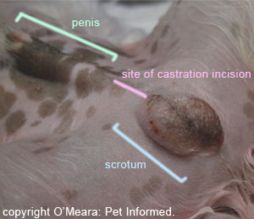
Follow-up
Most dogs will not realize that anything has happened.
However, some nausea can occur and it is not unusual for a dog to refuse food for a day or two after the operation.
If the dog licks or bites at the stitches, it will need an Elizabethan collar.
Activity should be restricted during the week after the operation to prevent swelling or the accumulation of fluid.
Stitches will be removed 10-14 days after the surgery.
It is important that a qualified professional removes the stitches in order to check for any complications.
Source: www.pet-informed-veterinary-advice-online.com

Slide 26
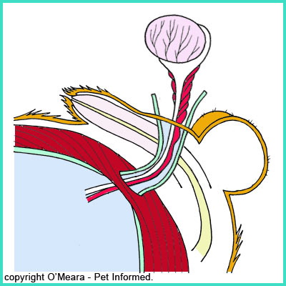
What happens to…
You may wonder what happens to the rest of the organs after surgery.
After all, only the testes (containing the seminiferous tubules) are removed.
What about the glands, the production of semen, and the rest of the male reproductive tract?
While those structures are still in place after neutering, their “signals” to perform came from the testes.
Therefore, they will be largely inactive after the procedure and do not need to be removed.
Source: www.pet-informed-veterinary-advice-online.com

Slide 27
Neutered Pets = Better Pets
In general, a dog or cat’s life will be largely unaffected by a neutering procedure.
Aside from sexual activity, the rest of their life will go on as if nothing had changed (and to them, nothing has changed as far as they know).
In addition, the reduced sexual urges of your pet combined with…
less aggressive behavior
less urine marking
less mounting
reduced occurrence of disease and disorder
the reduced likelihood of accidents or runaways
…will make your relationship with your pet happier, more affordable, and likely longer.

Slide 28
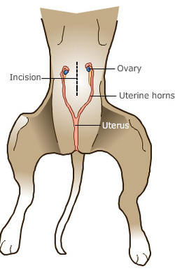
Spaying
Spaying, or an ovariohysterectomy, is also a very common procedure.
However, spaying a female is far more complicated and involved than castrating a male.
In this procedure, the ovaries, ducts, and uterus will all be removed.
Like castration, the animal must be put under anesthesia.
The abdomen is clipped and sanitized.
An incision is made on the lowest portion of the abdomen along the midline where connective tissue lies.
The midline is used because it will cause minimal bleeding compared to other areas above the reproductive tract.
Occasionally the incision must be made in an area outside of the midline.
The incision can still be made easily but it is much more likely that bleeding will occur and cause complications.
Source: carrollsmallanimalclinic.com

Slide 29
Spaying
Special care must be made not to cut into the abdominal organs that lie just below the abdominal connective tissue.
The animal is typically on its back in this procedure, and the uterus is generally found along the spinal column.
Once it is located, a uterine horn is brought forward to the surface.
A major blood vessel, the ovarian artery, must be clamped so that the animal does not bleed to death during the operation.
The same must be done for the ovarian vein.
Both are then sutured shut and cut near the base of the ovary.
The veterinarian must carefully examine these vessels after cutting them to ensure that the sutures will not fail; this would cause the animal to bleed to death inside.
Source: carrollsmallanimalclinic.com

Slide 30
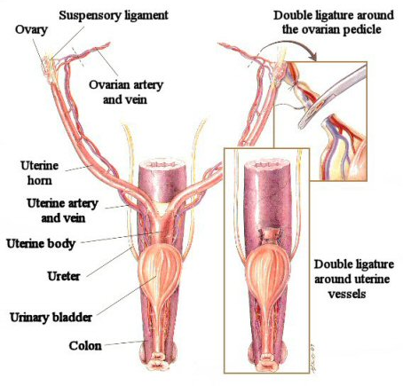
Spaying
Once the blood supply to the ovaries and uterus has been sutured (or ligated), the ovaries, the uterine horn, and most of the body of the uterus above the cervix are removed.
The abdominal area is examined for bleeding and if none is found, the incision is sutured back together.
Females typically are kept overnight after a spaying procedure.
This way the animal can be monitored closely and can receive adequate levels of pain medication appropriate for this more intensive procedure.
Because spaying is a more intense procedure, it is also more susceptible to complications.
With any operating procedure, infection is always a concern.
The risk of this is minimized by proper surgical preparation and usually does not cause an issue in most pets.
Source: www.parkwayanimal.com

Slide 31
Spaying Complications
Because a major blood vessel is incised during a spaying procedure, uncontrolled bleeding is a possible risk.
This is especially true in obese animals.
Obesity makes the procedure much more difficult because of the fat deposits in the connective tissue of the uterus and ovaries that obstruct access and visibility.
The blood vessels can be much harder to identify and the tissue will be harder to grasp.
Another possible complication is obstruction of a ureter.
The ureters are the vessels leading from the kidneys carrying urine to the bladder.
If a ureter is caught in the sutures used to close blood vessels after the removal of the uterus and ovaries, urine flow will become blocked.
This can permanently damage a kidney leading to that ureter.

Slide 32
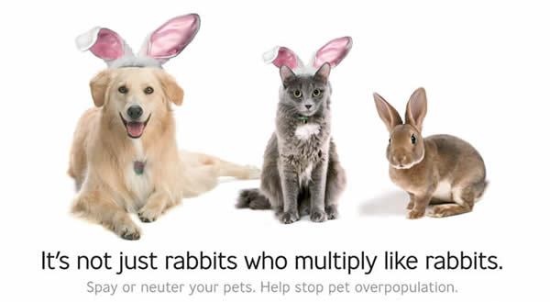
Spaying Complications are Rare
In most cases, complications from these routine procedures are rare.
Far more common are the daily problems caused by pets that are not spayed or neutered.
Spaying your animal before her first heat will allow for a happier and safer animal.
Source: csrahumanesociety.org

