Slide 1
Stem Cells
By C. Kohn Agricultural Sciences, Waterford WI
Produced in collaboration with faculty and staff from the Stem Cell and Regenerative Medicine Center of the University of Wisconsin - Madison, the Wisconsin Institute for Discovery, and TED LLC

Slide 2
Current Limitations of Medicine
Modern medicine has many limitations.
First, much of medicine is non-individualized.
Few medical treatments are specific to an individual’s genetics or history.
Second, damage to the body from injuries or illness can be permanent and untreatable.
For example, some of the damage from a heart attack or stroke is usually permanent, and the patient does not usually obtain a 100% recovery.
In many serious injuries or illnesses, a complete recovery may not be possible.
Finally, the need for tissue or organ transplant is far greater than the supply.
The number of people in need of an organ transplant far exceeds the number of organs available.
Even when a matching donor is found, a transplant may be rejected by the patient’s body.

Slide 3
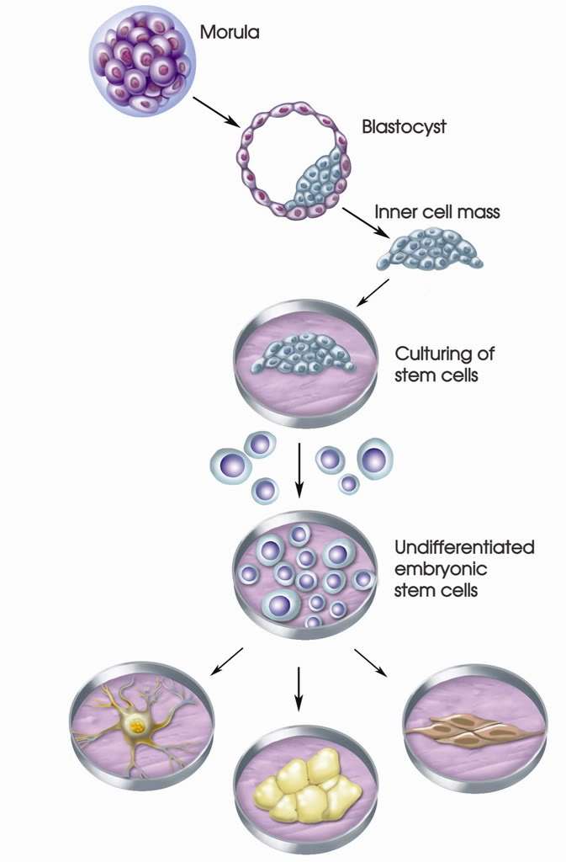
Stem Cells Medicine
Scientists believe that stem cells could help change how patients are treated by modern medicine.
Stem cells have the potential to create more individualized treatments that use the body’s own abilities to repair itself in order to create new tissue and maybe even new organs.
Additionally, stem cells may help scientists better understand why some problems occur, increasing the likelihood of finding effective treatments.
Stem cells are undifferentiated cells that become the kinds of cells that make up your body and replace old cells when they wear out and die.
An undifferentiated cell is a cell that doesn’t have a job…yet.
To differentiate means to acquire a specific job and characteristics.
For example, muscle cells have proteins that allow them to contract; nerve cells can send electrical signals; bone cells are capable of providing a rigid structure to support your body’s weight.
Source: weirdscience.ca

Slide 4
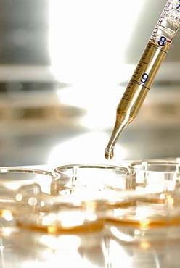
Types of Stem Cells
There are two main kinds of stem cells:
1) Tissue-specific Stem Cells
Also known as “somatic stem cells” or “adult stem cells”
These are stem cells found in all people and are used to replace cells in many kinds of tissue as they wear out and die.
2) Pluripotent Stem Cells
These include embryonic stem cells and induced pluripotent stem cells.
These cells can become any kind of tissue in the body.
Image Source: Jeff Miller, www.news.wisc.edu

Slide 5
Tissue-Specific Stem Cells
Many (but not all) tissues have somatic stem cells that continually replace old cells as they wear out and die.
For example, the base of your intestines have stem cells to replace the cells that are worn off by digestion and the passing of food.
These cells are completely replaced every 4 days!
Similar cells are found in your bone marrow, underneath your skin, and in many other kinds of tissues.
To date, tissue-specific stem cells have been derived from brain, bone marrow, blood, blood vessels, skeletal muscle, skin, teeth, heart, gut, liver, ovarian epithelium, and testis.
Image Source: www.medscape.com

Slide 6
Examples of Tissue-Specific Stem Cells
The following are examples of some kinds of tissue-specific stem cells:
Hematopoietic stem cells found in bone marrow are the source of all kinds of blood cells, including red blood cells and white blood cells.
Mesenchymal stem cells are a source of bone cells, cartilage, fat cells, and tendons.
Neural stem cells are the source of all neurons as well as two kinds of cells that support nerves in the brain and spinal cord.
Epidermal stem cells are found beneath the skin and at the base of hair follicles; these stem cells form the protective outer layer of your skin as well as hair follicles.

Slide 7
Tissue-Specific Stem Cells
Tissue-specific stem cells are multipotent.
Multipotent cell: a cell that can give rise to multiple different types of cells typically found in a specific tissue.
For example, the stem cells beneath your skin can only become the various types of cells that form skin under normal circumstances.
There are already treatments in existence that use tissue-specific stem cells.
While tissue-specific stem cells can only differentiate into a limited number of kinds of cells, it is feasible to treat or even cure some kinds of human diseases or disorders using these stem cells.
Image Source: www.clinicares.com

Slide 8
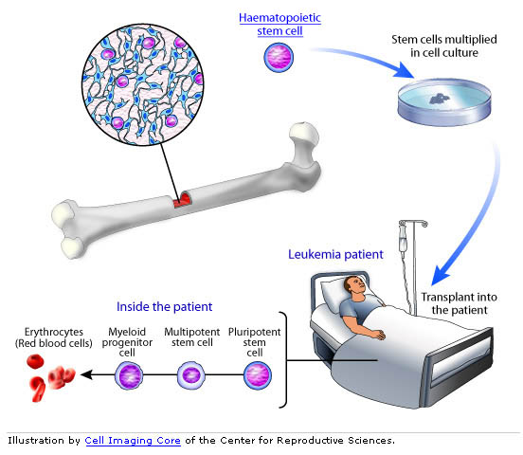
Stem Cell Treatments of Leukemia
Doctors already use tissue-specific stem cells to treat leukemia, a form of cancer that affects the cells in your bone marrow that produce blood cells.
After chemotherapy, a leukemia patient can get a stem cell transplant, replacing the old bad stem cells with healthy new ones.
The transplanted stem cells will perform the same job as the old stem cells – they will produce the blood cells needed by your body.
Scientists believe that some treatments that could be developed from tissue-specific stem cells include the regeneration of damaged or lost bone tissue, treatment of autoimmune diseases, development of insulin-producing cells to treat diabetes, neurodegenerative diseases like Parkinson’s Disease, and the repair of some damaged heart tissue after a heart attack.

Slide 9
Pluripotent Stem Cells
A pluripotent stem cell is a stem cell that can become any kind of cell in the body.
While a multipotent stem cell is generally limited to form the different cell types present in the tissue from which it was obtained, a pluripotent stem cell has the capacity to become any one of the 220 human cell types.
Pluripotent stem cells can also divide indefinitely – unlike tissue-specific stem cells, they will divide forever without losing their developmental potential.
There are two kinds of pluripotent stem cells:
1) Embryonic stem cells, which are developed from fertilized eggs that are leftover from fertility clinics and donated with the patient’s consent.
2) Induced pluripotent stem cells, which are adult cells that have been changed by scientists to have the same properties as embryonic stem cells.

Slide 10
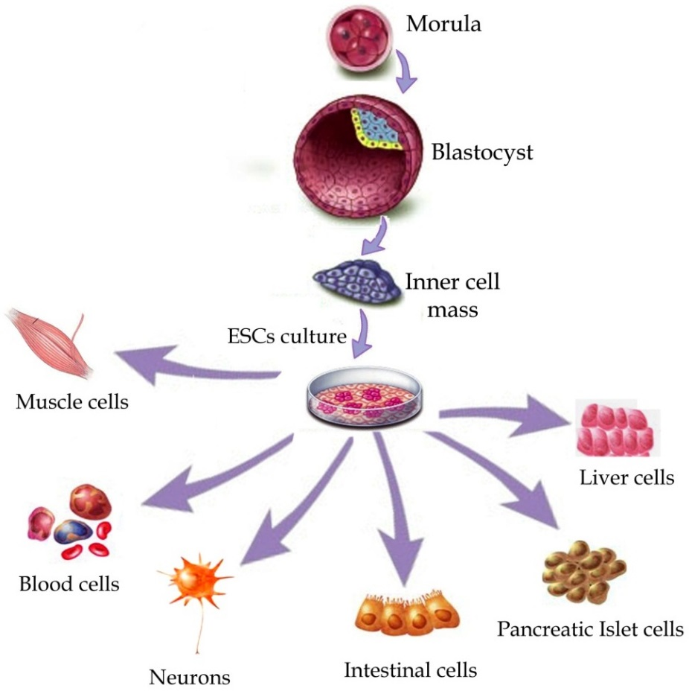
Embryonic Stem Cells
Embryonic stem cells are grown in labs from leftover embryos knowingly donated by patients at fertility clinics.
Embryonic stem cells are derived from the Inner Cell Mass of a 5-7 day old fertilized embryo (also called a blastocyst).
These embryos were fertilized in lab dishes at in vitro fertilization (IVF) clinics.
IVF patients will usually have multiple eggs fertilized in case they are not successful on the first try.
As a result, IVF clinics usually have leftover eggs that patients can choose to donate for research.
Any unused, unneeded embryos are usually discarded.
Image Source: www.intechopen.com

Slide 11
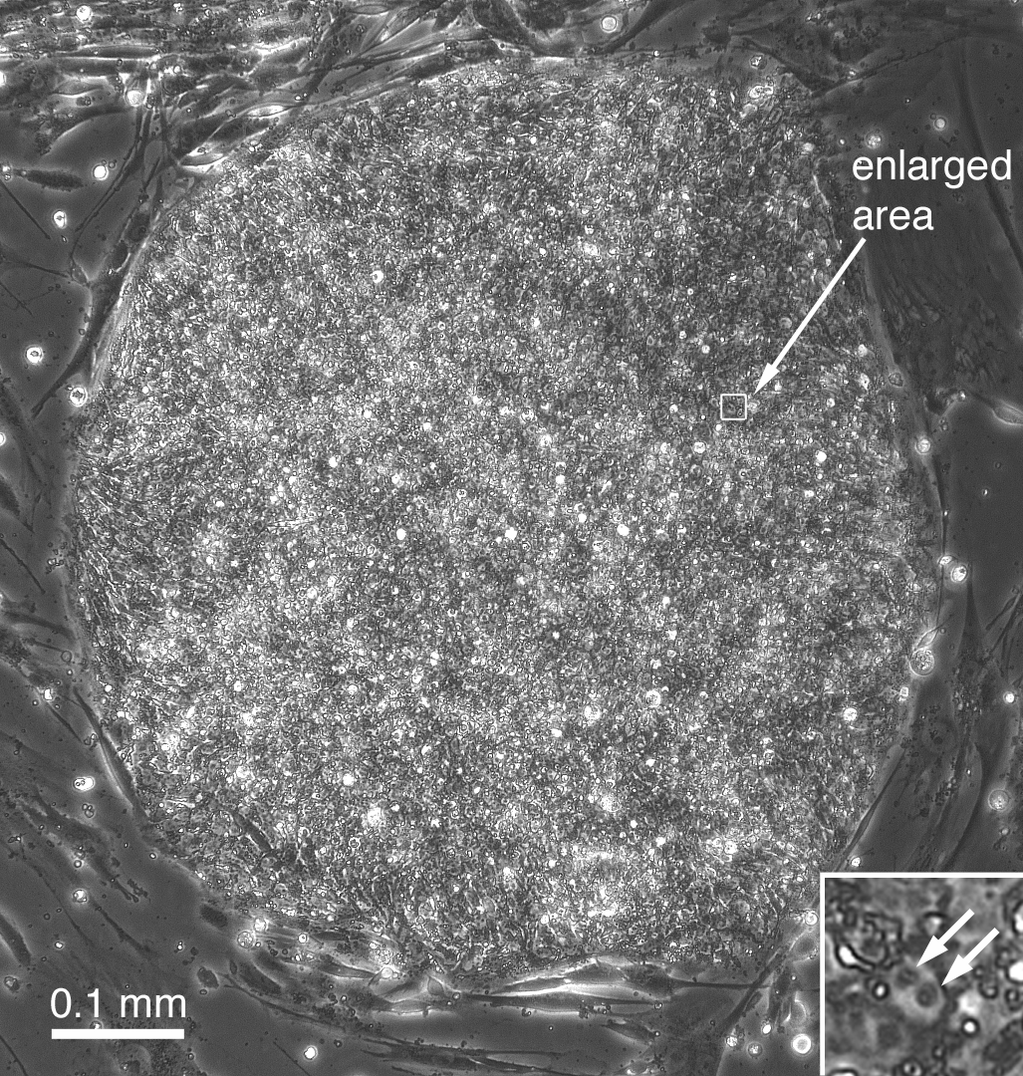
This is a colony of embryonic stem cells under the microscope.
ES cells look as if they have two large nuclei, because they are constantly dividing.
This slide courtesy of James Thomson, Director, Regenerative Biology - Morgridge Institute for Research, University of Wisconsin - Madison
Notes:
This view of a single colony gives you a better close up view of the individual stem cell. They are small with a large nucleus to cytoplasm ratio and often appear to have two distinct nucleoli in each cell. This is because they are constantly dividing. Again, these cells are defined by their proliferitive and developmental potential. After months or years of growth in culture they remain normal. One embryonic stem cell “line” means all of the cell cultures that are grown over time from one initially donated blastocyst, or early embryo.

Slide 12
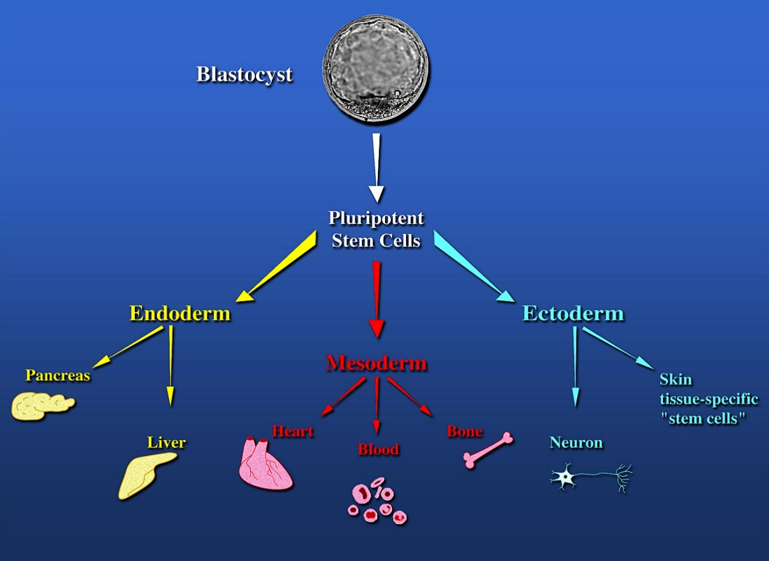
Germ Layers
All tissue in the body comes from the inner cell mass of a 5-7 day old blastocyst. The inner cell mass develops into three germ layers, the endoderm, the mesoderm and the ectoderm.
The endoderm forms soft tissues like the pancreas and liver.
The mesoderm becomes muscle (including the heart), blood, and bone.
The ectoderm forms the skin and nerve cells.
To be a pluripotent stem cell, a stem cell must be able to become all three of these germ layers.
This image courtesy of Jordana Lenon, B.S., B.A. University of Wisconsin-Madison Outreach Specialist

Slide 13
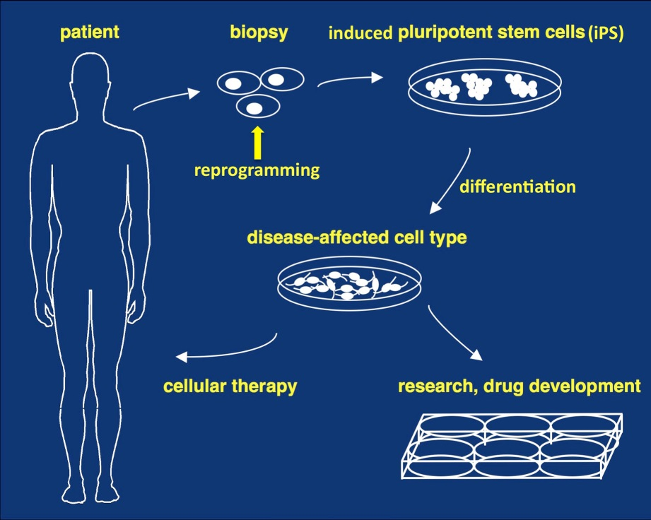
Induced Pluripotent Stem Cells
Induced pluripotent stem cells begin as just normal, mature cells.
These cells might come from skin, the liver, fat, or other sources.
Scientists change these cells in order to make them pluripotent and behave like an embryonic stem cell.
Scientists turn off some genes and turn on other genes of these mature cells so that they have the same set of genes turned on as in embryonic stem cells.
The cell then behaves as if it were an embryonic stem cell, allowing scientists to create a pluripotent stem cell without destroying a lab-fertilized embryo.
IPSC’s also be patient-specific. If a patient has a disease, scientists could recreate their actual cells to see how their body would specifically respond to new treatments before administering new therapies.
Image Source: wa3230.mj13.serverdomain.org

Slide 14
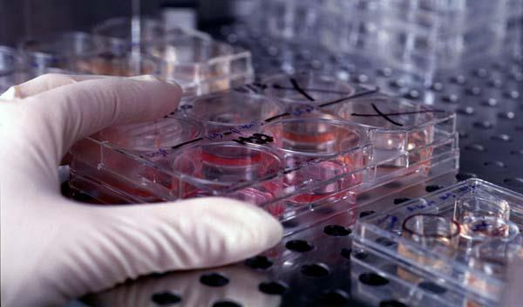
Advantages of Pluripotent Stem Cells
Both kinds of pluripotent stem cells (embryonic and induced pluripotent) have potential advantages over tissue-specific stem cells. These include:
They can become any of the 220 kinds of tissue in the human body.
They can divide in culture for long periods of time without losing their functionality.
They can be used for research on normal and abnormal development such as birth defects.
However, pluripotent stem cells have some disadvantages as well.
Embryonic stem cells are controversial because they require the destruction of an egg fertilized in a laboratory dish.
Induced pluripotent stem cells are difficult to create and are new to science.
It is very challenging to create mature, differentiated cells from pluripotent stem cells.
Photo courtesy of the University of Wisconsin Stem Cell and Regenerative Medicine Center Facebook page

Slide 15
 | Tissue-Specific Stem Cell | Embryonic Stem Cell | Induced Pluripotent Stem Cell
Also known as… | Adult Stem Cell Somatic Stem Cell | ESC | IPSC
Source | Found throughout the body in some kinds of tissue. | The inner cell mass of a 5-7 day old embryo fertilized in a laboratory dish. | Comes from normal mature bodily cells that have been reprogrammed genetically to resemble an embryonic stem cell.
Multipotent or Pluripotent? | Multipotent | Pluripotent | Pluripotent
Benefits | Can differentiate into relevant cell types for a given tissue. Widely available; found in all people. | Can become any cell type present in the body. Can divide forever. Will not lose their function over time. Useful for studying development. | Can become any tissue. Can divide forever. Will not lose their function over time. Less controversial than ECS’s. Can re-create diseased tissue for treatment-specific testing.
Drawbacks | Limited capacity to become kinds of tissue. Difficult to keep alive in a laboratory for long periods. | Less available; requires the destruction of a lab-fertilized egg. | Most difficult of the three kinds to obtain and create. Much research is still needed to develop treatments.

Slide 16
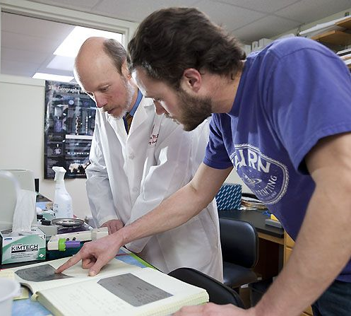
Current Areas of Pluripotent Stem Cell Research
Understanding Reproduction and Development
By studying embryonic and induced pluripotent stem cells, scientists can better understand how early cells and genes form and how this may affect development.
This may enable scientists to better understand how birth defects, cancers, and degenerative diseases occur.
Regenerative and Transplant Medicine for Treating or Curing Disease
Pluripotent stem cells may have the capability to become new tissues and possibly organs for transplant after an injury or illness.
Currently the number of people in need of a transplant is far greater than the supply of transplant tissue and organs.
Stem cells may provide more organs and tissue for transplant as well as provide tissue for transplant that currently is not available for treatments (such as is the case in paralysis).
Photo courtesy of the University of Wisconsin Stem Cell and Regenerative Medicine Center Facebook page

Slide 17
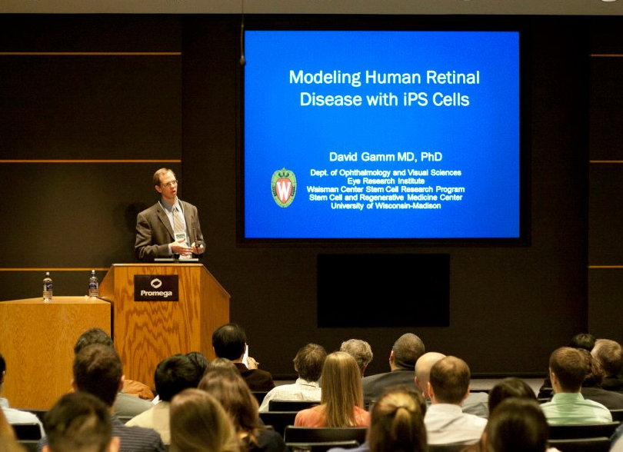
Current Areas of Pluripotent Stem Cell Research
Drug Discovery
Scientists need pure cultures of specific kinds of tissue on which to test new drugs.
This can provide them the opportunity to determine how to make a functional drug, decide at what level a drug becomes dangerous, and identify any possible side effects before doing human drug trials.
Current pluripotent stem cell research is focusing on cures or treatments for the following: Parkinson’s, diabetes, heart disease, spinal cord injuries, muscular dystrophy, leukemia, lymphoma, arthritis, autism, Down syndrome, sickle cell anemia, and more.
Photo courtesy of the University of Wisconsin Stem Cell and Regenerative Medicine Center Facebook page

Slide 18
Regulation of Embryonic Stem Cell Research
Researchers who work with stem cells must follow strict guidelines. These include:
Guidelines created by the U.S. National Academies of Science and the International Society for Stem Cell Research cover the ethical creation of embryonic stem cell lines.
These guidelines address proper research practices involving these lines and are updated to address any new ethical issues that might arise.
Special oversight committees exist at research institutions and must review and approve all embryonic stem cell research.
If federal funds are used to conduct embryonic stem cell research, these stem cell lines must be approved by the federal government and must follow guidelines created by the National Institutes of Health.

Slide 19
Acknowledgements
Thank you to the following contributors and reviewers who assisted in the development of these materials:
James Thomson, Director, Regenerative Biology - Morgridge Institute for Research, University of Wisconsin - Madison
William Murphy, Co-director of the UW Stem Cell & Regenerative Medicine Center and Associate Professor, Biomedical Engineering, University of Wisconsin - Madison
Timothy Kamp - Co-director of the UW Stem Cell & Regenerative Medicine Center and Professor of Medicine, University of Wisconsin - Madison.
Jordana Lenon - University Relations Specialist, UW Stem Cell & Regenerative Medicine Center
Sue Gilbert - UW Stem Cell & Regenerative Medicine Center
The staff of TED, LLC
All image sources are located below each picture.
Any non-cited images are Microsoft stock images.

