Slide 1
Taxes
By C. Kohn
Agricultural Sciences
Waterford, WI

Slide 2

Taxes in America
Americans pay taxes to three levels of government: federal, state, and local.
Americans pay taxes in four major categories:
  Taxes on Purchases
  Taxes on Property
  Taxes on Wealth
  Taxes on Earnings
Taxes on Purchases: this category includes state sales taxes as well as taxes on specific goods such as cigarettes and alcohol.
Source: www.smartgivers.org

Slide 3
Taxes on Property
Taxes on Property: these are usually local taxes on homes and businesses and pay the much of the cost of creating and maintaining roads, schools, police and fire protection, and other services.
  In Wisconsin, all general property is subject to taxation unless specifically exempt.
All property is assessed each year and the value assessed is required by the State Constitution to be that which would likely “be obtained at a private sale”.
  In Wisconsin, personal property is taxed locally while manufacturing property is taxed by the state’s Department of Revenue to ensure equal assessment and uniform treatment of all Wisconsin manufacturers.

Slide 4

Taxes on Wealth
Taxes on Wealth: in general there are two kinds of taxes on personal wealth.
  The Estate Tax is a tax on an individual’s right to transfer property after their death.
    The total value of all your possessions is called your Gross Estate. This may include cash, real estate, insurance, trusts, etc.
  Because some things are exempt from taxation (such as estate left to a spouse, charitable deductions, debt, and losses due to the expense of selling the estate), usually not
  everything in an individual’s
  Gross Estate is taxable.
  The portion that is taxable
  is called the Taxable Estate.
Source: www.aicpa.org

Slide 5
Taxes on Wealth
If an individual’s estate is worth more than $5 million (as of 2011), filing of an estate tax is required, unless the estate is being passed onto a spouse.
  Farms operated as family farms usually qualify for a reduced estate tax bill (usually up to just over $1 million). A similar deduction for family-owned businesses was revoked in 2004.

Slide 6
Taxes on Wealth
State Inheritance Tax: While Wisconsin imposes an estate tax, this tax has been inactive for deaths beginning in 2008. This is because of changes to federal law in recent years.
  The Wisconsin estate tax is a “pick-up tax”, meaning it allows the state to pick up a share of taxes that would otherwise have been paid to the federal government upon the transfer of an estate.
  Because Wisconsin’s estate tax depended on collection of federal estate taxes, action at the federal level has kept and will continue to keep Wisconsin’s estate tax dormant into the future (source: dor.state.wi.us).

Slide 7
Taxes on Earnings
Taxes on Earnings: This category includes income tax and Social Security Tax.
  Federal Income Tax is what most people think of when they hear the word “taxes”. This is the tax the tax we most associate with the April 15th deadline.
  The US Federal Income Tax was created with the passage of the 16th Amendment to the US Constitution in 1913.
An income tax is any tax imposed on income generated by all citizens of a country or jurisdiction.
  By law, business and individuals must file an income tax every year for the purpose of determining if they owe any taxes.
  The US Federal Income Tax is the key source of funds for the federal government and funds most of its activities.

Slide 8

Taxes on Earnings
Social Security tax is a tax applied to income from working.
  All employees and self-employed business owners pay into the Social Security system through this tax.
  All Americans pay a single rate of 12.4% of their wages or income from self-employment (up to the maximum wage base; in 2013 this was $113,700).
Half of this tax is paid by the employee and is taken directly out of their paycheck.
  The other half is paid
  by the employer.
  Self-employed individuals
  pay the full 12.4% as they
  are both the employee and
  the employer.
Source: www.bankrate.com

Slide 9
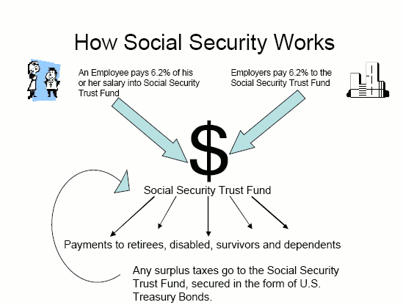
Taxes on Earnings
The Social Security tax is used to fund Social Security retirement benefits, benefits for widows and widowers, and disability benefits.
  The money you pay into Social Security today pays for the benefits received by retirees, those with disabilities, and widows/widowers today.
  When you need to
  collect this money for
  any of those reasons,
  the money you
  receive will be paid
  by the wages of those
  currently working and
  paying into the Social
  Security system.
Source: socialsecurity.procon.org

Slide 10
Tax Evasions vs. Tax Avoidance
The goal of any taxpayer should be to pay what is fair and legally required but take advantage of all tax benefits.
  Tax evasion is illegally failing to pay all taxes that are owed (such as if you failed to report all income you received in a year).
  Tax avoidance is any legal and legitimate method to reduce your obligation to the minimum that you owe.
  Tax avoidance is encouraged by the federal government and services are available to assist you with this. Tax evasion is illegal and could result in heavy penalties and even jail time.

Slide 11
Adjusted Gross Income
To determine what you owe for federal income tax, you must first determine your Adjusted Gross Income.
  AGI is what is left after you subtract adjustments (or deductions) from your gross income.
  Gross income is the sum of your earned income (wages, salary, tips, and bonuses), plus your investment income (dividends and interest), plus your passive income (from a partnership, for example).
Gross Income =
Earned Income + Investment Income + Passive Income.

Slide 12
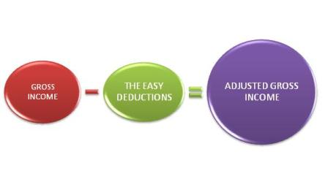
Adjusted Gross Income
Adjusted Gross Income = Gross Income – Personal Exemptions/Deductions.
  Personal Exemptions/Deductions can include alimony, retirement fund contributions, college tuition or money paid on student loan interest
  Adjusted Gross Income is the total income that is subjected to income tax; AGI directly determines your final income tax bill.
AGI can also impact your state taxable income.
  Many states
  use your AGI
  as the starting
  point for
  calculating your
  state taxable
  income.
Source: www.tuition.io

Slide 13
Deductions
A Tax Deduction is the amount subtracted from Adjusted Gross Income (AGI).
  AGI – Tax Deduction = Taxable Income.
  Tax Deductions can take two forms: Standard Deductions or Itemized Deductions.
Standard Deductions are the base amount of income that is not subject to tax and that can be used to reduce a taxpayer’s adjusted gross income (AGI).
  A standard deduction can only be used if the taxpayer does not choose to use the itemized deduction method.
  The primary reason for using a standard deduction (and not an itemized deduction) is because you wouldn’t have to keep track of possible deductible expenses throughout the year.
  It is usually generous enough that it may even exceed the amount deducted through Itemized Deduction.

Slide 14

Deductions
Itemized Deductions are those determined by calculating the amount of money spent on certain goods and services throughout the year. This may include expenses such as mortgages, state and local taxes, gifts, and medical expenses.
  Usually an itemized deduction is limited to a certain percent of your gross income.
  This is an alternative to
  standard deductions but
  requires the taxpayer to
  keep track of their
  expenses and receipts
  throughout the year.
Source: blog.boelmanshaw.com

Slide 15
Deductions
Individuals with large medical expenses, who make large donations, or who pay large state and local tax bills may have a lower federal tax bill with itemized deductions.
  However, there is often a threshold that must be exceeded in a particular category before those expenses are eligible.
    For example, you can only deduct the amount of your medical bills that exceeds 7.5% of your AGI.
    If your medical bills equaled 10% of your AGI, you could only deduct a quarter of those expenses.
    The lower your AGI, the more of your medical bills that you can deduct.

Slide 16

Exemptions – Personal
To calculate your taxable income, you must determine both your gross income, your deductions, and your exemptions.
  Exemptions are deductions for yourself, your spouse, and any dependents.
  Exemptions reduce your taxable income.
There are two kinds of exemptions – personal and dependents.
  Personal exemptions are for
  yourself; you may always
  claim one exemption for
  yourself if you are not
  someone else’s dependent.
Source: www.taxrates.com

Slide 17
Dependents
Dependents are those who depend on your income; you may claim your spouse only if you file separate returns and they claimed no gross income (you cannot claim a spouse if you file jointly).
  A dependent is generally a child or qualifying relative who is financially dependent on your income.
  If you are the dependent on another person’s return, you may still have to file your own tax return.
Whether or not you personally have to file depends on several factors including the money you’ve earned, your marital status, and any special taxes you owe.
  If you are a dependent, you may not claim an exemption.
  Dependents must also be US citizens (for US taxes) unless the dependent is an adopted child.

Slide 18
Tax Brackets
Once you have calculated your gross income, subtracted all deductions and exemptions, and determined your Adjusted Gross Income, you must determine your tax bracket.
  A tax bracket is simply the rate at which an individual is taxed based on their income.
  Tax brackets are determined by income levels; because the United States has a progressive tax system, the higher your income, the greater the percentage that you pay.
If your income exceeds the limit of one tax bracket, any dollars you earn above that amount are taxed at a higher percentage rate.

Slide 19
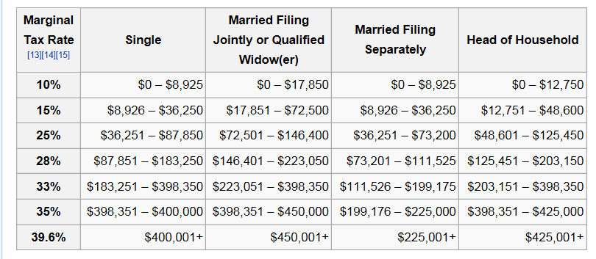
For example, let’s say you earn $40,000.
  Your first $8,925 are taxed at 10%, all of the dollars between $8,926 and $36,250 are taxed at 15%, and the rest are taxed at 25%.
  Your tax then is ($8,925 * .10) + (27,325 * .15) + (3750 * .25) = $5,928.75. $5,928.75 of your initial $40,000 puts you in the 14.82% tax bracket overall.

Slide 20
AMT and Tax Credits
Occasionally an individual will have an excessive amount of deductions.
  In this case, they will be expected to pay the Alternative Minimum Tax (AMT).
  This tax is designed to ensure that those who receive tax breaks also pay their fair share.
Individuals may qualify for tax credits.
  Unlike deductions or exemptions, which are calculated before AGI is determined, tax credits are those that are subtracted directly from the amount of taxes owed.
  Examples include adoption tax credits, retirement tax credits for savings plans, foreign tax credits, etc.
  While a tax credit for $100 would reduce your tax bill by $100, a tax deduction of $100 would reduce your AGI by $100 (and if you were in the 35% tax bracket, reduce your tax bill by $35).

Slide 21
Final Tax Bill
In sum, your final tax bill =
[Gross Income – Deductions & Exemptions] x [Tax Bracket Percentage] – [Tax Credit]
To file your taxes, you would use one of five filing status categories, which include:
  Single (or legally separated)
  Married, filing jointly
  Married, filing separately
  Head of Household (unmarried individual who has dependents)
  Widow or Widower

Slide 22

How to do your taxes
You can choose to do your own taxes, or you can hire a tax service to assist you.
  Tax services range from a single-person office to a Certified Public Accountant (CPA) to a government-approved tax expert to an attorney.
  You can also use tax software to aid your tax preparation.
Source: creativefinancialconsultantsinc.com

Slide 23
W-2’s and W-4’s
Those with minimal items to report (e.g. if you are single, have one source of income, and have no dependents or itemized deductions) can very easily complete their own tax forms.
  Much of the information you need will be provided to you on a W-2 form.
A W-2 form is a form provided by your employer to the federal government and to you showing your wages, tips, and other forms of compensation.
  It will also indicate what has been withheld from your check over the course of that year for federal income tax, social security, and Medicare.
  A W-2 form is sent to employees who have completed a W-4 form, which is the form that employees complete to help their employers determine how much money to withhold from their paycheck.

Slide 24
Taxes & Personal Responsibility
Regardless of if you complete your taxes on your own or if you use a tax service, you are responsible for providing complete and accurate information and for paying the proper amount of taxes each year.
  If you hire a professional and they make a mistake, you are still responsible for paying the correct amount plus interest on that amount plus penalty fines.
Those who incorrectly file their taxes may be subject to a tax audit, which is an examination of a tax return by the IRS to verify that it was filed correctly.
  Less than 1% of all tax returns are audited. However, the penalties for not filing your taxes correctly can be very severe and may even involve jail time.
    Underpayment due to negligence or fraud can result in penalties of up to 50-75% as well as interest.

Slide 25
Audits & Extensions
Audits may take three forms:
  A correspondence audit is simply a minor question sent to you by the IRS.
  An office audit takes place at an IRS office, requiring you to explain a situation in person and/or bring evidence to back a claim.
  A field audit is the most complex form, and involves an IRS agent visiting you at your home, office, or at your accountant’s office.
If you feel you are unable to complete your tax return on time, it is better to file for an extension than risk having an audit.
  Filing a Form 4868 grants an automatic six-month extension.
  This form must be submitted with an estimation for the tax that is due by April 15th.

