Slide 1
Teaching Strategies for Natural Resources and Environmental Science
By C. Kohn
Michigan State University
2016 National FFA Convention

Slide 2
Welcome!
Who I am
Ag Student → Ag Instructor → Ph.D. Student
Standards & Curriculum Writing
My Research – Three Circle Model & Sustainability in Agriscience
Visit wuhsag.weebly.com or NAAE CoP for curriculum.
Today’s Schedule
Overview of AFNR Standards Structure
NGSS Alignment
Sample Classroom Activity
Questions, Discussion, and Workshop Evaluation

Slide 3
Caveats
I’m not an expert.
While what I will show you is based on evidence and best practices, it is more of “what worked in my classroom” than “what will work in every classroom.”
Not all ‘experts’ agree on this – i.e. this is a way (not the only way) to view these ideas & philosophies.
You might do some of this already. If you do and it works, awesome.
You might be able to do other things and still be effective. This is just one approach to effective teaching.
This will look different from what many are used to in agricultural education.
All fields of science education are changing rapidly and dramatically – this is a sign we are starting to figure things out ☺

Slide 4
2015 AFNR Standards (Env. Systems)
Notes:
The 2015 AFNR National Standards, which are organized in three levels.
The broadest level entails the Common Career Technical Core (CCTC) Standards – these are standards that apply to all types of CTE courses.
Within the CCTC standards are the Performance Indicators. These are the “actual standards” as we typically think of them, and reflect what the National Council for Agricultural Education (or “The Council”) believes to be the specific content necessary for proficiency in a given agricultural course.
Finally, each Performance Indicator has Sample Measurements. These sort of look like what we would assume are the standards, but are actually more like suggestions for what a teacher could provide in their curriculum to satisfy the Performance Indicators and the 2015 AFNR National Standards as a whole.

Slide 5
CCTC’s → P.I.’s → S.M.’s (A.I.M.)
Notes:
The sample measurements are also reflective of problem solving approaches in education. These measurements are organized into three columns, with the leftmost column being the standards pertaining to awareness (terms, vocab, concepts, etc.). The middle column includes the intermediate concepts, which involve the application of the basic knowledge for a given Performance Indicator. The rightmost column includes the mastery concepts. These tend to focus on having students make predictions about unknown situations, apply lessons in a manner similar or identical to a workplace situation, or utilize large amounts of content to reach a conclusion. Notice that Mastery does not consist of perfect memorization of terms or concepts; this is still the Awareness level (the most basic of the three). Mastery can only come about when a student is able to apply their decision-making skills in a real-world scenario, often in a group-based situation that involves hypothesis formation, data collection & analysis, and communication of interpretations.

Slide 6
3D Learning in Next Generation Science
Notes:
NGSS is composed of three dimensions of learning. A curriculum is NOT aligned to NGSS unless it uses all three of these dimensions of learning in a coherent, continuous manner (i.e. having a unit on the scientific method at the start of a class does not constitute alignment of NGSS; to be NGSS-aligned, a curriculum has to continually implement scientific and engineering practices into the curriculum throughout the entirety of the class).

Slide 7
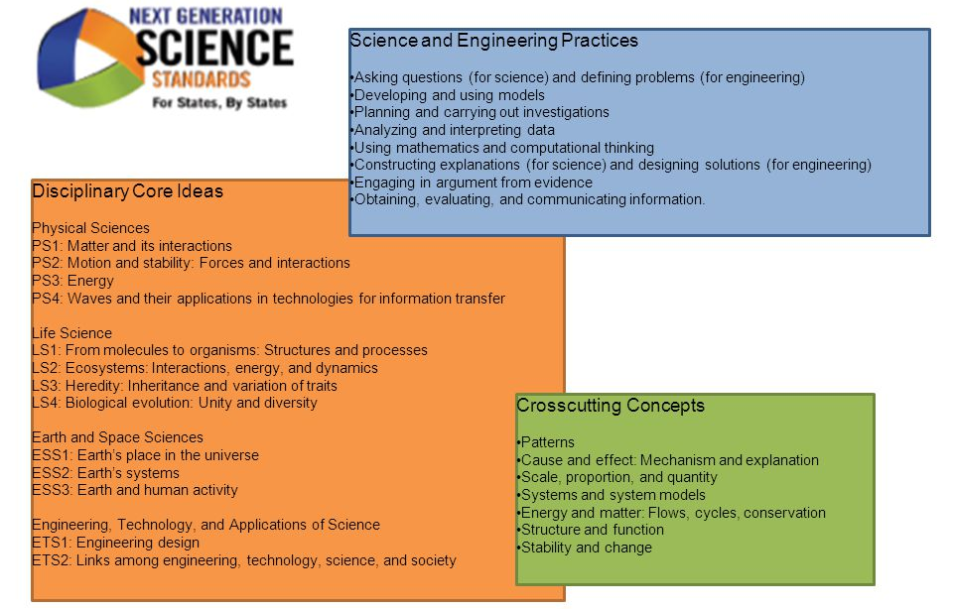
Next Generation Science Standards
Notes:
Notice that the disciplinary core ideas (what we typically think of as the ‘content standards’) are very broad. This is very intentional. Teaching a curriculum that is a ‘mile wide and an inch deep’ does almost nothing to develop scientific literacy in students, nor does that content stay with students in a reliable manner (i.e. they largely forget it once the test is done). Instead, the emphasis has shifted to allowing for deeper comprehension through 3D learning.

Slide 8
Next Generation Science Standards
Notes:
Inquiry-based learning should entail making observations and collecting data, identifying patterns in the data and observations, and developing intellectual models that can both explain what is happening as well as predict what might happen in a situation that involves similar phenomena.
Moving ‘up the triangle’ means that students are using data and observations to determine patterns. Moving ‘down the triangle’ means that students are using these patterns to construct models and explanations. Once students have succeeded in doing this, the instructor should provide an additional scenario to them to see if they can successfully address the question or problem without the direct assistance of the instructor or from scaffolding in the curriculum.

Slide 9
AFNR & NGSS: AIM vs. 3D Learning
Awareness: Developing an awareness and comprehension of Disciplinary Core Ideas and Cross Cutting Concepts
Intermediate/Interaction: Use of Cross Cutting Concepts and Scientific/Engineering Practices in guided application situations.
Mastery: Seamless use of DCIs, CCCs, Scientific/Engineering Practices in an increasingly un-coached, unstructured, real-world setting.
Notes:
AFNR and NGSS have some overlap (not perfect but very complementary).

Slide 10
Scientific Literacy
The primary goal of NGSS is scientific literacy.
Because 90% of students in general science courses do not become scientists or engineers, the shift in education is away from a ‘mile wide, inch deep’ curriculum to one that prepares all students to be able to think like scientists in their daily lives.
NGSS is about the mainline (literacy), not the pipeline (careers).
General science courses are about preparing students to be future sense-makers and functionally literate in science.
Higher-level & elective science courses are still available for the pipeline science-career students.
AFNR is a mix of mainline (literacy) and pipeline (careers).
Your classes might fall into both categories (e.g. Intro Ag may be about agriscience literacy, while higher level courses may be about pipeline agriscience-career students).

Slide 11
Example Activity – Bug Biodiversity
See handouts.
Posted at http://wuhsag.weebly.com/natural-resources.html under Week 3.
BIG IDEA: The health of an ecosystem can be measured by its level of biodiversity.
The greater the biodiversity, the healthier and more stable the ecosystem, and the more services that can be provided by that ecosystem (nutrient cycling, pollination, elimination of pollutants, etc.).
Greater biodiversity = greater sustainability.

Slide 12
Use the triangle to assess your findings:

Slide 13
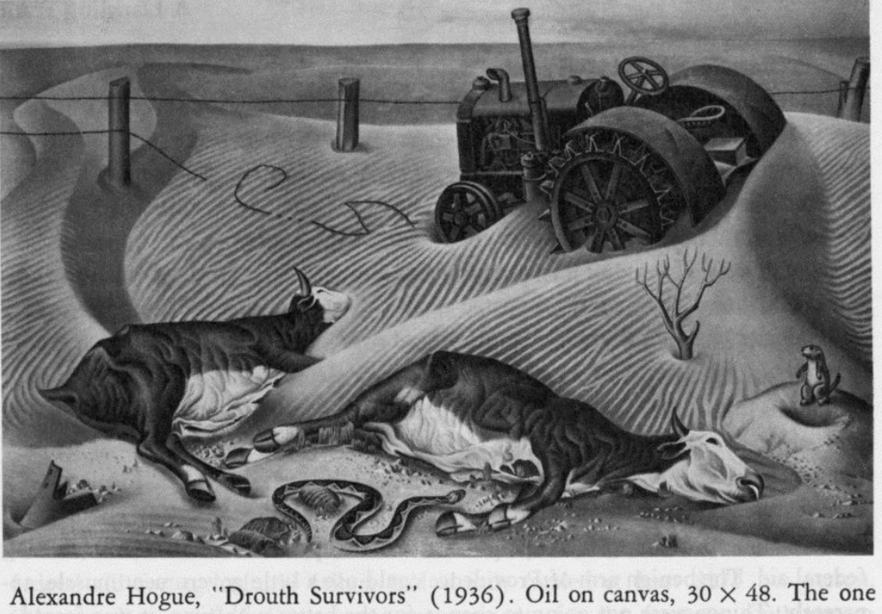
Sustainability
Sustainability refers to choosing practices that allow for needs to be met without compromising the ability of future generations to meet those needs.
A concern to agriculture due to the effects of modern lifestyles.
E.g. temps in eastern Africa have increased by 1.5 ℉ in the past century, resulting in a 15% decrease in rainfall (National Geographic, 2016). (Dust Bowl II?)
Farming in this region has become difficult as yields continue to decrease by an estimated 20%.
BIG QUESTION – what practices and changes can we adopt in ag, forestry, and science to ensure that our lifestyle can continue for many more years?

Slide 14
Questions & Discussion

Slide 15
Future Work
Research by Redman & Redman (2014) also came to the conclusion that teaching about sustainability alone does not result in behavioral changes; procedural and social knowledge are vital to this goal.
Chawla and Cushing’s 2007 concluded that the most effective sustainability education had extended duration of time, allowed for opportunities to learn and practice skills, and resulted in the accomplishment of a specific goal.
These instructional models are similar to the 3-circle model of ag ed, leading to the submission of a Graduate Research Fellowship application with the National Science Foundation (NSF).
Michigan State University and the NSF has fully funded my research for 5 years on this topic.
Current intention is to draft a curriculum next year, implement a pilot test in 2017-18, and implement a full version in 2018-19.
If interested in being a part of this project, please visit wuhsag.weebly.com.

