Slide 1
Tests of Water Quality
By C. Kohn
Agricultural Sciences
Waterford, WI

Slide 2
How do we know?
How do we know if a lake has become or will become eutrophic?
How would we know if toxins or mutagens are upsetting the energy flow and nutrient cycles of an aquatic ecosystem?
It is not usually readily evident, and lakes, rivers, and streams that seem fine on the surface may be collapsing without providing any visible signs.

Slide 3
Tests of Water Quality
Temperature
Dissolved oxygen – the amount of oxygen present in the water
Nitrogen – a measure of one category of nutrients that can cause eutrophication
Phosphorus – a second category of nutrients that can cause eutrophication
Heavy metals – likely to lead to biomagnification
Macroinvertebrates – small aquatic insects that provide a long-term indication of the health of an aquatic ecosystem.
pH – how acidic or basic the water is

Slide 4
Temperature
Thermal pollution is the increase in water temperature caused by adding relatively warm water to a body of water from industry (e.g. power plants) or urban activities (e.g. run-off from sidewalks and streets).
Cool water can hold more oxygen than warm water because gases are more easily dissolved in cool water.
Steam can’t hold any oxygen
Ice can hold oxygen for extremely long periods of time
Oxygen levels usually decrease in warmer waters both because of a lowered ability of the water to hold oxygen and because of increased oxygen use by bacteria
Decomposing bacteria are more active in warmer waters.
More decomposition means less oxygen

Slide 5
Warmer Waters = Less Oxygen
Human activity can raise the temperature of water in numerous ways, including…
Directly adding warm water to a body of water, such as when water is used to cool industrial machines and then is returned directly to the lake, river, or stream it was taken from
Removing shoreline trees can also increase temperature by allowing direct sunlight to warm the water.
Soil erosion, which causes soil particles to enter the water, can also raise the temperature of the water
The absorbed sunlight is turned into heat when it hits the darker colored soil suspended in the water.
Precipitation running over pavement will also be warmer when it enters a body of water.

Slide 6
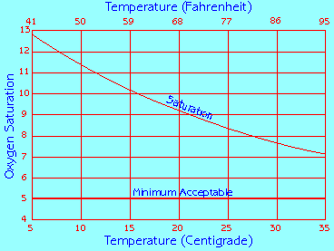
Maximum oxygen that the water can hold at the given temperature.
Level at which aquatic life cannot be supported

Slide 7
Dissolved Oxygen as a function of temperature
The temperature determines the maximum oxygen that water can hold.
Cold water holds more oxygen than warm water.
As water gets colder, the maximum amount of oxygen that the water can hold increases.
Water with dissolved oxygen below 5 mg/L is unsuitable for most kinds of aquatic life.
Dissolved oxygen can be measured with a conductivity probe.

Slide 8
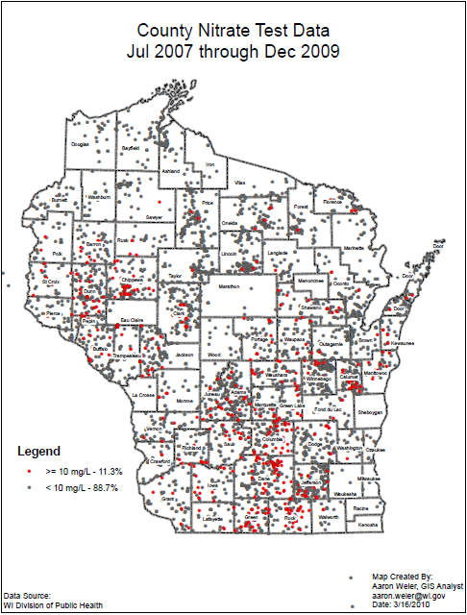
Nitrogen, Nitrates, and Ammonia
Nitrogen is an element needed by all living plants and animals to build protein.
It is most commonly found as N₂, composing 78% of the air we breathe.
Manure is rich in two forms of nitrogen: nitrate (NO₃) and ammonia (NH₃).
These can cause eutrophication.
Excess nitrates can come from sewage, inadequate waste water treatment plants, and improperly functioning septic systems.
Source: co.winnebago.wi.us

Slide 9
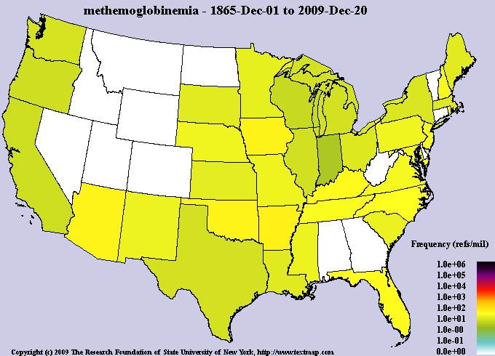
Sources of nitrogen
Other important sources include excessive fertilizer use (on fields and lawns) and improperly constructed barnyards and feedlots.
Water with high concentrations of nitrates can cause methemoglobinemia, or blue-baby syndrome.
This condition results when nitrates prevent a baby’s blood from taking in oxygen, quickly causing death.
Instead of binding to molecules of oxygen, the red blood cells bind to nitrates, reducing or preventing oxygen uptake.
In methemoglobinemia, the hemoglobin is unable to release oxygen effectively to body tissues.
textmed.com

Slide 10
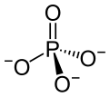
Phosphorus
Phosphorus – phosphorus is another element found in fertilizers and other sources that can cause eutrophication.
Phosphates, or PO₄³⁻, are widely used in fertilizers, detergents, and municipal water systems.
Like nitrogen, phosphorus and phosphates can cause algal blooms and eutrophication.
This has led many local governments to ban phosphorus-based fertilizers in order to reduce the impact of eutrophication on lakes, rivers and streams.
wikipedia.org/wiki/Phosphate

Slide 11
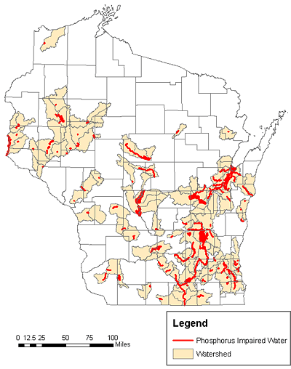
Phosphorus in Wisconsin
In Wisconsin:
172 lakes and streams are formally listed as impaired due to phosphorus pollution
Last year, 35 people in Wisconsin reported human health concerns and the death of at least two dogs due to blue-green algae.
Recent statewide stream assessment data suggests that thousands of streams may have excess phosphorus levels.
Excess phosphorus causes major changes in lake and stream food webs, which ultimately result in fewer fish and fish predators.
Source: http://dnr.wi.gov/news/mediakits/mk_phosphorus.asp
Source: dnr.wi.gov

Slide 12
Heavy Metals
Living organisms require trace amounts of some heavy metals.
Excessive levels of essential metals, however, can be deadly to a living organism.
The biggest threats to surface water systems are cadmium, chromium, mercury, lead, arsenic, and antimony
Source: http://www.water.ncsu.edu/watershedss/info/hmetals.html

Slide 13
Heavy Metals: Lead
Lead: Because of size and charge similarities, lead can substitute for calcium and included in bone.
Children are especially susceptible to lead because developing skeletal systems require high calcium levels.
Lead that is stored in bone is not harmful, but if high levels of calcium are ingested later, the lead in the bone may be replaced by calcium and the lead will be released at high levels into the body.
Once free in the circulatory system, lead may cause neurological damage to the brain and spinal cord
Source: http://www.water.ncsu.edu/watershedss/info/hmetals.html

Slide 14
Heavy Metals: Mercury
Mercury: When mercury enters water it is often transformed by microorganisms into a more toxic form.
Symptoms of acute poisoning include inflammation of the digestive tract, vomiting, kidney and liver damage, and circulatory collapse.
Chronic poisoning is usually a result of industrial exposure or a diet consisting of contaminated fish (mercury is the only metal that will bioaccumulate).
Source: http://www.water.ncsu.edu/watershedss/info/hmetals.html

Slide 15
Heavy Metals
Slightly elevated metal levels in natural waters may cause the following effects in aquatic organisms:
1) change in the structure of living tissues
2) suppression of growth and development, poor swimming performance, changes in circulation
3) change in biochemistry, such as enzyme activity and blood chemistry
4) change in behavior
5) and changes in reproduction (Connell et al., 1984).
In comparison to freshwater fish and invertebrates, aquatic plants are equally or less sensitive to heavy metals.
The water resource should be managed for the protection of fish and invertebrates, in order to ensure aquatic plant survivability
Source: http://www.water.ncsu.edu/watershedss/info/hmetals.html

Slide 16
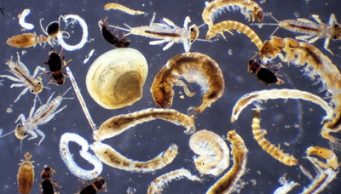
Macroinvertebrates
Macroinvertebrates are basically aquatic bugs.
These aquatic bugs are bioindicators, or organisms that provide a lot of information about the health of an aquatic ecosystem.
Macroinvertebrates are excellent indicators of water quality because they cannot move to a new section of water if it becomes unsuitable for life.
Examples of macroinvertebrates include aquatic insects, snails, crayfish, and worms.
They typically live on the bottom of an aquatic ecosystem,
They are often sampled by sifting a stream or lake bottom with a sieve or a filter.
ecologyadventure2water.edublogs.org

Slide 17
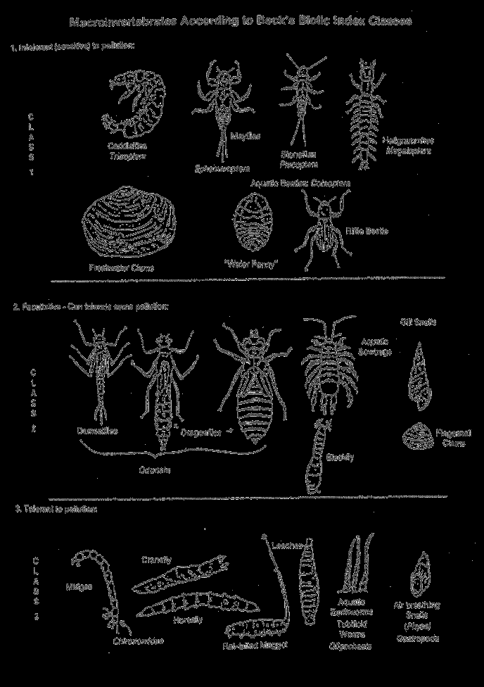
Macroinvertebrates
A major advantage of using macroinvertebrates as quality indicators is that they provide evidence of water quality over a long stretch of time.
While temperature, pH and other tests can fluctuate day to day and even hour to hour, macroinvertebrates show long-term trends in water quality.
The disadvantage of macroinvertebrates is that they cannot tell us exactly what the cause of the problem may be.
They just indicate that we have a problem.

Slide 18
Macroinvertebrates
The presence of a mixed population of macroinvertebrates indicates that water quality has been suitable for a while.
The absence of some macroinvertebrates may indicate that this body of water is not suitable for fish or other aquatic life.
Macroinvertebrate testing can also be known as EPT Testing.
“EPT” stands for Ephemeroptera, Plecoptera, and Trichoptera,
These are three highly sensitive species also known as mayflies, stoneflies, and caddisflies.

Slide 19
Macroinvertebrates
The higher the percentage of pollution intolerant species, the better the water quality of the site due to the fact that they require cool, oxygenated water.
Leeches, midges, worms, and black flies can handle a lot of pollution and will be found at higher concentrations in waters with poor quality.
We want to see lots of mayflies and stoneflies and relatively fewer leeches and blackflies.
Mayflies, etc. indicate there are few problems with oxygen and water conditions.

Slide 20
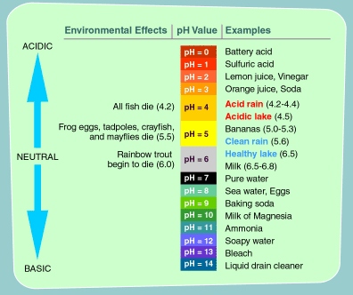
pH and Acid Rain
pH is the measure of hydrogen ion concentrations.
It is measured on a scale from 0-14,
The lower the pH the more acidic the water is
The higher the pH, the more basic (or alkaline) the water is.
7 is neutral and is best for most aquatic organisms.
Significant changes to a body of water’s pH may indicate that contaminants are being introduced.

Slide 21
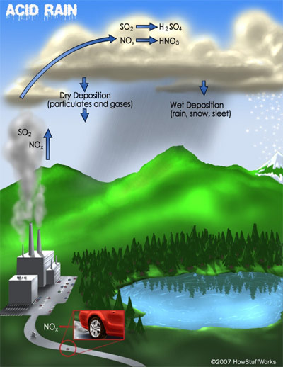
Acid Rain
Acid is rain is formed from sulfur dioxide (SO₂), ammonia (NH₃), nitrogen oxides (NOx) and acidic particles emitted into the atmosphere by burning of fossil fuels in power plants and cars.
Acid rain occurs when these gases react in the atmosphere with water, oxygen, and other chemicals to form various acidic compounds.
The result is a mild solution of sulfuric acid and nitric acid.

Slide 22
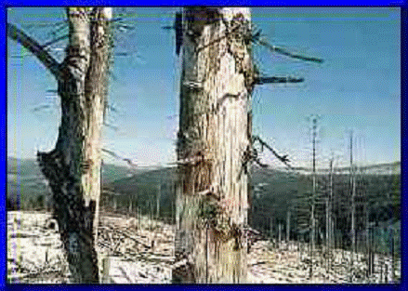
Acid Rain Damage
Acid rain harms the environment in the following ways:
Acids leach nutrients from the soil, preventing their uptake by plants. This can cause nutrient deficiencies in plants, possibly leading to their death. Nutrient deficiencies can also occur further up the food chain.
For example, birds of prey can have weakened egg shells
Acid rain that falls on leaves and needles of trees leaches the nutrients from them. Calcium, magnesium, and potassium ions may be removed from the leaves faster than the roots can resupply them. Acid rain in combination with ozone may damage the protective waxy coating on leaves and needles.
Acid rain can cause the buildup of toxic levels of metals in waterways. This is especially true of aluminum, which can quickly reach levels that are toxic to fish and other aquatic organisms.
Most aquatic organisms cannot survive at or below a pH of 5. Trout begin to die at a pH below 6.
Source: http://oceanworld.tamu.edu/resources/oceanography-book/acidrain.html

Slide 23
Review Concepts
Define thermal pollution and state how it affects waterways.
Describe how dissolved oxygen and temp are related.
Describe how nitrogen and phosphorus affect waterways
Define Methemoglobinemia – what it is, what it does, and how it is caused
Summarize how heavy metal pollution harms ecosystems
List the effects of lead and mercury on living organisms
Define aquatic macroinvertebrates and state how they are used to determine water quality
Describe pH and state how it is used to determine water quality
State how acid rain is caused and how it harms ecosystems

