Slide 1
The Principles of Design
By C. Kohn
Agricultural Sciences
Waterford, WI

Slide 2
Intro
The elements of design were the visual qualities used in creating any design.
The elements are what our brains use to make sense of a visual image.
The Principles of Design are the methods in which we organize and utilize the elements of design.
The Elements of Design are the theories of what makes something visually appealing.
The Principles of Design are how these theories are utilized in practice and implementation.

Slide 3
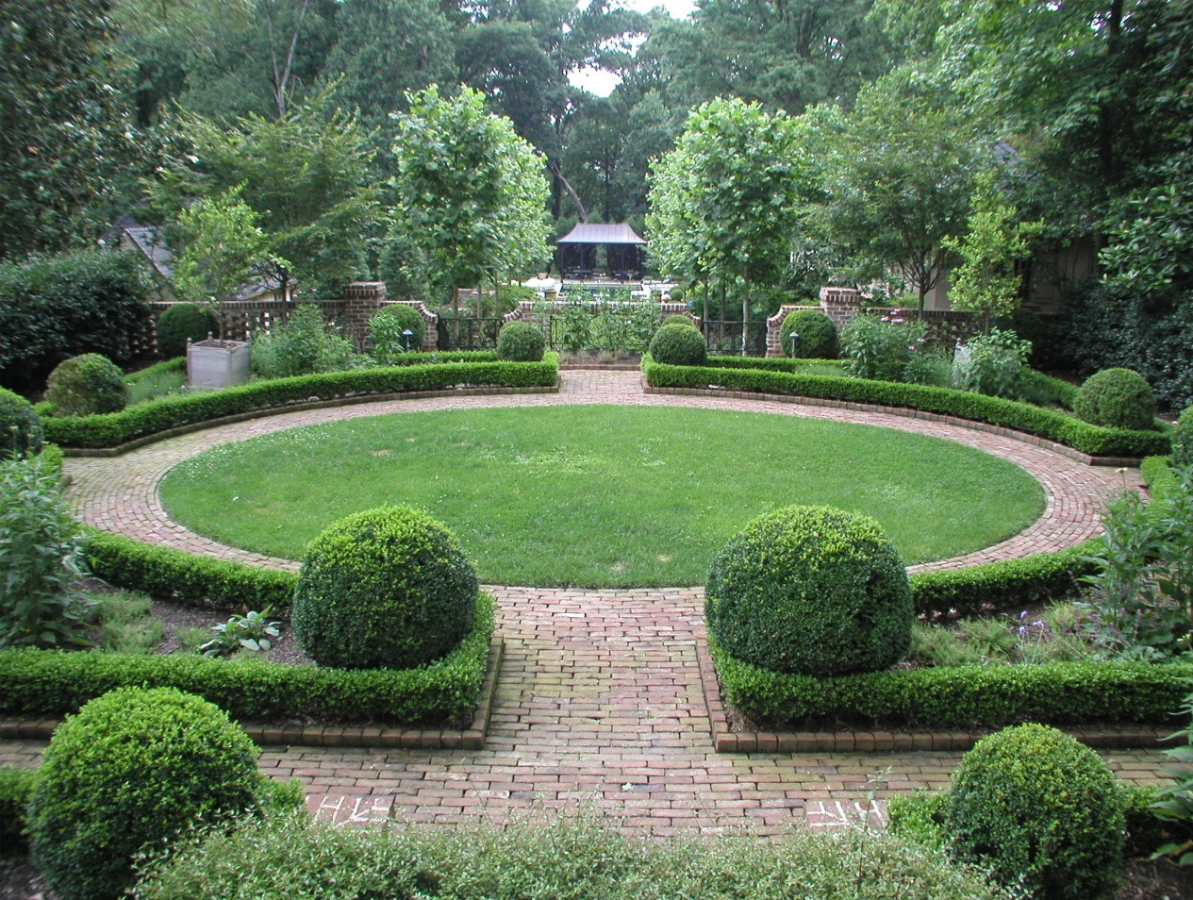
BEST RVU
The Principles of Design include: (Good use of the Principles results in the BEST RVU)
Balance
Emphasis
Scale
Transition
Repetition
Variation
Unity
Source: http://discoversouthwestnm.com/landscape-designs/28/landscape-design-aedas-landscape-design-aedas/

Slide 4
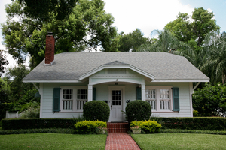
Balance
Balance is sense that the visual ‘weight’ of a design is equal on all sides.
A design that has too much on one side and too little on another side will seem visually “off-balance” and will be displeasing to the viewer.
A design that has good balance will have a sense of three-dimensional stability.
Source: http://texasgarden.wordpress.com/

Slide 5
Symmetrical vs. Asymmetrical
There are two kinds of balance: symmetrical and asymmetrical.
Symmetrical balance occurs when a landscape is identical on the left and on the right. The left and right are mirror images of each other.
Asymmetrical balance occurs when opposing sides of a landscape are not identical but both sides have the same ‘visual weight’.
In other words, each side is completely different from the other, but the sum of the components of each side seem to balance each other.
Symmetrical balance tends to be more formal; asymmetrical balance tends to feel more modern.

Slide 6
Symmetrical vs. Asymmetrical
Symmetrical Balance
Asymmetrical Balance
Source: http://extension.missouri.edu/explore/images/mg0011art01.jpg
Source: http://art.nmu.edu/groups/cognates/wiki/f21c5/images/ee693.jpg

Slide 7
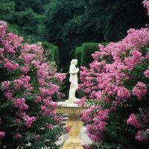
Emphasis
Emphasis: emphasis is the creation of a component or components of the landscape to which the eye is naturally drawn to before any other component.
Emphasis is necessary to create a focal point in the landscape.
The focal point is the area of greatest visual impact and the center of interest in a landscape.
It is what “stands out” more so than anything else in the landscape.
Emphasis should also be used to highlight functional components such as entries, exits, or user-areas (like a park bench or water fountain).

Slide 8
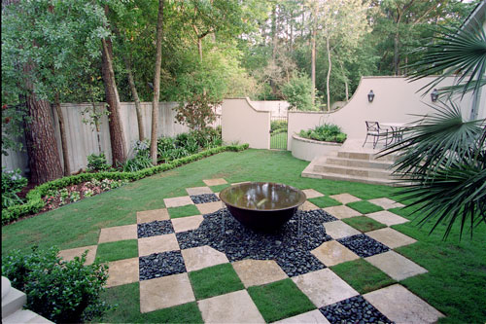
Contrast & Emphasis
Emphasis is primarily established through contrast, or the arrangement of different elements of opposite value.
Contrast can be accomplished by aligning dark values next to light values (such as a white line down a dark area).
Contrast can be accomplished by aligning smooth textures next to rough textures (such as a large-leafed plant in front of a small-leaved hedge).
Contrast can also be created by situating varying colors or forms adjacent to each other.
Emphasis is also created through the appropriate use of line to draw the eye to the focal point.
The combination of appropriate use of contrast and line most effectively creates a sense of emphasis through a focal point.
Source: escorialdesign.com

Slide 9
Scale
Scale: scale is how elements of a landscape compare to each other in regards to their size.
Scale applies both to how elements in the landscape relate to each other as well as how the size of the landscape itself compares to the area surrounding it.
Scale is about proportion, or the sense that the size of the components of the landscape are similar enough to each other to seem appropriate (as opposed to a 90 foot tall tree being next to a 10 foot house).

Slide 10
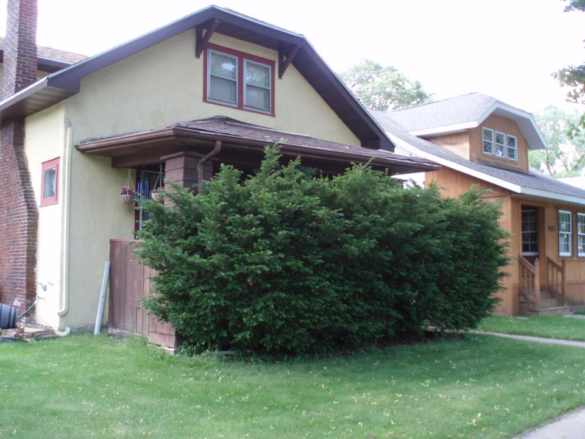
Scale
For example, if a tree is so large that it completely hides the house behind it, we would say the scale of the tree is too large compared to the house it is supposed to accentuate.
Alternatively, if a statue dwarfs its surrounding vegetation, the vegetation’s scale is too small for the statute it is supposed to emphasize.
Scale is very important for establishing Balance.
If the components on one side of a landscape are much larger than the components on the opposing side, the mismatched scale of the two sides will make the landscape seem unbalanced and inappropriate.

Slide 11
Scale – use trees and shrubs to frame a house, not to conceal it or draw attention away from it.

Slide 12
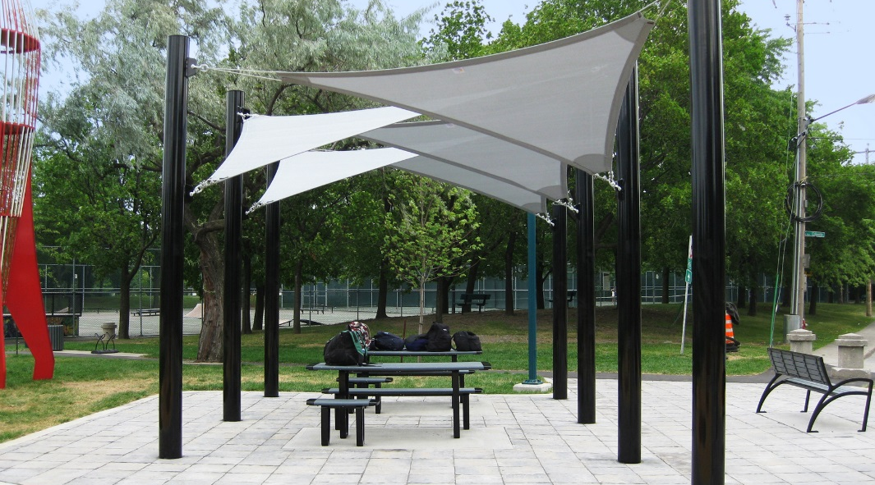
The “Human Scale”
While proportion is important, scale should also involve human needs and limitations.
Don't design a space that makes people feel like a bug or a giant.
Even Europe's largest, grandest fountains have edges that are human scaled.
The seat walls at these fountains are designed for the proportions of people.
Fountain statuary that is 25' tall doesn't have a rim that is 5' off the ground but low enough to easily enable seating.
If the landscape is not human-scaled, be sure to add components to address this.
For example, if a sitting area is beneath enormous trees that dwarf the people, adding a smaller structure can help the area to feel more intimate.
Source: http://www.designsforshade.com/wp-content/uploads/3-Point-Shade-Sail-2.jpg

Slide 13
Transition
Transition: transition is the method of combining elements using a series of gradual changes.
A viewer’s brain usually dislikes abrupt, unexpected changes to a landscape.
Transition creates a softened transition among elements.
For example, hedges and trees on the corners and sides of a house soften the transition of height from the flat landscape to the vertical walls.
Shrubs and bushes along the sides of a lawn prevent an abrupt change from texture and size when the eye moves towards the flat lawn of the landscape.
While sometimes an abrupt transition can be good (especially when trying to draw attention to emphasize a focal point), in general a viewer’s brain prefers smooth transitions from one element of a landscape to another.

Slide 14
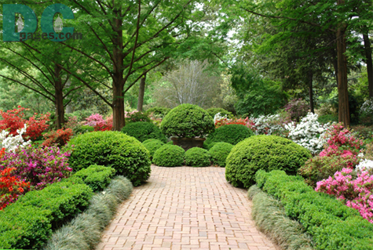
Transition
Good transition softens how the landscape changes by allowing the changes to be gradual instead of abrupt and sudden.
Transition can apply to size and height as well as to color, texture, and value.

Slide 15
Transition Softens Vertical Changes

Slide 16
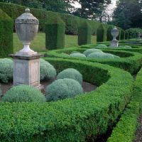
Repetition
Repetition: Repetition is the creation of a pattern or sequence of elements in a landscape through repeated use of color, form, texture, and other components.
Repetition can be accomplished by using the same type of color repeatedly, the same kinds of shapes and forms, the same types of vegetative texture, the same use of construction elements such as wood or brick, and so on.
The use of repetition creates a sense of orderliness, which when properly used is appealing to the viewer’s brain because it enables predictability and calm.

Slide 17
Patterns
Repetition is established through the use of patterns, or repetition that occurs in an orderly fashion (for example – Red, Red, Blue, Red, Red, Blue…. Or Sphere, Sphere, Pyramid, Sphere, Sphere, Pyramid).
How much patterned-repetition is used depends on how formal you want the landscape to feel. Little to no pattern in the repetition makes the landscape feel organic and informal, but also if overdone creates a disorderly and jumbled landscape.
Repetition that follows strict patterns may feel more formal and manicured but if overdone can also feel stuffy and boring.

Slide 18
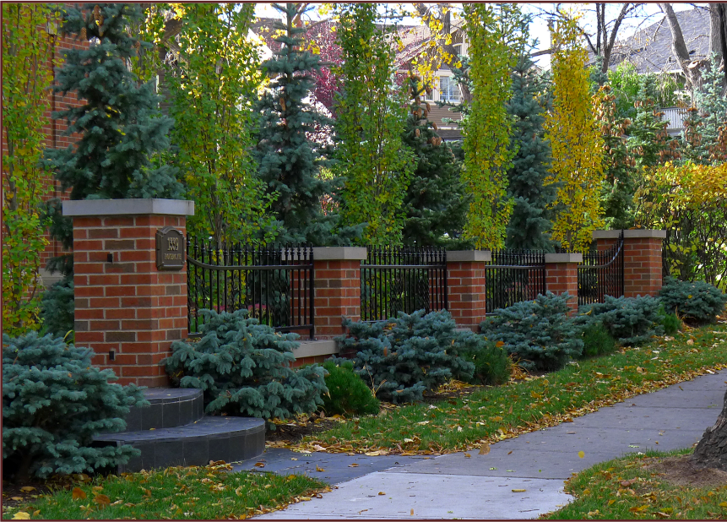
Rhythm
Repetition is necessary to create rhythm. Rhythm is the sense of ‘movement’ in the landscape created by the planned placement of repeated elements.
A sense of rhythm is created when a landscape has a visual feel of a tempo or a beat.
The closer the repeated items, the ‘faster’ the beat of the landscape’s rhythm, creating a sense of excitement or even business (if the tempo is too fast).
The more widespread the elements, the ‘slower’ the beat will seem, creating a sense of relaxation or even boredom (if the tempo is too slow).
source: http://notanothergardeningblog.files.wordpress.com/2012/10/spruce-aspens-and-pine.png%3Fw%3D640%26h%3D403

Slide 19
Variation
Variation – Variation is how dissimilar the elements that are used are from each other.
The least amount of variation possible creates monotony.
Just like a person with a monotonous voice has the same pitch and tone no matter what they are talking about, a monotonous landscape uses the same form, color, and value in every component.
Monotony prevents emphasis.
The most amount of variation can also be visually unappealing.
Excess variation results in no repetition or pattern, creating a disorderly landscape that prevents the viewer’s brain from making sense of what it is seeing.
Monotonous Height
Variety of Height
Source: http://www.aces.uiuc.edu/vista/html_pubs/COMMLAN/P12.gif

Slide 20
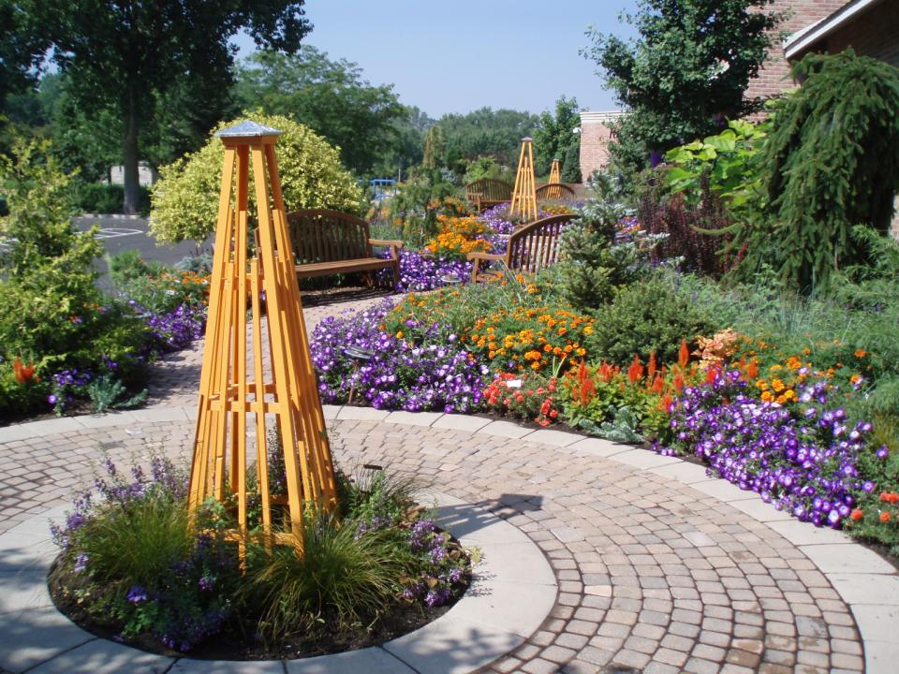
Monotony vs. Disorder
The best variation is a healthy balance between monotony and disorder – you want enough variation to prevent the landscape from being boring, but not so much that it appears disorderly.
Remember that variation includes not just color, but also value, form, and texture.

Slide 21
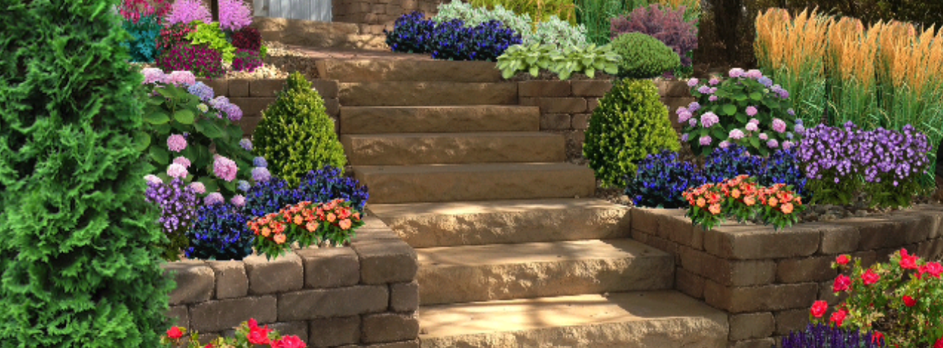
Unity & Harmony
Unity: unity is the sense that a landscape’s components belong with each other, complement each other, and are a part of a single coherent and well-planned landscape.
Unity is necessary to establish harmony, or the blending of elements to create rhythm, balance, emphasis, scale, transition, repetition, and variety in a manner that accents their similarities, avoids monotony, and creates a sense of visual appeal.
Source: https://lh6.ggpht.com/GUOB-Usyj0nJpOY4KqW6NJTvUpK9FgO8iVSMfxSHDjU_0xH0QQiCqnkX9oZyVcRYKw%3Dh900

Slide 22
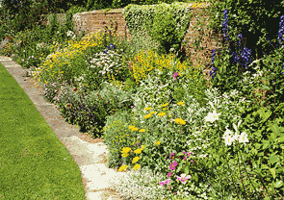
Unity & Harmony
Unity and harmony are best accomplished when all the elements and principles of design are used appropriately with each other in a manner that complements each element and component.
Everything “goes well together” in the landscape when there is harmony and unity.
Source: http://texasgarden.files.wordpress.com/2010/02/unity1.gif

