Slide 1
Wound Repair
By C. Kohn
Agricultural Sciences Waterford, WI

Slide 2
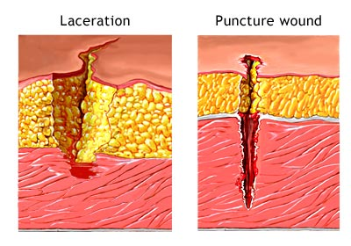
Kinds of Wounds
A wound occurs when the a break in tissue occurs.
This can be because of trauma.
It can also be intentional, such as is the case during a surgery.
There are five kinds of wounds (PAAIL).
Puncture Wounds are vertical penetrations of the surface-layers of epidermal tissue.
Abrasions are injuries destroying only surface layers of the skin.
These are sometimes called “scrapes”.
Avulsions are injuries in which tissue is forcibly separated or torn off.
Tissue is not so much cut as ripped.
Incisions are wounds produced by sharp instruments
These types of cuts usually have smooth edges and are “clean cuts”.
Lacerations are cuts with irregularly torn edges.
Source: www.orthopaedics.com.sg

Slide 3
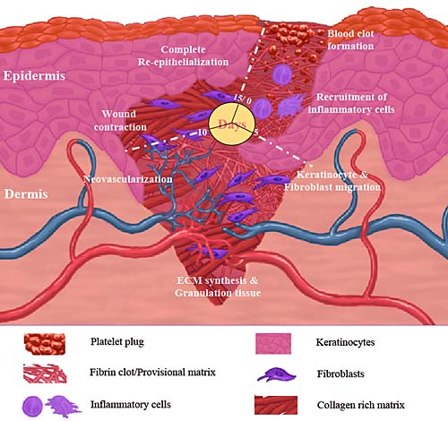
Five Phases of Wound Repair
Wound repair has five distinct phases - HIDRM
Hemostasis
Inflammation
Debridement
Repair
Maturation
Source: www.bioscience.org

Slide 4
Phase 1: Hemostasis
Phase 1 - Hemostasis: the loss of blood is stopped.
Immediately after an injury, hemorrhage (escaped blood) will fill the wound.
This will clean the edges of the wound and carry away foreign material.
Blood vessels will immediately constrict after an injury to reduce blood loss.
This process is called vasoconstriction.
Source: commons.wikimedia.org

Slide 5
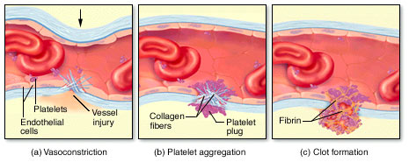
Platelets
Collagen (structural fibers in the skin) will stick out of the wound into the bloodstream.
Platelets (a kind of blood cell) will stick to the collagen fibers because of their protein coat in a process called platelet plug formation.
As more platelets stick to the edges of the wound, they physically ‘plug’ the wound.
The formation of the platelet plug is the most important role of the platelet, but there are many other roles that the platelets play.
Source: www.medprorx.com

Slide 6
Degranulation
Finally, platelets will undergo degranulation in which they release chemical signals and start the formation of the fibrin-mesh scab.
Once platelets have been exposed to air, they will begin to form a fibrin blood clot.
In the presence of air, platelets will break apart.
Broken platelets will react with a protein called fibrinogen to form tiny molecular threads called fibrin.
The fibrin threads will form a mesh (sort of like a soccer net) that will capture passing blood cells.
The combination of the fibrin mesh, red blood cells, white blood cells, and platelets will dry and form what commonly known as a scab.
The scabbing process is dependent on a plentiful supply of platelets, the presence of the fibrinogen, protein, calcium, and vitamin K.
Source: www.medprorx.com

Slide 7
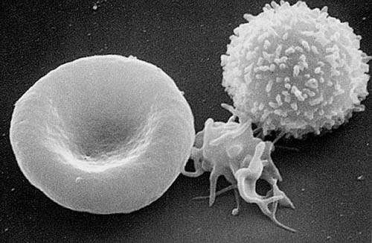
Platelet Properties
Platelets have several unique properties that are critical to the healing process.
Platelets are the smallest and most numerous of the three major types of blood cells (the others being red blood cells and white blood cells).
Due to their small size they only take up a small fraction of the total blood volume.
Platelets are produced in the bone marrow like all other kinds of blood cells.
Platelets are not true cells because they do not have a nucleus.
Platelets are actually fragments of a specific kind of bone marrow cell.
Red blood cell, platelet, and white blood cell.
Source: en.wikipedia.org

Slide 8
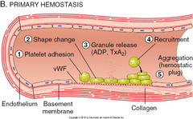
Platelet Properties
Platelets contain granules (which are sort of like cellular packages) that secrete coagulation proteins enable plug broken blood vessels to be plugged in order to slow or stop bleeding during an injury.
The proteins released by previously-stuck platelets (during degranulation) will cause the platelets nearby to become “sticky” to each other.
Under normal circumstances, platelets will not generally stick to each other.
This could result in a massive blood clot that could lead to a heart attack or stroke.
Source: quizlet.com

Slide 9
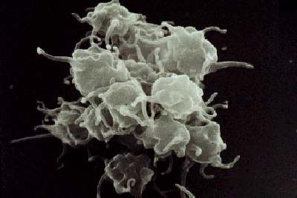
Platelet Properties
Platelets have a protein coat that allows them to stick to collagen that sticks out of wounds. This protein also allows platelets to stick to each other during an injury.
The presence of this protein coat is what enables them to stick to the site of an injury (and to each other) in order to form the platelet plug that stops the flow of blood.
This is the most important role of the platelets.
Platelets will not stick to other structures in the body.
Platelets only adhere to collagen, other platelets, and foreign material from outside the body
Source: www.ouhsc.edu

Slide 10
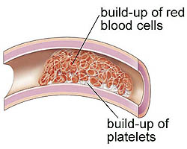
Platelet Properties
Because platelets can stick to each other, the body must closely regulate its production of coagulants and anticoagulants.
Coagulants thicken the blood and increase the likelihood that platelets will stick to each other.
Anticoagulants thin the blood and reduce the likelihood that platelets will stick together.
For example, aspirin is an anticoagulant that interferes with the platelets’ ability to stick to each other.
This can be a good thing if someone is having a heart attack but can be a bad thing if a patient has a medical disorder such as hemophilia or too few platelets.
Source: my.clevelandclinic.org

Slide 11
Platelet Properties
Platelets contain contractile proteins similar to muscle cells.
Contractile proteins enable platelets to change shape when they become “sticky” – normally platelets are “plate-shaped”.
During an injury, they sprout “arms” (like an octopus) to ‘grab’ other platelets as they pass and to patch open wounds.
After 2-3 days, the platelets’ contractile proteins will pull the edges of the wound closer together.
This reduces the chance of further bleeding or disruption to the wound.
Platelets are the lightest of the blood cells, which causes them to be pushed to the outside of blood vessels, causing them to ‘roll’ along the walls of blood vessels.
This makes it more likely that they will be the first to encounter and stick to collagen that is exposed during an injury.
Source: www.hematology.org

Slide 12
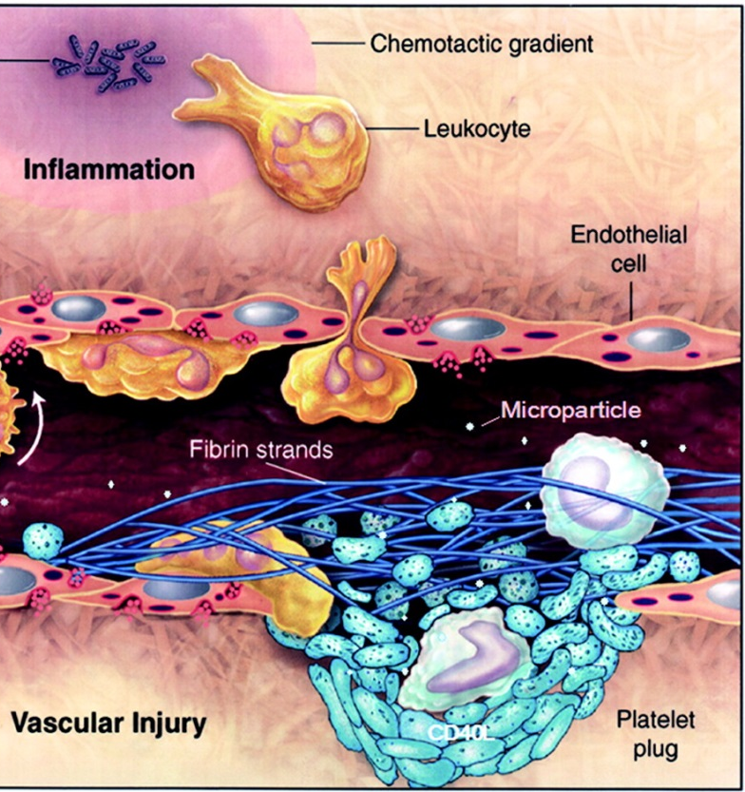
Phase 2: Inflammation
Phase 2 - Inflammation: once the fibrin mesh scab forms, blood vessels will dilate or expand.
Dilation will cause the wound to swell due to the increased blood volume in the blood vessels.
It will cause the wound to appear reddish in color because of the extra blood.
Once white blood cells break down bacteria and dead tissue, it will cause heat to be given off in the next stage.
During this phase, the platelets also use their contractile proteins and linked ‘arms’ to reduce the size of the wound.
Source: atvb.ahajournals.org

Slide 13
Phase 3: Debridement
Phase 3 - Debridement begins with white blood cells begin to appear at the site of the wound.
These white blood cells remove dead or dying tissue (also known as necrotic tissue).
They will also fight and destroy pathogens and foreign material.
As white blood cells destroy necrotic tissue, pathogens, and foreign material, exudate will form on the surface of the wound.
Exudate is commonly known as pus.
While exudate is a common aspect of the healing process, excess exudate can interfere with key components of healing.
The fibrin-mesh scab will continue to form through this phase.

Slide 14
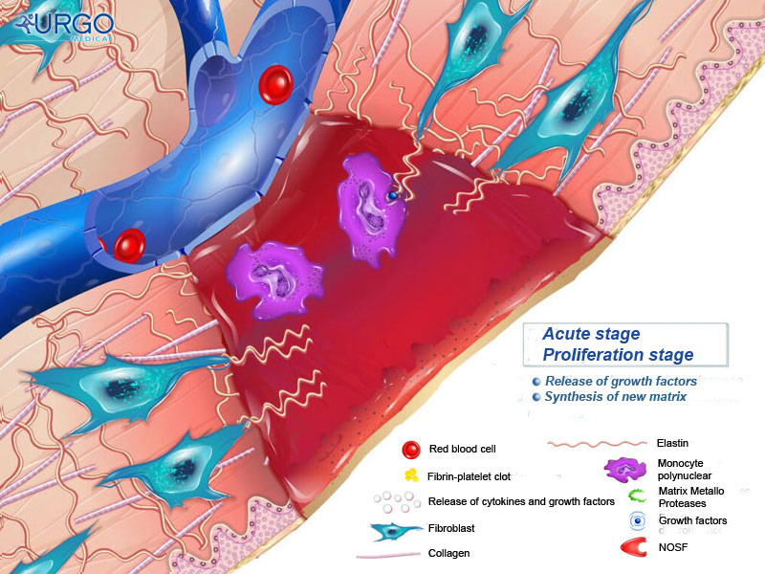
Phase 4: Repair
Phase 4 - Repair: this phase begins after the fibrin-mesh scab has fully formed and white blood cells have removed necrotic tissue and invading bacteria.
This phase begins when fibroblasts begin to appear at the site of the wound.
A fibroblast is a kind of connective cell that secretes collagen proteins.
This creates a structural framework needed for tissue repair.
Source: www.urgomedical.com

Slide 15
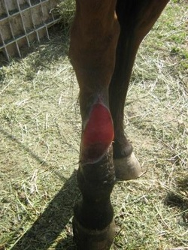
Granulation Tissue
Capillary tissue returns to the wound in this phase, which allows blood to return to the damaged tissue.
A sign of capillary growth is red, freshly, vascular granulation tissue under the scab.
Granulation tissue: a collection of newly formed connective tissue and blood vessels that forms on the surface of a wound during the healing process.
Granulation tissue is important for healing because it…
Replaces the lost tissue
Protects the wound
Provides a barrier to infection
Provides a scaffold for new skin to form over the top of it.
Source: calicofarm.weebly.com

Slide 16
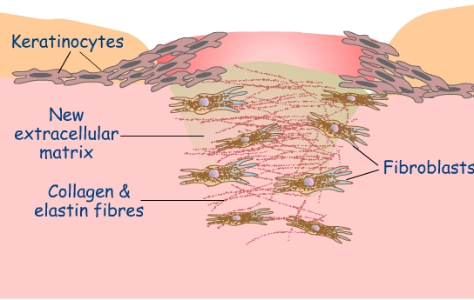
Myofibroblasts
Granulation tissue also supplies myofibroblasts to the wound.
Myofibroblasts: a kind of fiber-producing connective tissue that enables the formation of smooth muscle in granulation tissue.
This smooth muscle causes the wound to contract completely.
This causes a dramatic increase to the strength of the wound, greatly reducing the likelihood of the wound re-opening.
Contracted wounds are less susceptible to being re-opened and reduce the amount of new tissue that has to be created by reducing the surface area needed to be covered.
If a wound is too large or damaged for wound contraction, bandages and sutures are needed for healing to occur without complications such as infection.
A sign of poor healing includes white granulation tissue with high amounts of connective tissue and fewer blood vessels.
Source: www.camacs.ca

Slide 17
Epithelialization
After the wound contracts, epithelialization occurs.
New epithelial tissue will form 4-5 days after an injury.
This can be as little as 1-2 days for a smooth incision where the edges of the wound are close, such as from a proper surgical procedure.
Epithelial cells will undergo increased mitosis (cell division), and new tissue will form across the granular tissue matrix.
The epithelial tissue will start as a layer one-cell thick and gradually thicken layer by layer.
Source: www.scarfreehealing.com

Slide 18
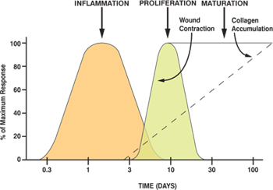
Phase 5: Maturation
Phase 5 - Maturation: the final phase of healing that will occur 3 weeks after injury. This phase takes weeks to years to complete.
During this phase, collagen connective tissue will be remodeled to improve wound strength.
As the wound matures, less damage will need to be repaired, reducing the need for the oxygen and glucose delivered by the blood.
This will result in the reduction of the amount of blood vessels that support the new tissue, which will cause the scar to become paler.
Maturation is completed once collagen levels in the wound reach the level achieved prior to the injury.
Depending on the injury, the wound will most likely never have the strength it had prior to the injury.
Source: www.clinimed.co.uk

Slide 19
Wound Healing Factors
Wound Considerations – the follow factors will affect how quickly a wound heals.
Wound size – smaller wounds will heal faster than larger wounds.
Smaller wounds require fewer platelets to plug the disrupted tissue and need less mitotic cell division to re-form the lost tissue.
Foreign material: the rate of normal wound healing will be slowed by materials from outside the body.
If bacteria are present in the wound, healing will be delayed as energy is diverted to fight pathogens.
Sutures and other medical materials will also be seen as foreign objects by the body’s immune system, causing more inflammation and will result in a great immune response and slowed healing.

Slide 20
Wound Healing Factors
Excessive Exudate: bacterial toxins and inflammation will increase the amount of exudate.
Accumulated exudate can cause tissue separation, delaying healing.
Blood supply: damage to the blood supply during the injury or during treatment (e.g. if the bandages or sutures are too tight) will slow the rate of healing.
Oxygen is needed for cellular metabolism and the production of ATP to power cellular activity.
Cell division, pathogen elimination, formation of granular tissue, and other critical activities cannot occur without the production of ATP, for which oxygen is needed.

Slide 21
Wound Healing Factors
Wound disruption: physical damage to the wound will slow the rate of healing.
Wound should be protected from physical damage (such as brushing against objects or other animals).
The location of the wound may also require limb/tissue stabilization.
E.g. if a wound is on a joint, the joint may need to be immobilized.
Drug interference: certain drugs and treatments may interfere with or slow healing.
Anti-inflammatory drugs (such as aspirin or ibuprofen) will not affect wound strength but may reduce the ability of blood vessels to supply platelets, clotting factors, growth factors, and fibroblasts to the site of the wound.
Corticosteriods, or drugs that are used to treat excessive inflammation, arthritis, autoimmune diseases, and other conditions, will depress all phases of healing and increase the likelihood of infection.

