Slide 1
Canine Feeding and Nutrition
By C. Kohn
Based on “Canine Feeding and Nutrition” by the Alabama Cooperative Extension System and “Nutrition” by Tiffany Griffin, Baker College

Slide 2
Introduction
While dogs may be carnivores, they like and need a variety of foods
Dogs need to consume a nutritionally balanced diet to stay healthy.
Like humans, dogs have nutritional needs for…
Carbohydrates
Fats
Proteins
Vitamins, minerals, and water

Slide 3
Carbohydrates
Carbohydrates are mostly high-energy, plant-based nutrients (exception: lactose in milk is the only sugar produced by animals).
Carbohydrates can be found as simple sugars, starches, soluble fiber, and insoluble fiber.
Examples include grains, sugars, milk, beet pulp, etc.

Slide 4
Carbohydrates
There is no known dietary requirement for carbohydrates in dogs.
However, carbohydrates are an excellent source of energy and are a valuable part of a dogs diet when fed in moderation.
Cereal grains (corn, barley, rice, or wheat) have a high content of starch, and comprise a main source of energy in commercial dog foods.
In the wild, the carbohydrates in a dog’s diet would have already been broken down by the stomachs of their prey.

Slide 5
Carbohydrates - Fiber
Insoluble carbohydrates (fiber, e.g. beet pulp) can help prevent and/or treat diarrhea and other digestive disorders.
Fiber can also speed up digestion and decrease the amount of time that food is retained in the digestive tract.
Fiber can help in preventing constipation and can reduce obesity rates by increasing satiety (the feeling of being full).

Slide 6
Carbohydrates
Milk is also high in carbohydrates (lactose sugar) but may cause diarrhea in some dogs.
Because of this, milk should not be fed to dogs after they are weaned from their mother’s milk
A diet too low in fiber can lead to diverticulosis, or the formation of pockets in the large intestine that can lead to inflammation and infection.
A diet too high in fiber can cause dental tartar buildup, and cause large, smelly stools.

Slide 7
Fats
Fats are a more concentrated form of energy than carbohydrates.
Saturated, unsaturated, and Linoleic acid are the three essential fatty acids needed in a canine diet.
Fats used commercially include cottonseed oil, hydrogenated vegetable oil, poultry fat, lard, and tallow.

Slide 8
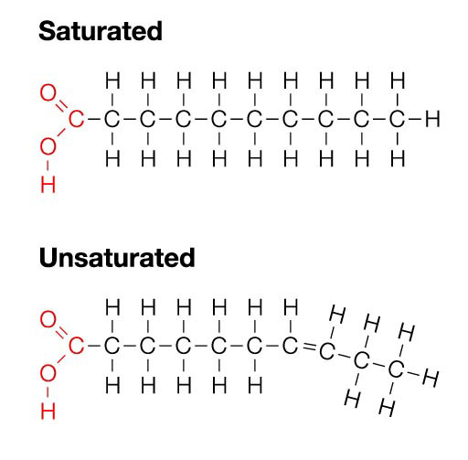
Fats
Saturated fats are “saturated” with hydrogen atoms.
Unsaturated fats have a double-bond, reducing the amount of hydrogen that can bond to this molecule.

Slide 9
Fats
The presence of this double-bond keeps unsaturated fats liquid at room temp.
A diet too high in saturated fat can lead to high cholesterol and heart disease.

Slide 10
Fats
News Release - 03/03/2003 - AU Research Keeps Bomb-Sniffing Dogs on Heightened Alert
“We found that unsaturated fat is metabolized faster and sustains physical exertion longer than saturated fat,” Cummins said.
“Both before and after periods of intense exercise, the dogs on the unsaturated-fat diet were more alert and their senses of smell significantly more sensitive than those on the saturated-fat diet.”

Slide 11
Fats
Saturated fat comes from animal sources and is used mainly for energy.
Unsaturated fat is used for skin and coat and one of the best sources for it is flax seeds.
Linoleic acid is also found in flax seeds, and also in safflower oil. (Source: Baker College)

Slide 12
Fats
Fats contribute to palatability, or the tastiness and texture of dog food.
Fats carry the fat-soluble vitamins A, D, E and K.
The most prevalent problem related to fat is overconsumption and obesity.

Slide 13
Fats
Some of the outcomes of not having enough fat in your dog's diet could include:
Course Dry Coat
Improper Growth
Poor Blood Clotting
Itching
Lack of Energy
Heart Problems
Cell Damage
Skin Lesions
Skin Growths
Calluses & Skin Infections

Slide 14
Proteins
Protein is among the most important nutrients found in dog food.
Dogs need protein for amino acids, the building blocks of protein.
Proteins are essentially chains of amino acids.
There are 20 amino acids required for dogs; dogs can synthesize half of these within their bodies. The other half must be consumed.

Slide 15
Protein & Amino Acids
Those amino acids that cannot be produced by the dog’s body and must be consumed are called essential amino acids.
Every protein contains varying levels of each of the 20 amino acids.
Because of this, some proteins are of higher quality than others.
Animal-based proteins are higher quality proteins than plant-based proteins because they will have a more complete balance of amino acids.

Slide 16
Vitamins
Vitamins are enyzmes, or biological catalysts in biochemical reactions in the body
i.e. they enable the chemical reactions necessary for life to occur more efficiently and with less energy
Some biochemical reactions in our body cannot occur without the presence of adequate levels of specific vitamins.

Slide 17
Vitamins
Vitamin A was discovered by Dr. E.V. McCollum at UW-Madison in 1917.
McCollum’s work was based on Dr. Stephen Babcock’s “single-grain” experiments performed on cattle at the UW Dairy Barn.
Dr. Babcock eliminated specific grains one at a time to determine the impact on their health.
McCollum discovered Vitamin A in the milk of cows after Babcock’s initial work.
He later discovered Vitamin B and also showed that Vitamin D prevented the bone disease rickets.
The letter names were meant to be temporary until more suitable names could be found.

Slide 18
Vitamins
Dr. Harry Steenbock at UW-Madison invented the process by which Vitamin D is added to milk.
Steenbock used the money from his patent on this process to create the Wisconsin Alumni Research Foundation, or WARF
WARF funds scientific research at UW
Today WARF is one of the largest funders of research in the world.

Slide 19
Vitamins
Vitamins can be classified in one of two groups:
Fat soluble vitamins A,D,E, and K.
Water soluble vitamins B’s and C
There are multiple B vitamins
Because fat-soluble vitamins are commonly stored in fat tissue, they can build up to toxic levels if over-supplemented.
This is less likely with water soluble vitamins.

Slide 20
Vitamins
Insufficient vitamin levels can lead to immune problems, weakened teeth and gums, and reduced ability to acquire energy from digested food.
Excess water soluble vitamins can be excreted from the body and are rarely a problem
Excess fat-soluble vitamins can cause toxicity and poisoning.

Slide 21
Minerals
Minerals play a similar role in metabolism as vitamins.
Minerals…
assist in the formation of blood and bones
enable proper salinity and composition of bodily fluids
carry oxygen in the blood
and promote a healthy nervous system.

Slide 22
Minerals
Minerals can be divided into two categories
Macrominerals – needed in large amounts
Microminerals – needed in small amounts
A deficiency, imbalance, or excess of minerals can cause severe skeletal deformities

Slide 23
Water
Water a key nutrient for every living thing, plant or animal.
Water assists in…
body temperature regulation
blood formation and the creation of liquids throughout the body
and prevents dehydration.
Clean water should be available all times for your dog. (Source: Baker College)

