Slide 1
Co-Dominance & Incomplete Dominance
By C. Kohn, Agricultural Sciences Waterford, WI

Slide 2
Review of Mendelian Genetics
In the simplest version of Mendelian genetics, every trait as at least two genes (one version of the gene contributed by each parent).
These genes can either be dominant or recessive.
Dominant traits are always expressed as long as at least one of the genes is dominant.
Recessive traits are only expressed if both versions of the gene (or both alleles) are recessive.
We use Punnett squares to determine what types of offspring are possible from different types of parents.
For example, if both parents are heterozygous (or have both a dominant and a recessive gene), their offspring could have any possible combination of genes.
If both parents were homozygous recessive, they could only have offspring that are homozygous recessive. Ditto if they are both homozygous dominant.
The Punnett square uses the parents’ genotypes (the combination of genes they have) to determine the offspring’s genotypes and phenotypes (the physical characteristics they will have due to the combination of genes they inherit).

Slide 3
Multiple Alleles
In earlier examples, we made it seem like there can only be two versions of every trait.
In reality, there often be more than two alleles of a trait.
For example, there are three possible alleles for human blood – A, B, and O.
Different genotype combinations of these types of blood result in different blood type phenotypes.
If both of your parents gave you A alleles, you would have Type-A blood.
If one parent gave you an A allele and one gave an O allele, you would still have type A blood.
If one parent gave you an A allele and one gave a B allele, you would have type AB blood.
If one parent gave you an B allele and one gave an O allele, you would still have type B blood.
The fact that there are 3 alleles of blood means that our simpler earlier version of Mendelian genetics is not sufficient to explain this phenomena.
Some genes are a mixture of dominant and recessive, and sometimes more than one gene can be dominant.

Slide 4
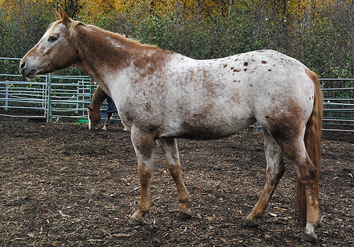
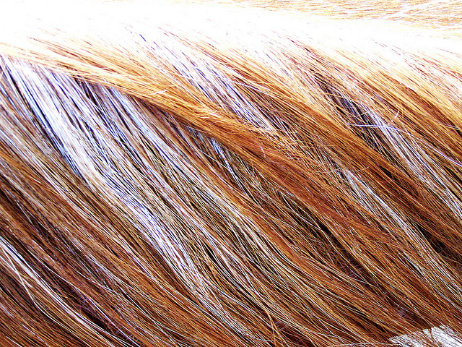
Co-Dominance
Sometimes two different versions of a gene can both be dominant at the same time.
When two different genes are co-dominant, this means that both genes are dominant and will be equally expressed if they are passed on to offspring.
For example, horses can have what is called a “roan” color.
Roan appears pink from a distance but actually consists of equal amounts of red hair and white hair.
Roan horses have a co-dominant trait – both the red color and the white color are equally dominant.
Because both the red color and the white color are equally dominant, they are equally expressed, resulting in a horse that has both red and white hair.

Slide 5
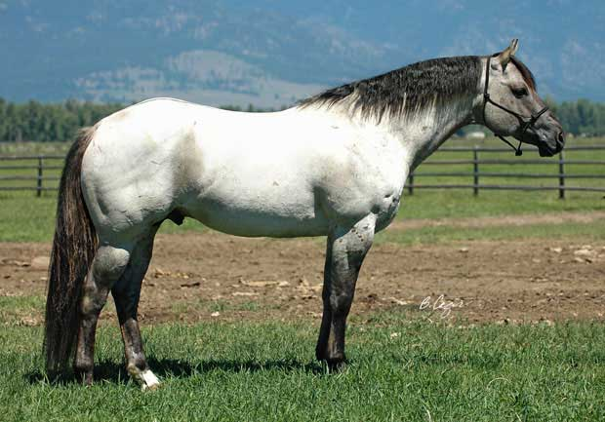
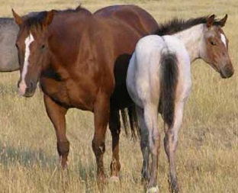
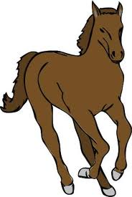
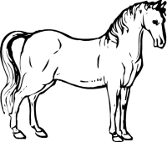
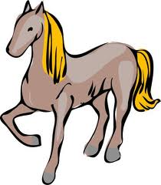
Co-Dominance and Punnett Squares
Because multiple traits are dominant in co-dominance, each trait needs a capital letter when we use a Punnett square.
Because both traits need a capital letter, we need to use two different letters when we are filling in a Punnett square.
For example, the white horse below is the father of the foal. The red horse on the right is the mother and the roan foal (baby horse) is on the far right.
Both the white father and the red mother have dominant colors.
Because both colors are dominant, they both need capital letters.
The Punnett square below shows how we would portray these traits.
R R
W
W
RW RW
RW RW
Source: http://meadowsranchinc.com/sm06red.jpg

Slide 6
Blood Type
Co-dominance helps to explain why you can have Type-AB blood but not Type-AO or Type-BO blood.
In blood, both Type-A and Type-B blood are dominant.
Type-O blood is recessive.
The only way to have Type-O blood is to have both recessive Type-O alleles (see the Punnett square below).
If the O allele is paired with an A allele or a B allele, you will have either Type A or Type B blood.
Because both A and B are dominant, they are co-dominant.
This means that if both A and B alleles are inherited, that individual will be Type AB.
If a heterozygous Type A parent has offspring with a heterozygous Type B parent, they could have offspring with any kind of blood type.
A o
B
o
AB B
A O

Slide 7
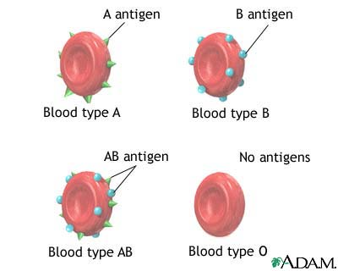
Blood Donors
Blood type has a major impact who can donate or receive blood.
Blood type is a reflection of the protein coat found on blood cells.
There are three variations of this protein coat:
Type A protein coat.
Type B protein coat.
Type O = no protein coat
Blood is kind of “territorial” – if your blood senses that a different kind of blood is present, your body will try to destroy that other kind of blood.
For example, if you have Type-A blood but are given a donation of Type-B blood, your body will try to destroy that donation of blood because it is different.
Anyone can receive Type-O blood because it doesn’t have a protein coat and is “undetectable” by your body.
However, Type-O patients can only receive Type-O blood – they cannot receive Type A, Type B, or Type AB blood or their body will try to fight it.
Type AB blood can receive any kind of blood – A, B, O, or AB.
However, an AB person can only donate to another AB person.
Source: health.kernan.org

Slide 8
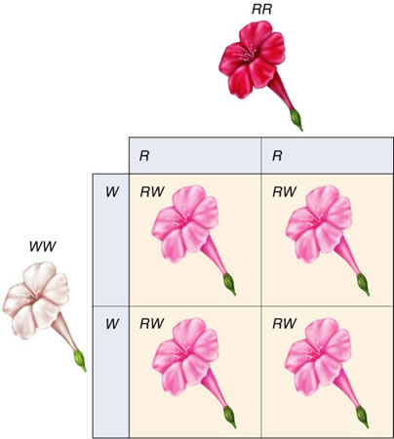
Incomplete Dominance
Sometimes we can have two traits where neither of the traits is completely dominant.
If neither of the traits are dominant, both will sort of blend with each other to create a mix of the two traits.
Incomplete dominance is when neither trait is fully dominant, resulting in a mixture of the two traits.
For example, if a tulip flower is red and the other flower is white, they may have offspring that have a mix of both of their traits – pink.
If red and white parents have offspring, neither parent will contribute a gene that is dominant.
As a result, the red and white traits will “mix” to create pink offspring.
Source: ayalavida.blogspot.com

Slide 9
Incomplete Dominance & Punnett Squares
In Incomplete Dominance, the Punnett square will again involve two different letters.
In this case…
White flowers have the genotype WW (but are not totally recessive).
Red flowers have the genotype RR (but are not totally dominant).
The pink heterozygous offspring have the RW genotype.
R R
W
W
RW RW
RW RW
Source: ayalavida.blogspot.com

Slide 10
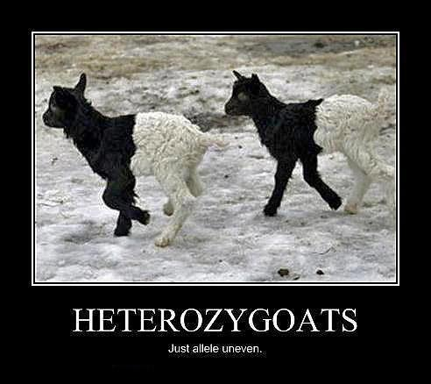
Co-Dominant vs. Incomplete
Co-dominance and incomplete dominance can be easy to mix-up (they even kind of sound and look the same).
An easy way to remember which is which is by using the following mnemonic:
Co-Dominant: Both dominant.
A black parent and a white parent will have black and white offspring →
Both black and white will be expressed because both are dominant.
Incomplete is In-Between
A black parent and a white parent will have gray offspring.
Gray is expressed because it is “in-between” the two incompletely dominant traits.
Source: www.reddit.com

Slide 11
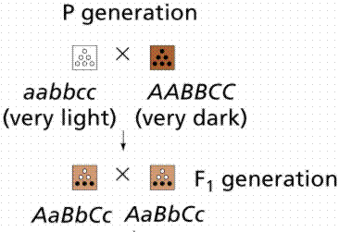
Polygenes
For some traits, an individual may have four, six, or more genes.
When a group of genes work together to influence a single trait, this is known as a polygene.
Poly- means “many”.
For example, human skin color is a polygenic trait (or a trait controlled by multiple genes).
Six alleles determine the pigment of your skin.
The more dominant genes you have for skin color, the darker your skin will be.
For example, imagine that a very dark-skinned person had a child with a very light-skinned person.
The dark-skinned person would have genotype AA,BB,CC.
The light-skinned person would have genotype aa,bb,cc.
Their children would most likely have a medium-shade of skin color (Aa,Bb,Cc).
Source: www2.estrellamountain.edu

Slide 12
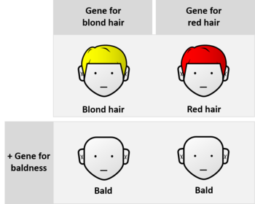
Epistasis
Sometimes one gene can prevent the expression of another gene.
For example, male animals carry the genes for female body parts.
Every male animal has both a Y (male) chromosome and an X (female) chromosome.
However, because they have a Y chromosome, the genes for the female parts are not expressed.
The genes on the Y chromosome block the expression of the genes on the X chromosome.
The process in which the expression of one gene is blocked by the expression of another gene is called epistasis.
Epistasis can prevent an organism from exhibiting a trait even though that individual has the genes for that trait.
For example, if you have the genes for red hair but also the genes for baldness, the baldness genes will prevent the genes for red hair from being expressed on your head.
Source: en.wikipedia.org

Slide 13
Epistasis and Labradors
Labrador dogs are a well-known example of a polygene and of epistasis.
Labradors have two genes that influence the color of their coat.
The E gene determines the presence of a dark pigment in their coat.
The B gene determines the amount of that pigment that is expressed.
For example, a Labrador puppy with genotype BBEE or BBEe would be a black lab.
A Labrador puppy with genotype bbEE or bbEe would be a chocolate lab.
However, a Labrador puppy with genotype Bbee, BBee, or bbee would be a yellow lab.
This is because the E gene has an epistatic effect on the B gene.
If the puppy has both recessive “e” genes, it does not matter what combination of “B” gene is present – the dog will be a yellow lab.
However, other traits such as the nose or mouth may be slightly different.
Source: http://www.bio.miami.edu/dana/pix/lab_genetics.jpg

Slide 14
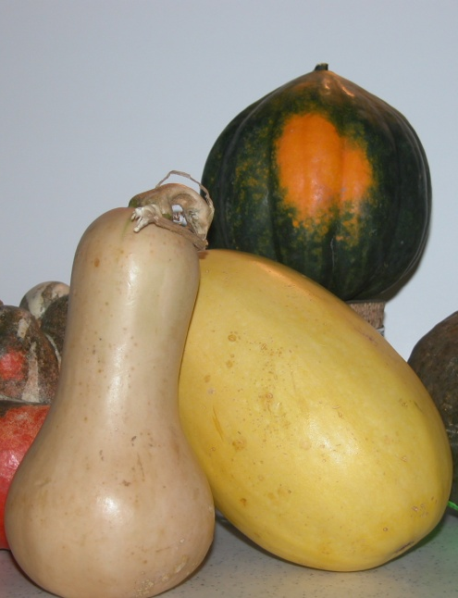
Polygenes, Epistasis, and Punnett Squares
Because polygenic traits involve multiple alleles, a standard Punnett square (with 4 squares) is not enough to predict what the offspring will look like.
When epistasis or polygenes are involved, we need to use larger Punnett squares to determine how the combination of multiple genes will affect the phenotype of that organism.
For example, the color of squash is determined by two different genes.
The “W” gene determines if the squash is white or colored.
The “G” gene determines if the squash is yellow or green (if it is colored).
A Ww_ _ or WW_ _ squash will always be white.
A wwGg or wwGG squash is yellow.
A wwgg squash is green.

Slide 15
Larger Punnett Squares
Imagine we cross-pollinate a double-heterozygous squash with another of the same genotype.
In other words, we pollinate a WwGg squash with another WwGg squash. What would their offspring look like?
To solve this problem, we would need to create a 16-square Punnett Square (called a dihybrid Punnett square).
 | WG | Wg | wG | wg
WG
Wg
wG
wg
WWGG | WWGg | WwGG | WwGg
WWGg | WWgg | WwGg | Wwgg
WwGG | WwGg | wwGG | wwGg
WwGg | Wwgg | wwGg | wwgg

Slide 16
Setting Up the DiHybrid Punnett Square
To set up the dihybrid Punnett square, we first have to break down each parent’s genotype into all the possible combinations that parent could give to their offspring.
When we are using a dihybrid Punnett square, we are looking at two different genes, each with two different alleles.
Because each parent contributes one allele from each gene, there are four possible combinations of alleles that each parent could pass onto their offspring.
For example, each squash parent had the genotype WwGg.
Each squash could give their offspring either the W or the w allele.
Each squash could also give their offspring either the G or the g allele.
This means that four possible combinations of these two genes could be passed on: WG, Wg, wG, or wg.
These are the letters that will go along the top and sides of the dihybrid Punnett square.

Slide 17
FOIL the genotype
An easy way to remember how to set this up is to remember the acronym “FOIL”, or First Letters, Outside Letters, Inside Letters, Last Letters.
Again, our squash genotype of WwGg.
The FIRST letters are WG.
The OUTSIDE letters are Wg.
The INSIDE letters are wG.
The LAST letters are wg.
 | WG | Wg | wG | wg
WG
Wg
wG
wg

Slide 18
Match up the Combo’s
Once we’ve set up the side and top of the dihybrid Punnett square, we simply need to match up each combination of letters to create the possible genotypes that could be created by this combination of parents.
Remember to keep similar letters together and to write capital letters first.
 | WG | Wg | wG | wg
WG
Wg
wG
wg
WWGG | WWGg | WwGG | WwGg
WWGg | WWgg | WwGg | Wwgg
WwGG | WwGg | wwGG | wwGg
WwGg | Wwgg | wwGg | wwgg

Slide 19
Determine the Offspring
Finally, use the predicted genotypes to determine what kind of offspring will be created by this cross.
In this case, we’d see the following (again, colorless is dominant; any uppercase W’s mean ‘no color’ or white)
Based on the Punnett square below, we’d 12 white; 3 yellow; 1 green from this cross (always make sure your totals add up to 16).
 | WG | Wg | wG | wg
WG
Wg
wG
wg
WWGG | WWGg | WwGG | WwGg
WWGg | WWgg | WwGg | Wwgg
WwGG | WwGg | wwGG | wwGg
WwGg | Wwgg | wwGg | wwgg

Slide 20
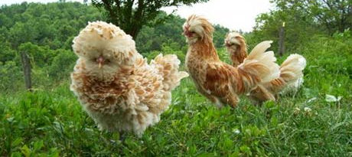
Pleiotropy
Sometimes a single gene can affect more than one trait.
When one gene influences multiple unrelated traits, this is known as pleiotropy (PLY-oh-TROH-pee).
For example, chickens can inherit a “frizzle” gene that causes them to produce fuzzy, poofy feathers.
This may look funny but can be advantageous for chickens in warm climates to help keep them cool.
However, the frizzle trait also causes these chickens to lay fewer eggs and have a reduced metabolic rate (they aren’t as efficient at producing ATP and grow less quickly).
A common example of human pleitropy is sickle cell anemia.
Sickle cell anemia is a mutation in the shape of blood cells.
Those heterozygous for sickle cell anemia also have greater resistance to malaria.
Source: backyardpoultrymag.com

