Slide 1
Feeding Ruminants
By C. Kohn
Dept of Agricultural Sciences, Waterford, WI

Slide 2
Ruminant Dietary Nutrition
The most important job of a farmer or a rancher is to adequately provide for the nutritional needs of their cattle.
All other needs are secondary to the daily need for proper nutritional care
All other needs (with the exception of air) are not as immediate or pressing as the need for high quality food and water.
An animal without quality food or water can very quickly die.
An animal without quality food or water is a neglected and abused animal.

Slide 3
Water Requirements

Slide 4
Water
Cattle without access to water on a summer day can die from heat stroke after only a few hours
In winter, water is equally important
Water is necessary for regulation of body temperature, growth, reproduction, lactation, digestion, lubrication of joints, eyesight, and as a cleansing agent.
Limiting water intake can depress animal performance more quickly and drastically than any other nutrient deficiency.
Source: North Dakota State Univ.

Slide 5
Estimated daily water intakes (gallons per head per day)
Dry Cows,
Monthly Lactating Bred Cows,
Month Average Temp Cows and Heifers Bulls
-------------------------------------------------------
(�F) - - gallons per head per day - -
January 36 11.0 6.0 7.0
February 40 11.5 6.0 8.0
March 50 12.5 6.5 8.6
April 64 15.5 8.0 10.5
May 73 17.0 9.0 12.0
June 78 17.5 10.0 13.0
July 90 16.5 14.5 19.0
August 88 16.5 14.0 18.0
September 78 17.5 10.0 13.0
October 68 16.5 8.5 11.5
November 52 13.0 6.5 9.0
December 38 11.0 6.0 7.5
-------------------------------------------------------
-------------------------------------------------------
Source: North Dakota State Univ.
Adapted from GPE-1400, Water Requirements for Beef Cattle.

Slide 6
Water requirements of growing and finishing beef cattle (gallons per head per day).
Table 2. Water requirements of growing and finishing beef cattle (gallons per head per day).
-----------------------------------------------------------------------------
Growing Cattle Finishing Cattle
------------------------ ----------------------------------
Month Avg. Temp. 400 lb 600 lb 800 lb 600 lb 800 lb 1000 lb 1200 lb
-----------------------------------------------------------------------------
(�F) - - - - - - - gallons per head per day - - - - - - - - - -
January 36 3.5 5.0 6.0 5.5 7.0 8.5 9.5
February 40 4.0 5.5 6.5 6.0 7.5 9.0 10.0
March 50 4.5 6.0 7.0 6.5 8.0 9.5 10.5
April 64 5.5 7.0 8.5 8.0 9.5 11.0 12.5
May 73 6.0 8.0 9.5 9.0 11.0 13.0 14.5
June 78 6.5 8.5 10.0 9.5 12.0 14.0 16.0
July 90 9.5 13.0 15.0 14.5 17.5 20.5 23.0
August 88 9.0 12.0 14.0 14.0 17.0 20.0 22.5
September 78 6.5 8.5 10.0 9.5 12.0 14.0 16.0
October 68 5.5 7.5 9.0 8.5 10.0 12.0 14.0
November 52 4.5 6.0 7.0 6.5 8.0 10.0 10.5
December 38 4.0 5.0 6.0 6.0 7.0 8.5 9.5
-----------------------------------------------------------------------------
-----------------------------------------------------------------------------
Source: North Dakota State Univ.
Adapted from GPE-1400, Water Requirements for Beef Cattle.

Slide 7
Access to Water
Cows given free access to water will produce more milk and more butterfat than cows allowed to drink only twice a day.
The same animal will consume different levels of water at different physiological states.
For example, a pregnant or lactating animal will consume more than an non-pregnant, non-lactating animal.
Source: North Dakota State Univ.

Slide 8
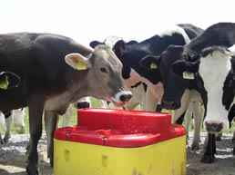
Cleanliness
Stale water can cause reduced water consumption - all water troughs should be cleaned frequently.
Livestock should never be forced to drink dirty or contaminated water.
Dirty water is a host for disease organisms.
Disease can spread rapidly if animals drink from the same trough, so sick animals should be isolated from the trough and the trough cleaned and disinfected.
A good disinfectant is dilute bleach solution after the trough has been thoroughly cleaned.
Sprinkling baking soda into the fountain periodically may reduce algae growth.
Source: North Dakota State Univ.
ritchiefount.com

Slide 9
Cleanliness
Have an elevated base around automatic waterers.
Make the base wide enough so animals can easily put their front legs on it when they are drinking, but not their hind legs.
Animals will not normally place only their hind legs on this base and therefore will not defecate in the water.
Source: North Dakota State Univ.

Slide 10
Composition of Water
Water quality and quantity may affect feed consumption and animal health.
Low quality water will normally result in reduced water and feed consumption.
Conversely, pure water is undesirable for livestock (pure water is never found naturally)
Certain salts and gases in solution make water more palatable if not excessive.
Overly salty or mineralized water can reduce the palatability (taste) of the water, reducing consumption.
Other materials which may effect palatability or toxicity include pathogenic microorganisms, oily substances, and pesticides.
Source: North Dakota State Univ.

Slide 11
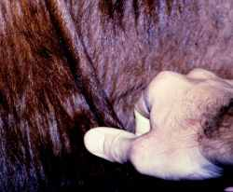
Checking for Dehydration
Signs of dehydration or lack of water are tightening of the skin, loss of weight, and drying of mucous membranes and eyes.
In cattle, the eyes will appear sunken and dull.
In lactating dairy animals, dehydration will cause milk production to nearly stop.
One way to check for dehydration is by skin tenting.
Pull the skin and hold a moment.
Release and count the seconds until the fold disappears.
On a dehydrated animal, the skin will stand for several seconds (like bread dough)
Source: North Dakota State Univ.
medical-dictionary.thefreedictionary.com

Slide 12
Feeding Requirements

Slide 13
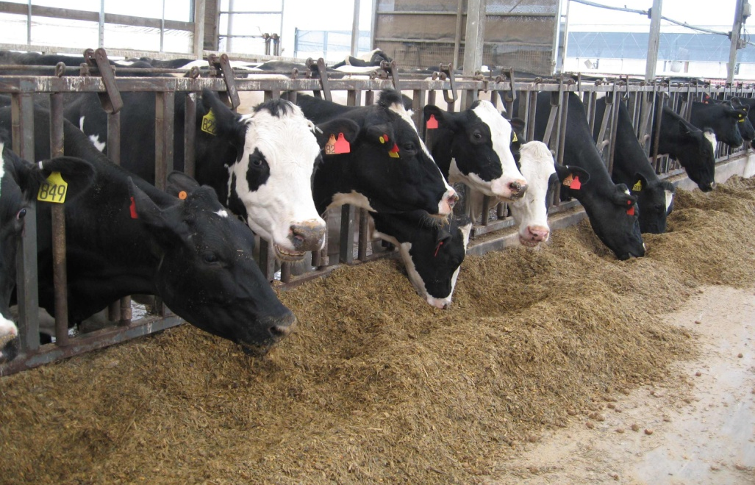
Feeding Challenges
Feeding cattle is never simple – the needs of cattle change with age, with productivity, and with weather.
Furthermore, each animal is different and no one feeding ration will equally meeting the needs of all animals in a herd even under similar circumstances.
Feeds must be adjusted to the changing needs of cattle and re-checked regularly.
research.vet.upenn.edu

Slide 14
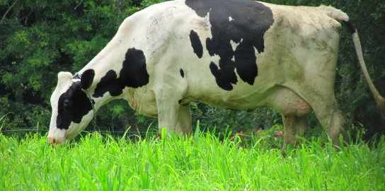
Component’s of a Cow’s Diet
A cow, like any living organism needs five key ingredients in her diet
Energy
Protein
Vitamins
Minerals
Water
To acquire these elements, a cow’s diet typically contains the following key ingredients: 1) forages, 2) energy concentrates, and 3) protein supplements.
Source: Univ of Minnesota Extension
ecocentricblog.org

Slide 15
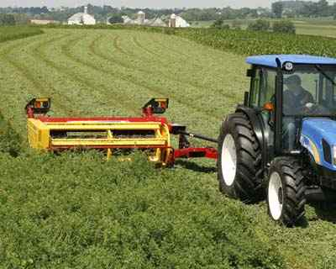
Forages
Forages are typically thought of as the hay/pasture/grassy portion of a cow’s diet.
Forages are not as energy dense as concentrates and most of the energy in a forage is in the form of cellulose.
However, immature forages can be more energy-dense
Source: Univ of Minnesota Extension
swiderskiequipment.com

Slide 16
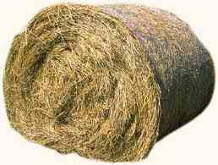
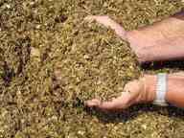
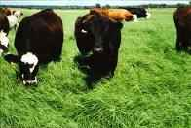
Forages
Categories of common forages
Legumes and grasses (alfalfa, hay, haylage) – These forages are excellent sources of protein, calcium, and other minerals if harvested and stored properly
As they mature, legumes and grasses decrease in energy and protein and increase in fiber (which reduces the digestibility of the food)
Terms: hay – cut and dired grass or alfalfa; haylage = fermented cut hay
Corn Silage - an excellent source of energy for dairy cattle - cows will eat large amounts of this feed.
Corn silage requires protein and mineral supplementation to be balanced for high milk production.
Terms: corn silage – fermented chopped corn leaves/stalks
Pasture – has the advantage of eliminating feed handling and manure hauling.
Additional grain is needed for high-producing cows.
As quantity and quality of pasture changes during the summer, cattle need to be supplemented with stored forages and other feeds
Source: Univ of Minnesota Extension
Source:carolvaage.net
Sourcecompletefeed.net
Source pasturegrass-seed.com

Slide 17
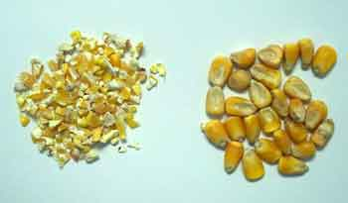
Energy Concentrates
Naturally, a ruminant would not need much more than grass in their diet (e.g. imagine the millions of buffalo that ate little other than grasses on the Great Plains).
However, the energy demands of domesticated cattle are much greater, requiring sources of supplemented energy.
Seed grains are the most traditional source of energy concentrate.
Breaking the seed coat increases digestion.
Cows will eat more grain if it is coarse-textured and processed because it will be more palatable.
Fine grinding of grain can increase digestibility , but can also lower milk fat percent and cause rumen acidosis.
Too coarsely-ground feed will not be completely digested; up ot 30% may pass completely through a cow undigested.
Source: Univ of Minnesota Extension
aragriculture.org

Slide 18
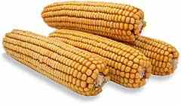
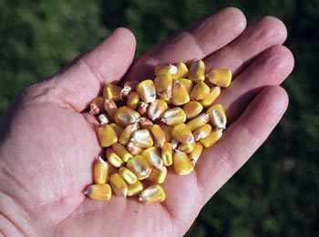
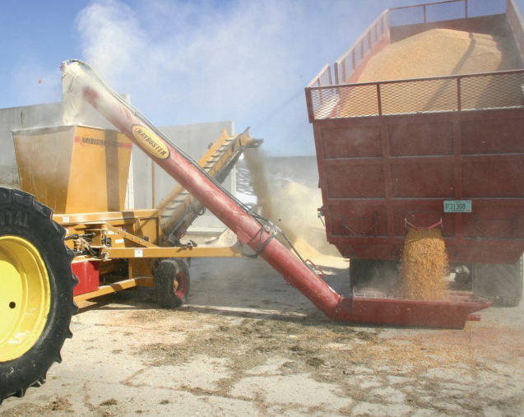
Examples of Feed Concentrates
Corn – corn is the most widely fed feed concentrate. Corn can be fed in several ways –
1. Whole ear – feeding a whole ear of corn provides more fiber but will also have proportionally less energy and is less digestible
2. Corn, shelled – shelled corn grain is the most commonly fed kind of corn. It is simply the kernels of corn fed straight to the cow. Because it is a dense source of energy, improper feeding can quickly lead to disorders.
3. High moisture corn – this is corn that is harvested with 24%+ moisture so that it can ferment in the silo. It can be harvested sooner, reduces the expense of drying it, is very palatable to the cow, and requires less labor to produce.
Source: Univ of Minnesota Extension
Source:ebirdseed.com
Source: cornstoverguide.com
Source: NDSU.edu

Slide 19
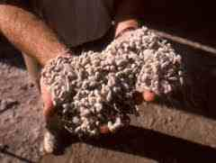
Examples of feed concentrates (cont)
Cottonseed - a medium protein, high fat, high fiber, and high energy feed. It is a low-cost by-product of the cotton industry
Whole cottonseed is white and fuzzy, while de-linted cottonseed is black and smooth in appearance.
The amount fed should not exceed 7 pounds per cow per day.
Corn-gluten – a relatively high fiber, medium energy, medium protein by-product of the corn wet milling industry.
Source: Univ of Minnesota Extension
Source: edcotcoopgin.com
Source: tradekorea.com

Slide 20
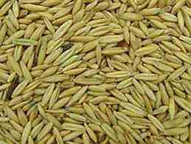
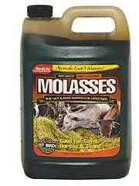
Examples of feed concentrates (cont)
Oats contain 15 percent less energy but 20 to 30 percent more protein than shelled corn.
The advantage of adding oats to dairy rations is that it adds fiber and bulk, and may help maintain rumen function.
Molasses (cane and beet sugar) is used primarily to enhance the taste of the ration.
The amount used should be limited to 5 to 7 percent of the grain mix to avoid rumen disorders and prevent clogging of equipment
Fat - several kinds of animal and vegetable fats or oils are available for feeding
Total added fat in diets should not exceed 4 percent (DM basis) with animal, vegetable or rumen inert fats individually not exceeding 2 percent.
Source: Univ of Minnesota Extension
extension.uidaho.edu
agway.com
kentshowfeeds.com

Slide 21
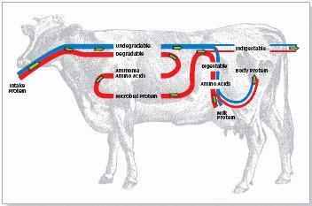
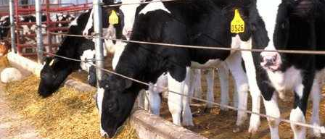
Protein Supplements
The requirement for protein is dependent upon the age of the cow, stage of production, and level of production. Protein requirements, like energy, are additive during any point in the cows production cycle
Cattle protein requirements are met by two basic sources, the feedstuffs that they consume and the microorganism that populate the rumen.
Dietary protein component can be divided into two categories:
Degradable intake protein (DIP)
Undegradable intake protein (UIP).
Source: Basic Nutrient Requirements of Beef Cows
robertscottbell.com
farmwest.com

Slide 22
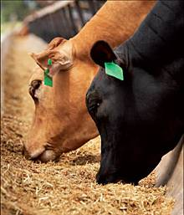
A Tale of Two Proteins
The DIP component is the protein from the diet that is digested in the rumen, utilized by rumen microorganisms, and ultimately becomes bacterial (microbial) protein.
This is the protein that a cow gets from the bacteria; the cow is the ‘second’ one to get the protein.
The UIP component is the protein fraction of the diet that is not digested in the rumen and that thereby "escapes or bypasses" the rumen. This is also called “bypass protein”.
The UIP protein may then be digested and absorbed in the small intestine – it bypasses the microbes and goes directly to the cow.
Together, the bacterial protein and UIP fraction comprise the metabolizable protein available for the cow to meet her protein requirement.
Source: Basic Nutrient Requirements of Beef Cows
lasatergrasslandbeef.blogspot.com

Slide 23
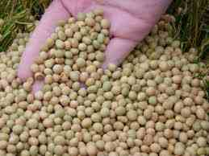
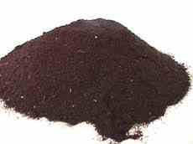
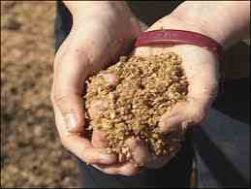
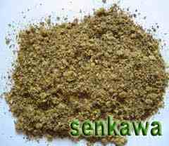
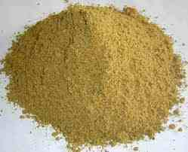
Protein Supplements
celsias.com
Soybeans are an excellent source of crude protein and fat for cattle.
Cows should be adjusted to beans gradually to avoid diarrhea and off-feed.
Roasting, extruding, or other heat processing reduces anti-protein factors and urease activity and increases UIP value of the soybeans.
Bloodmeal is dried blood from animal processing plants.
Bloodmeal is high in true protein, UIP and the amino acid lysine.
Do not feed in diets high in moisture, as palatability can become a problem
Brewers grain, a by-product of the fuel ethanol and beer industries, contains 70 to 80 percent water.
On a dry matter basis, brewers grains are high in protein and a fair source of energy.
Cottonseed Meal – made from oil of whole cottonseed, this produce is very palatable to cows but varies in protein content.
Fishmeal includes bones, head, trimmings, and fish parts. Fish oil is high in protein but reduces fiber digestion in the rumen.
Source: Univ of Minnesota Extension
ca.uky.edu
kval.com
allproducts.com

