Slide 1
Antibiotics
By Craig Kohn, Waterford, WI
Based on Kirkham’s “Animal Health Management”.

Slide 2
Drugs
Drugs used by veterinarians and producers may be classified in one of two categories:
1. Pharmaceuticals: mainly used for the treatment of a disease or infection (such as an antibiotic).
2. Biologicals: used to prevent a disease (such as a vaccine).
Both can play an important role in the health of animals.
Pharmaceuticals should only be used for their approved and intended purposes.
Use of a pharmaceutical in a way not intended by a producer is called off-label usage.
A licensed medical professional can prescribe a use of a pharmaceutical in a way not originally intended; this is call extra-label usage.

Slide 3
Pharmaceuticals
Pharmaceuticals are very specific in their action and effectiveness.
A pharmaceutical should never be used without a solid diagnosis that requires that particular treatment.
Pharmaceuticals can come in a variety of forms, including:
Drenches
Boluses
Liquids
Feed Additives
Powders

Slide 4
Pharmaceuticals: In General
For a pharmaceutical to work, a sufficient dosage level must be reached and maintained for a specific length of time.
The route of administration, dosage, and frequency of dosage are all important factors in sustaining an adequate dosage level for fighting a disease.
The ideal pharmaceutical should…
Have selective and effective antimicrobial activity.
Should kill bacteria, not just slow its growth.
Should not cause the buildup of microbial resistance.
Should reach a dosage level quickly and maintain it.

Slide 5
Types of Pharmaceuticals
”.

Slide 6
Antibiotics
Antibiotics are pharmaceuticals used to treat bacterial infections.
The word “antibiotic” means “against life”.
In the case of veterinary medicine it means “against bacterial life”.
Some antibiotics are specific in killing only a certain strain of bacteria – these are called narrow spectrum antibiotics.
Others are effective against a wide range of bacteria.
These are called broad spectrum antibiotics.
Examples of antibiotics include penicillin, tetracyclines, and neomycin.

Slide 7
Antibiotics
Antibiotics kill bacterial cells by interrupting a key cellular function.
They originally came from fungi (molds).
They have no effect on viral diseases.
Different bacteria often require different antibiotics.
Antibiotics work using at least one of four mechanisms:
Breached bacterial cell walls
Bacterial cells need their cell walls to be protected from their environment
Some antibiotics ‘break’ open this cell wall, exposing the inside of the bacterial cell to the surrounding environment.

Slide 8
Antibiotic Mechanisms
Interruption of protein manufacturing (ribosomes).
When the ribosomal function is impaired, proteins cannot be produced by the bacterial cell.
Proteins are the functional component of a cell – without proteins, the cell cannot perform most of its function.
Disrupted metabolic processes – the antibiotic disrupts a key process needed for cellular function.
For example, bacterial cells need to produce folic acid to survive.
This class of antibiotics could prevent the production of folic acid from occurring.
Blocked DNA / RNA synthesis.
DNA in a cell must continuously be replicated and transcripted (copied) into RNA for translation.
Without instructions from its DNA or RNA, a cell cannot function and will shutdown.

Slide 9
Antimicrobial groups approved for cattle:
Antibiotic Class | Antibiotic Within Class | Resistance Mechanism | Lipid Solubility | ~ Protein Binding %
Aminocyclitols | Spectinomycin | PS | Low | Low
Aminoglycosides | Gentamicin, Neomycin | PS | Low | 20-25%
Beta-lactams | Penicillin G, Ampicillin, Ceftiofur | CW | Low | P&A 20, Cef 80+
Chloramphenicol derivatives | Florfenicol | PS | High | 60
Fluoroquinolones | Enrofloxacin, Danofloxacin | GR | High | Low
Lincosamides | Lincomycin | PS | High | 55-75
Macrolides | Erythromycin, Tilmicosin, Tylosin | PS | High | 70-80
Sulfonamides | Sulfa - dimethoxine, methazine, chlorpyridazine | MP | Low | SM 70, SDM 80-85
Tetracyclines | Oxytetracycline, Chlortetracycline | PS | Intermediate | OTC 20-25, CTC 65
CW | crippling production of the bacterial cell wall that protects the cell from the external environment
PS | interfering with protein synthesis by binding to the machinery that builds proteins, amino acid by amino acid
MP | wreaking havoc with metabolic processes, such as the synthesis of folic acid, that bacteria need to thrive
GR | blocking genetic replication by interfering with synthesis of DNA and RNA
Slide courtesy of the Great Plains Vet Education Center

Slide 10
Sulfa Compounds
Sulfa-based drugs work by preventing the reproduction of bacteria, allowing the host’s immune system to get a fighting chance
Sulfa drugs are considered broad-spectrum treatments – they work against a variety of bacterial species.
Because they work against a wide variety of bacteria, sulfa compounds can also become ineffective if overused.

Slide 11
Nitrofurans
These are broad-spectrum drugs that inhibit the growth of pathogenic bacteria
They are very effective in digestive infections
They also have low toxicity
These are an effective treatment in many ear, skin, eye, and genital infections

Slide 12
Steroids
Steroids are commonly used to reduce the inflammation that can lead to systemic shock in a patient.
Steroids cause blood vessels to constrict, preventing blood pressure from dropping too much.
However, steroids can also compromise the function of the immune system
Steroid-use is complex and should only be used under the careful watch of a veterinarian

Slide 13
Antibiotic Resistance
”.

Slide 14
Drug Resistance
In some cases, not all the bacteria that caused the original infection are destroyed by the pharmaceutical; this can lead to drug resistance.
Resistance: when a pharmaceutical becomes ineffective against its intended pathogen due to overuse, abuse, or inappropriate use.
Resistance is where the surviving bacteria pass on genes for protection from a drug when they divide into daughter cells or interact with other bacterial cells.
The drug that was used to treat this infection becomes ineffective against the new strain of bacteria and does not kill it.
Resistance occurs because of changes in the bacteria’s genetic material.
These changes can occur due to a variety of reasons.

Slide 15
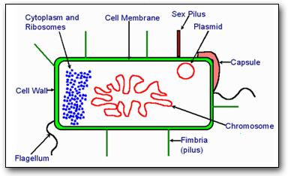
Bacterial Genetics
Like animals and plants, bacteria have double-stranded DNA.
However, the bacterial chromosome is a double stranded DNA molecule that forms a loop (like a donut).
Because bacteria lack a nucleus, they are more susceptible to mutation (a change, deletion, or addition of DNA).
Usually mutations are very bad, but sometimes a beneficial mutation can arise that gives that particular bacterial cell an advantage in its environment.
This is rare but over millions of bacterial cells this will occur occasionally.
Chromosomal Resistance. occurs when a random mutation creates a source of protection for bacteria that did not exist before.

Slide 16
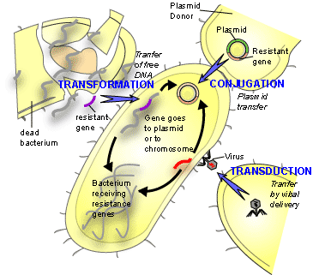
Bacterial Genetic Transfer
Pharmaceutical resistance is more likely to occur when a beneficial mutation is transferred from one bacterial cell to another via plasmids.
This is known as Plasmid Resistance.
In order for plasmid resistance to occur, genes must be transferred from one cell to another.
With plasmid resistance, bacteria “share” genes for resistance.
Bacteria are able to exchange genes in one of 4 ways:
1. transformation
2. transduction
3. conjugation
4. transposon insertion
Source: http://textbookofbacteriology.net/resantimicrobial_3.html

Slide 17
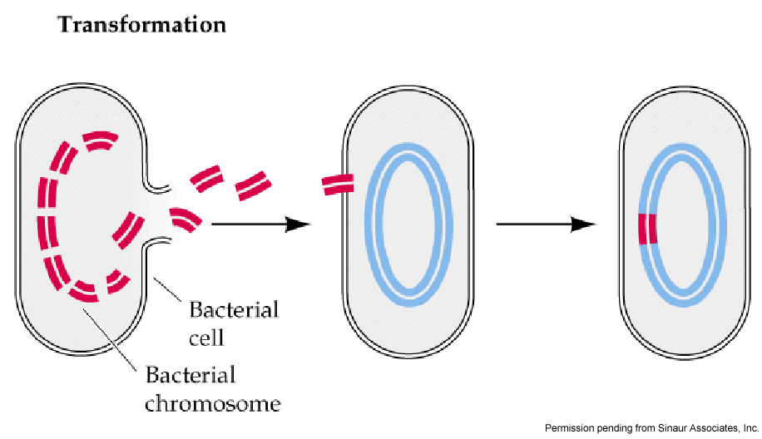
Transformation
Transformation occurs when DNA fragments from one bacterium (released when the cell is lysed, or broken open) are absorbed by other bacterial cells.
The absorbed DNA can then be incorporated into the recipient bacterial cell’s DNA
This can only occur if the DNA of the recipient bacteria is very similar to the donor bacteria
This is why transformation usually only occurs among bacteria of the same species

Slide 18
Transduction
Transduction occurs when a virus that infects bacteria carry DNA from one bacterial cell to another.
These viruses are called bacteriophages.
A virus is a crystalline-protein structure that surrounds a molecule of DNA or RNA; it is not alive and reproduces by ‘hijacking’ other cells.
Some bacterial cells have repressors that stop the action of a bacteriophage.
In the process of fighting these viruses, the bacterial genes may become replicated and released with the virus particles.
The virus particles, when infecting other cells, may release these genes.

Slide 19
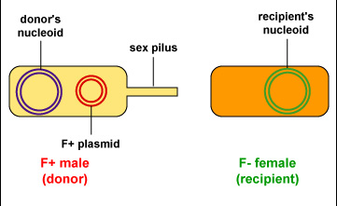
Conjugation
Conjugation is sort of like ‘bacterial sex’.
In conjugation, DNA is transferred by cell-to-cell contact.
For conjugation to occur, a bacterium must have a plasmid with genes for resistance that exists outside of its regular chromosomes.
We call these F-plasmids.
Cells with F-plasmids are called F(+) Donors
Cells without the plasmids that receive are called F(-) Recipients.

Slide 20
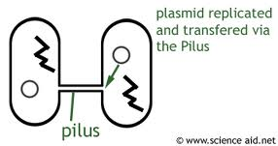
Conjugation
The F-plasmid has genes that encode for proteins that form the something that looks and works like a penis on the cell’s surface.
Because of this ‘extra’ F-plasmid, a bacteria can grow a sex pilus, a hair-like appendage used for exchanging genes.
When a F(+) donor wishes to exchange genetic material, it activates these proteins which forms a sex pilus on its surface.
The sex pilus forms a ‘bridge’ between the two cells, and the F(+) cell donates a F-plasmid strand.
This strand may potentially carry the genes for pharmaceutical resistance
Source: scienceaid.co.uk

Slide 21
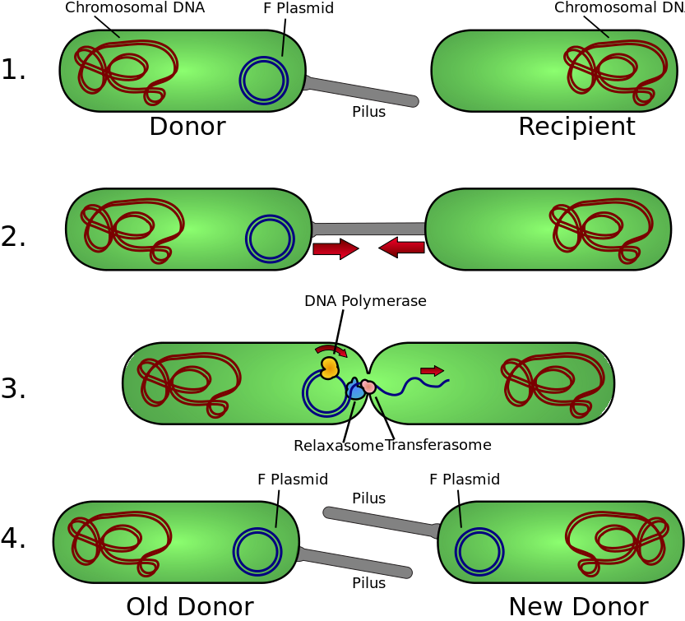
Conjugation
The strand that is passed to the new cell is single-stranded.
This strand was double-stranded; one stranded is kept by the original bacterial cell and one is sent to the new bacteria cell.
The single-stranded plasmids than duplicate themselves to become double-stranded again.
F-plasmids are responsible for actions such as creating enzymes that degrade penicillin or the release of certain exotoxins
Source: http://upload.wikimedia.org/wikipedia/commons/thumb/3/3e/Conjugation.svg/833px-Conjugation.svg.png

Slide 22
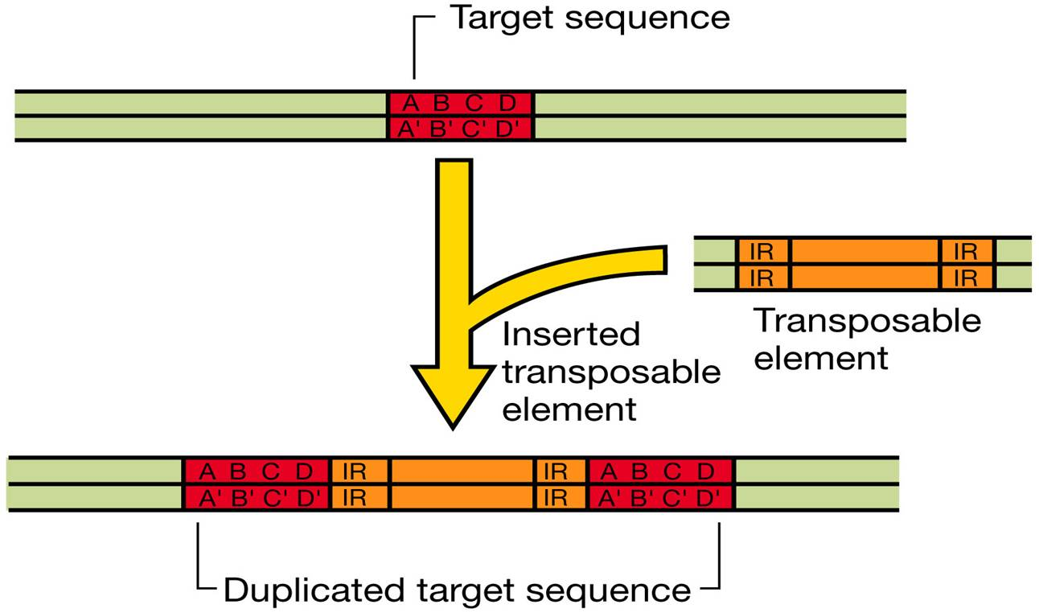
Transposons
Transposons are “jumping genes”.
They have special sequences that enable themselves to be inserted anywhere in a bacterial cell’s genome.
Transposons are not plasmids and cannot reproduce on their own; transposons can only “jump” into new genomes.
Once they insert themselves into a plasmid, they can be spread via conjugation.
Source: http://202.204.115.67/jpkch/jpkch/2008/wswx/chapter%2010.htm

Slide 23
Mechanisms of Resistance
Bacterial cells can become resistant to antibiotics in a number of ways.
One mechanism of resistance is to have reduced permeability to absorption of an antibiotic.
Because gram negative bacteria have an extra ‘outer layer’, they are less susceptible to antibiotics.
A second possible mechanism is to have efflux pumps.
While the antibiotic can get past the cell membrane, it is immediately ‘pumped out’ by the efflux pumps.

Slide 24
Mechanisms of Resistance
A bacterial cell can also have antibiotic-deactivating enzymes.
The bacterial cell produces special protein enzymes that deactivate or destroy the antibiotic.
The cell can also produce an altered-binding site.
The antibiotic will bind to a non-important part of the cell.
This binding will deactivate the antibiotic.
Finally, the bacterial cell can over-produce the substance the antibiotic targets.
Like the altered-binding site mechanism, the antibiotic will be deactivated without destroying all of its target.

Slide 25
Slide courtesy of the L. Dyner, MD, Standford University

Slide 26
Factors that Promote Resistance
Bacterial antibiotic resistance is more a risk when the following occur:
Exposure to lower levels of antimicrobials than prescribed.
If a patient does not receive the full dose of antibiotics, some bacterial cells will remain, causing them to re-grow and spread.
Exposure to broad-spectrum antibiotics (which aren’t specific to a microbe).
Broad-spectrum antibiotics are easier for a bacterial cell to overcome and are not as effective in destroying a pathogenic bacteria as a narrow-spectrum antibiotic.
Exposure to microbes carrying resistant genes
When a bacterial cell encounters a different resistant-bacterial cell, it can acquire its genes.

Slide 27
Factors that Promote Resistance
Bacterial antibiotic resistance is more a risk when the following occur (cont.):
Lack of hygiene in clinical environments.
Overuse of antibiotics in foods/agriculture.
Inappropriate antimicrobial use, including:
Prescriptions not used/taken for a total duration of therapy.
Antibiotics for viral infections.
Antibiotics sold without medical supervision.

Slide 28
This graph shows both the introduction of different kinds of antibiotics and when resistance to the antibiotic was first observed.
In some cases, the antibiotic experienced resistance within 10 years of its creation.
Slide courtesy of the L. Dyner, MD, Standford University

