Slide 1
The Chemistry of Fuel
By C. Kohn
Agricultural Sciences
Waterford, WI

Slide 2
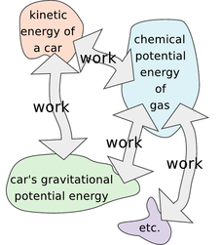
Matter & Force
Everything in the universe can be grouped into one of two categories:
Matter: anything that has mass and takes up space.
Force: something that changes the motion of an object (a push or pull).
Work is defined as the distance that a force pushes or pulls an object (matter).
Work = Force x distance.
W = F*d
Source: www.lightandmatter.com

Slide 3
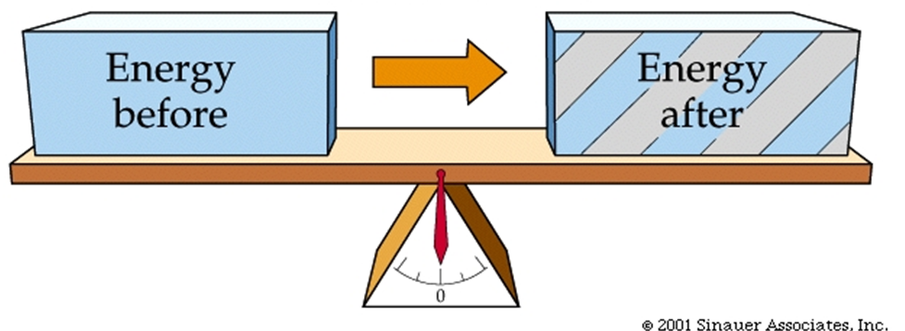
Energy
Energy is defined in chemistry as the ability to do work.
In other words, energy is the capacity to make something happen.
For example, the energy of moving water can make a wheel turn.
The turning of a wheel can generate electricity.
The flow of electricity can turn the blades of a fan in your house.
The use of energy is constrained by two laws.
The Laws of Thermodynamics describe the physical characteristics and limits of energy.
For example, when someone refers to “energy production”, they are actually referring to “energy transformation”.
Energy transformation occurs whenever matter changes position (movement) or whenever matter changes state (for example, combustion or melting).
Source: https://smartsite.ucdavis.edu/access/content/user/00002950/bis10v/week2/2webimages/figure-06-03a.jpg

Slide 4
Laws of Thermodynamics
The First Law of Thermodynamics is that energy cannot be created or destroyed.
The total amount of mass and energy in the universe is always the same.
You cannot change the amount of energy, only the form of energy.
For example, if energy is converted into electricity, that electricity can be used to power a fan, but some of that energy will be converted to heat and noise as well as motion. However, all of the same energy will exist in the fan as it did in the electrical wires.
The First Law of Thermodynamics can be represented by the formula E = W + Q, where E is the total energy, W is the work, and Q is the heat produced.
More accurately, we can use the formula ∆Q + ∆W = ∆E, where ∆E is the change in the energy of the system, ∆Q is non-useful work (heat and noise) and ∆W is the work done.
∆ refers to “change”.

Slide 5
Entropy
As energy changes forms, it usually becomes more inaccessible and less useful.
For example, the gasoline in the tank of a car is compact, useful, and easily stored and transported.
However, as the energy in the gasoline is converted into the movement of the car, the energy becomes dispersed as heat and noise in addition to motion.
While the energy of the motion could be “recaptured” and used elsewhere, the heat and noise are mostly unusable sources of energy.
While the total amount of energy remains the same, the amount of “useful” energy is reduced as more and more becomes heat and noise as the energy is converted.
The Second Law of Thermodynamics states that the non-useful energy increases overtime.
In other words, as energy is transformed through work, the amount of unavailable energy increases.
The increase in disorder that results as energy transforms from useful to non-useful energy is known as entropy.
Each time work is produced through a conversion of energy, the amount of entropy in the universe increases.

Slide 6
Efficiency
The amount of entropy that results from a transformation of energy can be used to define whether or not a fuel is efficient.
Efficiency is defined as the work done as compared to the energy needed.
Efficiency can be calculated mathematically as N = work done/energy spent.
N = efficiency.
Another way of writing this is N = work output/energy input.
For example, a well maintained automobile has an efficiency of 8-12%, meaning about 90% of the energy from gasoline is converted into heat and noise and only 10% of the energy is actually transformed into motion.
A hydroelectric plant has an 80% efficiency, while only 30-40% of the energy in coal is converted into electricity.
In the human body, only 20% of the calories you consume is used to keep your body functioning, while roughly 80% is lost as unutilized heat.
90% Heat
10% Motion

Slide 7
Kinds of Energy
There are two kinds of energy: potential and kinetic.
Kinetic energy is the energy of motion.
Potential energy is kind of like “stored” energy; potential energy is the energy of an object due to its relative position.
For example, a ball on top of a hill has potential energy because it can roll down the hill, transforming into kinetic energy.
Water at the top of a waterfall has more potential energy than at the water at the bottom because it has the potential to fall further (meaning it has the potential to do more work).
Potential energy can also be used to describe chemical reactions.
More stable molecules have a lower potential energy than less stable molecules.
For example, gasoline is very unstable – a small amount of energy (such as a single spark) can cause a huge release of energy (or an explosion), which means gasoline has a higher potential energy.
Water is very stable and therefore has very low potential energy (and low value as a potential fuel).
A single spark will not cause water to explode like it would cause gasoline to explode.

Slide 8
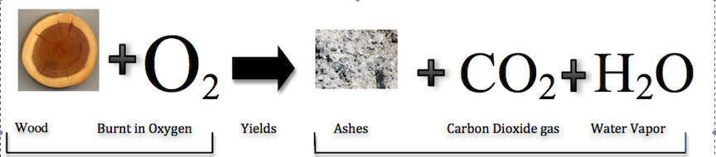
Bond Energy
The value of a type of molecule as a fuel depends on the bond energy of that molecule.
Bond energy is the amount of energy released when a bond is formed between two atoms.
Energy is used to break a bond and energy is released when a bond is formed.
Energy can be released when a reaction causes a molecule with a higher potential energy (the reactant) to be rearranged into molecule(s) into lower potential energy (the product) through a chemical reaction.
For example, when wood is burned in a campfire, heat and light are produced because the molecules of the wood with high potential energy are being converted into CO₂ and H₂O (with low potential energy).
Because there is ‘leftover’ energy, it is emitted as light and heat; the greater the reaction, the more intense the light and the heat.
In this case, wood and oxygen would be the reactants and CO₂ and H₂O would be the products.
Source: chemwiki.ucdavis.edu

Slide 9
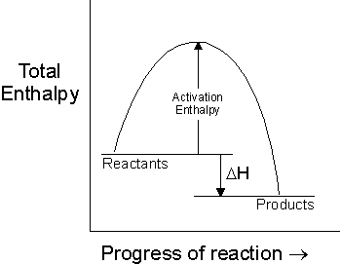
Enthalpy
A molecule that is a valuable fuel is one whose atoms can be broken apart with minimal energy and causes a large release of energy when those atoms reform a more stable molecule.
A reaction (such as combustion) that causes energy to be released is called exothermic.
A reaction that absorbs energy as it occurs is called endothermic.
Enthalpy is the amount of energy absorbed or released because of a reaction.
Enthalpy is symbolized with an H in chemistry.
Enthalpy is negative in an exothermic reaction (energy is lost to the surroundings) and enthalpy is positive in an endothermic reaction (energy is gained from the surroundings).
Enthalpy
Source: www.avogadro.co.uk

Slide 10
Activation Energy
Reactions typically require an activation energy in order to start a reaction.
In a reaction that involves burning, this is the “spark” that starts the fire (or combustion reaction).
In an exothermic reaction, while an input of energy is needed to start the reaction, the amount of energy released is greater than the energy absorbed as activation energy, resulting in a release of energy to the surrounding environment.
Burning, or combustion, is the exothermic reaction in which atoms of a molecule are rearranged with those of oxygen (O₂) at high temperatures to form stable molecules.
Because the burned substances (reactants) require less energy to be “broken apart” than the energy that is released when CO₂ and H₂O (the products) are formed, burning is exothermic and causes a release of energy in the form of heat and light.
Activation Energy
Source: www.avogadro.co.uk

Slide 11
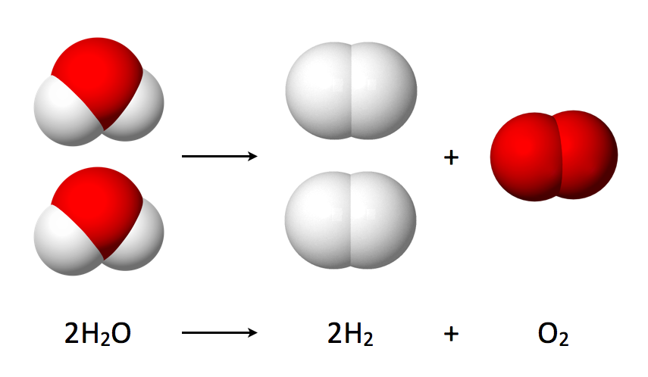
Water as fuel?
Bond energies can also be used to explain why water would not be valuable as a fuel.
Because water is stable and has a low potential energy, the hydrogen and oxygen cannot form a more stable molecule with a higher bond energy.
The only way in which water could be used as a source of fuel would be to use an input of energy to break apart the molecule in order to cause the release of energy when the hydrogen bonds to oxygen.
Because energy needed to break apart the water molecule is as great (or greater) than the energy given off when the water re-forms, there would be no energy gained by using water as a fuel.
Because of entropy and inefficiency, the use of water as a fuel would actually result in the loss of usable energy.
Input of Energy →
Source: en.wikipedia.org

Slide 12
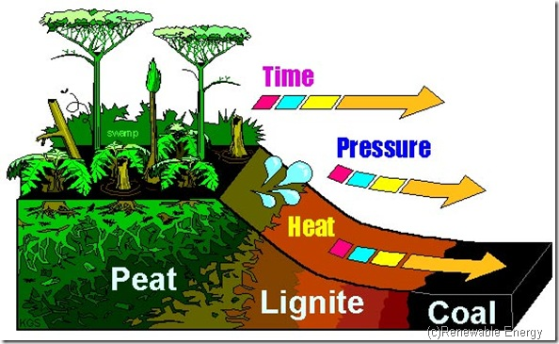
Fossil Fuels
Bond energies are a primary reason why fossil fuels have a high potential energy as a fuel.
Fossil fuels are hydrocarbons, or molecules comprised of carbon and hydrogen.
The energy need to separate the carbon from hydrogen and other carbon atoms (as well as the energy needed to break apart O₂) is far less than the bond energy given off when CO₂ and H₂O are formed.
Fossil fuels are valuable as fuel because the energy needed to break the molecular bonds is much less than the energy released by the formation of H₂O and CO₂.
Petroleum is a blend of many different kinds of hydrocarbons formed from prehistoric plants and animals.
The accumulation of pressure and temperature turned organic carbon molecules into simpler forms of hydrocarbons.
Other elements were “squeezed” out of the molecular structure of organic carbon by this intense heat and pressure.
Source: solarpowerwindenergy.org

Slide 13
Refinement
In order to produce the products that consumers use (such as gasoline, diesel fuel, natural gas, and kerosene), the petroleum must be heated to a variety of different boiling points.
As the petroleum is heated to higher temperatures, each type of petroleum product will evaporate as it reaches its boiling point.
Small petroleum molecules, such as propane, have a very low boiling point and will be the first to evaporate.
Higher temperatures will be needed for larger molecules such as gasoline (chains of 5-12 carbon atoms), kerosene (12-16 carbon atoms), and lubricating oil (16-20 carbon atoms).
Petroleum-based fuels are valuable because they provide a concentrated source of energy that can be easily transported and stored, can be widely used and distributed, and can be sold at a price that most consumers can afford.
For this reason, fossil fuels provide about 85% of the energy used by the United States.
However, petroleum-based fuels have many drawbacks that limit or reduce their value as fuels.
Source: www.eoearth.org

Slide 14
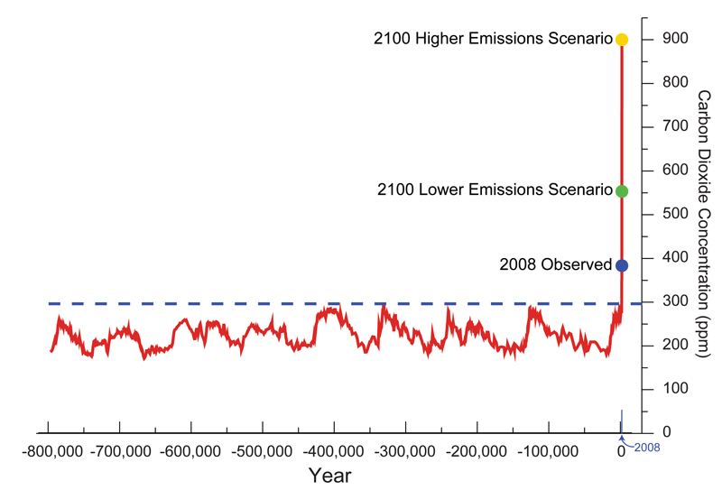
Carbon Dioxide & Climate Change
The main concern with the use of petroleum-based fuels is the byproducts that result from their use.
Carbon dioxide (CO₂) is the main byproduct of the use of fossil fuels.
Since the start of the Industrial Revolution, the use of fossil fuels has been linked as the primary cause of increases to atmospheric levels of carbon dioxide.
The increase of atmospheric CO₂ slows the loss of surface heat from the planet, resulting in a collection of changes to weather patterns and precipitation known as climate change.
Due to climate change, unpredictable weather patterns are affecting ecological processes and pose a threat to the businesses and economies throughout the world due to the uncertainty of these changes and their impact on the use and availability of natural resources.
Source; www.skepticalscience.com

Slide 15
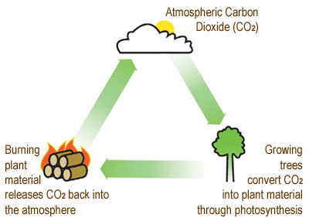
Carbon Neutral Fuels
Unlike fossil fuels, fuel made from renewable plant-based sources are carbon neutral.
This means that the carbon dioxide that is released when plant-based fuels are combusted will be reabsorbed when those plants are re-grown, resulting in no change to the total amount of atmospheric carbon dioxide.
On the other hand, the carbon dioxide released from the combustion of fossil fuels is not reabsorbed to the same extent, resulting in increases to the total amount of carbon dioxide in the air with each passing year.
Source: nared.org

Slide 16
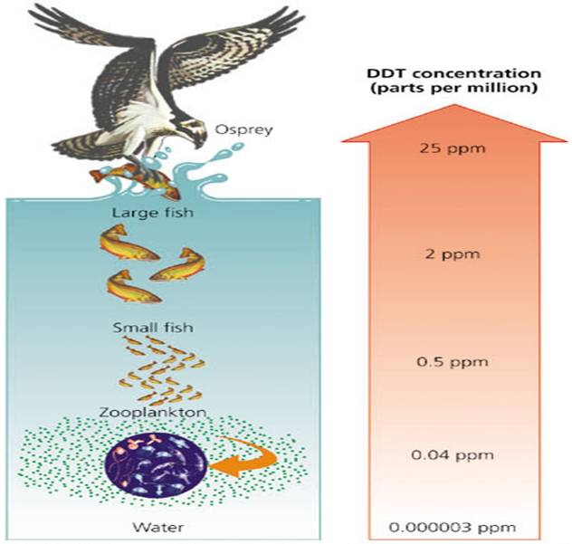
Air Pollution
Fossil fuels are a primary cause of air pollution.
This is primarily due to the fact that when petroleum products and coal are combusted, the combustion reaction does not fully occur.
In other words, the fossil fuel molecules do not completely break down during combustion.
The partially-combusted fossil fuel products are highly reactive and are very small, and they will easily bind to particulates in the smoke to form cancer-causing agents.
Fossil fuels also contain nearly every element on the periodic table, including mercury and lead.
Because widely-used fossil fuels, these elements are found in increasingly-high levels in the environment.
Lead and mercury levels are of particular concern because of their ability to biomagnify.
Biomagnification is the process in which a pollutant (such as mercury and lead) increase in concentration as they make their way up the food chain from producers (plants) to consumers (herbivores) to secondary consumers (predators).
Pollutants that biomagnify can be found in very small concentrations in the environment but can reach toxic levels in top predators like eagles, sharks, & humans.
Source: www.meritnation.com

Slide 17
Limited & Inefficient
Petroleum-based fuels are also limited in supply.
Fossil fuels can be used far more quickly than they can be created.
For this reason, it is expected that petroleum-based fuel production will peak in the next 100 years, possibly as early as 2020 (if it hasn’t already happened).
While it is unlikely that the world will every physically run out of petroleum, it will run out of easily-accessibly petroleum.
This means that as petroleum becomes harder and harder to access, it will become more and more expensive to the consumer.
Fossil fuels have a net energy loss when they are produced.
It takes 1.23 BTUs of fossil fuel to produce 1 BTU of gasoline.
This means that for the energy equivalent of 1 gallon of gasoline, it took the equivalent of over 1.2 gallons to produce it.
This is because of the energy needed to drill, refine, and transport the fuel.

Slide 18
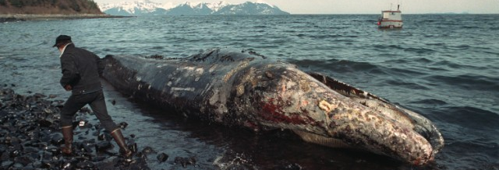
The Impacts of Oil
The processes of exploration and acquisition of fossil fuels are also closely associated with environmental and health problems.
Almost all fossil fuels are found deep beneath the surface of the earth, requiring methods that are often invasive and harmful to the environment.
Exploration and production of petroleum have caused detrimental impacts to soils, groundwater, and ecosystems in 36 states.
This damage was primarily caused by improper disposal of wastewater, oil spills, and problems after mining or drilling (such as leakages, fires, and cave-ins).
While some environmental concerns are clearly evident, such as the Exxon Valdez spill in Alaska and the Deep Water Horizon spill in the Gulf of Mexico, many other environmental impacts are less obvious and occur over much longer periods of time.
Source: www.cnn.com

Slide 19
Alternatives
Because fossil fuels are limited in supply, likely to become increasingly expensive, are inefficient to produce, can cause severe health problems, and are a primary cause of climate change and other environmental problems, alternate sources of fuel would be socially, economically, and environmentally ideal.
The challenge is to find a fuel that is as energy-dense, as easily transported and distributed, can address modern energy needs, and is as cost-effective as petroleum-based fuels that will cause less harm to the environment.
In order for a fuel to replace petroleum-based fuels in the United States, it must perform as well or nearly as well as petroleum products at a similar cost with much fewer negative side-effects.
Source: mgsenergy.com

