Slide 1
Biodiesel
By C. Kohn
Agricultural Sciences
Waterford, WI

Slide 2
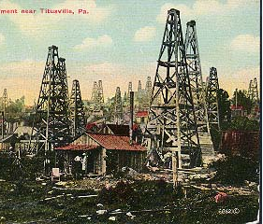
The Internal Combustion Engine
The internal combustion engine is an engine that is capable of converting chemical energy into thermal energy in order to finally generate mechanical energy.
The internal combustion engine moves a vehicle by mixing fuel and air in a combustion chamber.
When the mixture of fuel and air is ignited, it creates a small explosion that pushes down a piston, turning a crankshaft and driving the vehicle’s wheels.
While many prototypes of an internal combustion engine were developed prior to the Industrial Revolution, the discovery of crude oil in Pennsylvania in 1859 enabled the internal combustion engine to become the primary source of power for transportation.
Prior to this point, there was not a reliable fuel available that could make the internal combustion engine feasible for common use.
The closest substitutes, including whale oil, coal, and gunpowder were unreliable and inconsistent.
Petroleum from places like Pennsylvania provided the gasoline and lubricating oil necessary for a modern internal combustion engine.
Source: little-mountain.com

Slide 3
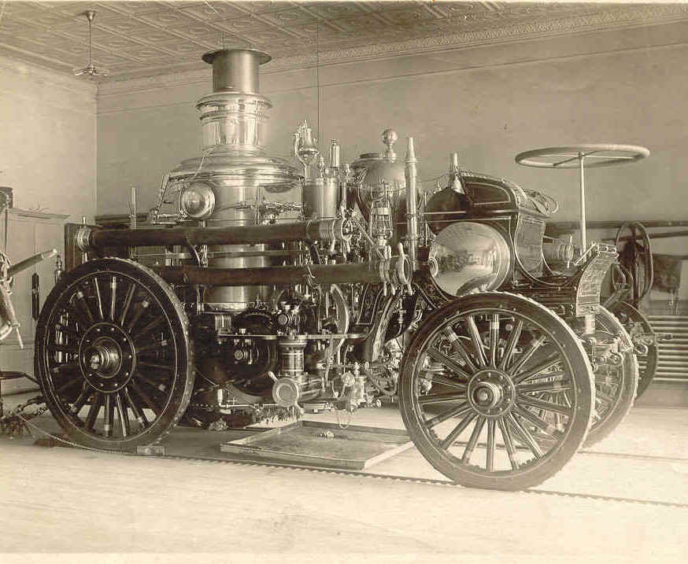
Combustion Competition
The internal combustion engine developed through competition with other forms of propulsions, namely steam and electricity.
Electricity and steam were largely eliminated as transportation fuels because of the limited distances and conditions under which they could reasonably travel.
Steam also fell out of favor because it required large start-up times to build a fire and heat a boiler; unlike a modern automobile, you couldn’t just start it and go.
Electrical propulsion was largely limited to city centers; while electric rail is very feasible (and still used today), it is relatively difficult to power electric transportation outside of a major city.
Source: www.gopixpic.com

Slide 4
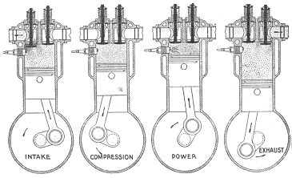
Four Stroke Ignition Engine
By 1900, two key kinds of internal combustion engines had been developed:
The first was the four-stroke spark ignition engine. This engine has two key characteristics:
1. The engine requires a spark plug to ignite the fuel to create the combustion and explosion the pushes a piston.
2. The engine requires four strokes, or movements, of the engine’s piston before the cycle repeats. These four strokes include:
A. Intake Stroke (˅): fuel and air are drawn into the combustion chamber at a normal pressure by the piston moving downward away from the combustion chamber.
B. Compression Stroke (˄): the piston moves towards the chamber, compressing the fuel/air mix.
Source: www.carbasics-1950.com

Slide 5
Four Stroke Engines
C. Power Stroke (˅): the spark plug gets a brief electrical current, which creates the spark that ignites the fuel/air mixture. This creates heat and pressure, which pushes the piston back down to turn the drive shaft, and produces exhaust gases.
D. Exhaust Stroke (˄): the combustion chamber is cleared of exhaust gases as the piston moves back towards the combustion chamber so that the engine can absorb fresh fuel and air for the next combustion cycle.
Source: www.carbasics-1950.com

Slide 6
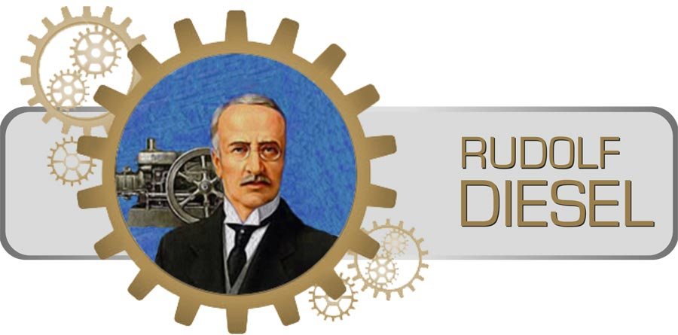
The Diesel Engine
The second type of internal combustion engine that was developed prior to 1900 was the compression ignition engine, perfected by Rudolph Diesel in 1892.
In the compression ignition engine, the combustion process starts when the air/fuel mixture ignites without a spark due a high amount of compression that causes high temperatures.
These engines are often called diesel engines because of Rudolph Diesel’s significant contributions in perfecting this type of engine.
Rudolph Diesel calculated that the high compression required for the diesel engine would also lead to higher efficiency.
When running properly, the diesel engines may have up to 30 percent higher efficiency than a spark ignition engine.
Diesel engines are very efficient because the greater amount of compression concentrates oxygen in the fuel/air mixture.
This creates a greater availability of oxygen for combustion, allowing more of the oxygen to react in order to create a more powerful and efficient explosion.
Diesel’s general concept of the four-stroke diesel engine has remained mostly unchanged for over 100 years.
Source: simplyknowledge.com

Slide 7
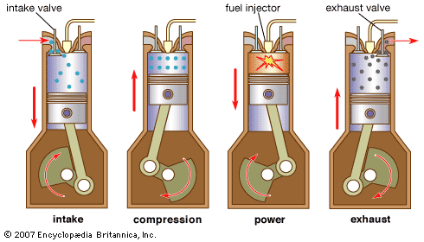
Diesel Four Strokes
Like most spark ignition engines, a compression ignition engine uses a four-stroke design.
The first stroke (intake) pulls air into a cylinder as the piston moves away from the intake valve.
The piston then swings around and compresses the air, which also heats the air. As the piston compresses the air, fuel is then injected under high pressure. The fuel will ignite immediately as it comes in contact with the heated air.
The hot combustion gases will expand and push the piston downward (power stroke).
As the piston moves upward again, it will push out the exhaust and the cycle restarts.
Source: kids.britannica.com

Slide 8
Diesel Technological Problems
Diesel engines have improved significantly in the past century.
Older versions of diesel engines mixed fuel and air in a pre-combustion chamber before injecting and combusting it.
This process was mechanically controlled, reducing the ability to adjust fuel-to-air ratios to changing engine conditions.
Mechanical control resulted in partial combustion, wasted fuel, and high tailpipe emissions (with lots of dark black smoke with high particulate matter).
Complete combustion will result in the production of only carbon dioxide and water.
Dark smoke is a general indicator of incomplete combustion; when a substance is completely combusted, it has little smoke and little visible evidence of combustion.
Particulate matter (PM) is composed of solid and gaseous waste products consisting mostly of carbon, ash, and metallic molecules.
Source: www.tenfourmagazine.com

Slide 9
Diesel Technological Improvements
Today’s diesel engines use computerized technology to control the amount of fuel used during the combustion.
This allows for complete electronic control over the multiple functions of the engine.
This enables fuel to burn more thoroughly, which results in more power, greater fuel economy, and fewer emissions than older diesel engines.
Diesel engines are already more efficient than gasoline engines, and greater use of diesel engines and improvements to diesel engine technology could substantially reduce US dependence on fossil fuels. To make this possible, additional improvements would be necessary to…
Reduce nitric oxide and nitrogen dioxide (commonly referred to as NO_{x}) and particulate matter (PM) emissions; NOx contributes to acid rain and smog, high PM amounts can cause major health problems.
Eliminate PM and NO_{x} emissions in a manner similar to how a spark ignition engine’s catalytic eliminate emission from gasoline combustion.
Develop new sources of diesel fuel with fewer emissions and similar or greater fuel efficiency

Slide 10
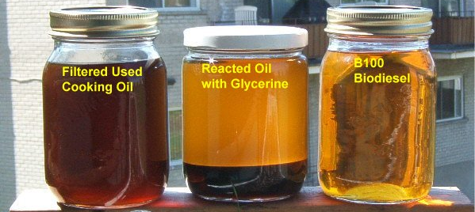
Biodiesel
Switching to biodiesel is one option for reducing emissions while maintaining most of the fuel efficiency of diesel.
Biodiesel is a renewable fuel that can be manufactured from vegetable oils, animal fats, or recycled restaurant grease.
Biodiesel burns cleaner and more completely than petroleum diesel fuel.
Biodiesel is both nontoxic and biodegradable.
Pure biodiesel (B100) will have 89% of the fuel economy of petroleum diesel, and B20 (20% biodiesel, 80% petroleum diesel) will have 97% of the fuel efficiency of pure petroleum diesel.
Source: www.b100wh.com

Slide 11
Transesterification
Biodiesel is produced from plant or animal oils using a process called transesterification.
Pure plant oil or animal fat molecules are too “branched” to combust efficiently.
The transesterification reaction converts the highly branched oil molecules (or triglycerides) into straight hydrocarbon chains that will combust more quickly and efficiently in an engine.
An alcohol such as methanol is necessary to change the oil to become a straight-chained hydrocarbon.
A strong base (such as NaOH or KOH) serves as a catalyst; a catalyst is a substance that increases the rate of a chemical reaction.
The transesterification will convert the oil, alcohol, and base into biodiesel and glycerin (a waste product that can be made into soap or a variety of other products).
Source: http://www.greencityltd.com/images/enzymescience.jpg

Slide 12
Esters
The term ‘transesterification’ refers to the conversion of one ester into another type of ester.
An ester is any molecule that contains a carbon atom that is single bonded to one oxygen atom and double bonded to another oxygen atom.
Animal and vegetable fats and oils are just big complicated esters.
During transesterification, the triple-ester (or triglyceride) oil molecule will be converted into a mono-ester.
The transesterification reaction is very efficient.
100 g of soybean oil (when reacted with 21.7 g of methanol and a base) will produce 100.4 g of biodiesel plus glycerin as a waste product.
Source: www.mediahex.com
Source: pixgood.com

Slide 13
Stages of Production
The production of biodiesel has four key stages:
1. Reaction Stage: as oil reacts with an alcohol in the presence of a strong base during transesterification, the lighter biodiesel will float to the top as the darker glycerin sinks to the bottom.
2. Washing Stage: rinsing with water or a chemical treatment is necessary to remove impurities from the biodiesel including the glycerin, incompletely reacted oil, methanol, and any remaining base.
3. Drying Stage: the biodiesel is allowed to sit so that water that was used to wash the biodiesel can evaporate.
4. Testing Stage: the fuel must be checked to ensure that all impurities have been removed and that the oil or fat completely reacted.

Slide 14
Benefits of Biodiesel
Biodiesel has many benefits that make it an attractive alternative to petroleum diesel fuel.
Because biodiesel molecules are partly comprised of oxygen, biodiesel will combust more completely.
This results in reduced particulate matter and carbon monoxide pollution in comparison to petroleum diesel fuel.
Biodiesel use results in a reduction in net CO2 emissions.
The amount of CO2 emitted during combustion is essentially the same as petroleum diesel fuel.
However, for biofuels made from plant-based sources, roughly the same amount of carbon dioxide was absorbed to grow the plant.
This makes plant-based biodiesel a carbon neutral fuel.
Source: www.goshen.edu

Slide 15
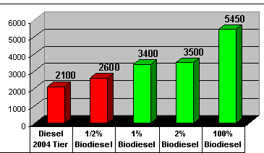
Benefits of Biodiesel
Biodiesel is a safer fuel because it has a high flashpoint.
The flashpoint of a fuel is the temperature at which the vapors above the fuel become flammable.
Biodiesel has a flash point that is considerably higher than petroleum-based diesel.
This means that the fire hazard associated with transportation, storage, and utilization of biodiesel is much lower than petroleum fuels.
Biodiesel can also lengthen the life of an engine because it has high lubricity.
Lubricity is the reduction of friction and wear in an engine.
In a diesel engine, the fuel acts as a lubricant for the parts in the diesel fuel injection system.
Pure biodiesel and high-level biodiesel blends have excellent lubricity in comparison to low- sulfur diesel blends currently in use in the US.
Source: http://web.cals.uidaho.edu/

Slide 16
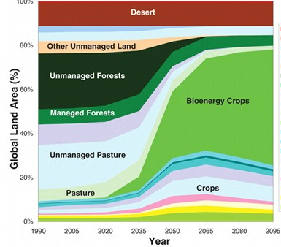
Disadvantages of Biodiesel
Biodiesel also has a higher cetane number.
The higher the cetane number, the faster the fuel ignites in a compression engine and the more complete the combustion.
While standard petroleum diesel has a cetane number of 48, B100 is rated at 55 and B20 is rated at 50.
Biodiesel does have disadvantages.
The most important disadvantage of biodiesel is that it is very limited in comparison to petroleum diesel fuel.
If all of the vegetable oil and animal fat were used to produce biodiesel, we could only replace about up to 10% of the current demand for diesel fuel.
There is also concern with the prospect of converting native ecosystems to monoculture production of oil crops such as soybeans; increased use of biodiesel could also lead to increased losses of wildlife habitat.
This could potentially lead to increases in greenhouse gasses if the crops that replace the native vegetation are less capable of absorbing CO₂.
Source: http://www.sciencemag.org/content/324/5931/1183.abstract

Slide 17
Disadvantages of Biodiesel
Biodiesel can also suffer from performance issues.
Biodiesel can usually only be used in warm climates or during warm months because it will gel in cold weather.
Biodiesel will also clean the engine as it is used because it is an excellent solvent; this can lead to clogged fuel filters in engines not specifically designed to accommodate biodiesel.
Biodiesel can also break down rubber hoses and other rubber components of an engine.
So why produce and use biodiesel?
First, it provides a market in which to profitably dispose of excess vegetable oils and animal fats.
It also decreases dependence on foreign sources of petroleum while stabilizing fuel prices by minimizing the fluctuations in fuel availability.
It can reduce carbon dioxide emissions.
Even small additions of biodiesel can convert fuel with poor lubricating properties, such as modern ultra-low-sulfur diesel fuel, into a fuel with acceptable lubricity.

Slide 18
Future of Biodiesel
Additional biotechnology research could also result in larger quantities of oil production for biodiesel use.
Research at Michigan State University has resulted in the production of plants in which more oil can be produced, stored, and harvested per crop acreage.
These plants accumulate oil in their leaf and stem structures (instead of just in the seeds as in most normal oil-producing plants like soybeans).
Additionally, researchers at the University of Wisconsin have developed genetically-modified E. coli strains that can convert plant sugars into fatty acids which can be converted into oils similar to those produced by plants.
Not only would this result in almost a 10-fold increase in the capacity to produce oils but could also mean more consistency in the production of oils with fewer unwanted attributes and impurities.

Slide 19
Future of Biodiesel
Algae may also serve as a promising source of oil for biodiesel in the future.
While soybeans can produce 40-50 gallons of oil per acre, algae can produce 10,000-20,000 gallons of oil per acre.
The large-scale farming of algae is still largely not feasible on a commercial scale, but with continued research and development, this may prove to be a promising fuel source in the future.

Slide 20
Works Cited
http://www.academia.edu/6472163/Engineering_Fundamentals_of_the_Internal_Combustion_Engine_._i
http://www.autolife.umd.umich.edu/Environment/E_Overview/E_Overview.htm
http://www.grc.nasa.gov/WWW/k-12/airplane/engopt.html
http://www.afdc.energy.gov/fuels/biodiesel_basics.html
http://www.gmc.com/fuel-efficiency/diesel-vs-gasoline.html
http://www1.eere.energy.gov/vehiclesandfuels/pdfs/basics/jtb_diesel_engine.pdf
http://www.eia.gov/oiaf/analysispaper/biodiesel/
http://web.cals.uidaho.edu/biodiesel/biodiesel-shortcourse/
https://www.glbrc.org/research/technologies/090022
https://www.glbrc.org/research/technologies/P09329US02

