Slide 1
Mendelian Genetics
C Kohn, Waterford WI

Slide 2
Genetics
Genetics is the study of inheritance of genes.
i.e. genetics is how traits are passed down from parents to offspring
Every individual offspring inherits at least two copies of every gene – one from the mother and one from the father.
Each version of a gene is called an allele.
You inherit at one allele from both parents for every gene.
Genes can either be dominant or recessive –
Dominant genes are always expressed if they are present
Recessive genes are only expressed if no dominant genes are present.
Source: blogography.com
Source: techcynic.wordpress.com

Slide 3
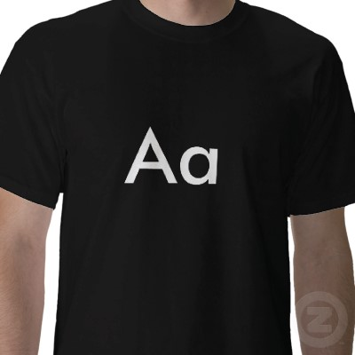
Homozygous vs. Heterozygous
The combination of genes that you have can be described by homozygous or heterozygous.
Homozygous means that both of your genes are the same – either both are dominant or both are recessive
AA would be Homozygous Dominant (both alleles are dominant)
aa would be Homozygous Recessive (both alleles are recessive)
Heterozygous means that you have both a dominant and a recessive copy of a gene.
Aa would be Heterozygous (one dominant allele, one recessive allele)
Source: zazzle.com

Slide 4
Genotype vs. Phenotype
Genotype is the term for the genes that an organism has.
Phenotype are the physical characteristics created by the combination of genes that an organism has.
For example, Mr. Kohn is heterozygous for eye color – his genotype has genes for both blue and brown eyes.
However, Mr. Kohn’s phenotype is brown eyes – the blue eye color is not expressed because it is recessive.
A A
a
a
Aa Aa
Aa Aa

Slide 5
Punnett Squares
A Punnett Square is a tool used for determining the possible genetic outcomes of the offspring of two parents
Punnett Squares are can be used to determine the parents’ or offsprings’ phenotypes and genotypes.
Punnett Squares show all of the possible combinations of offspring genotypes that a couple could have.
A A
a
a
Aa Aa
Aa Aa

Slide 6
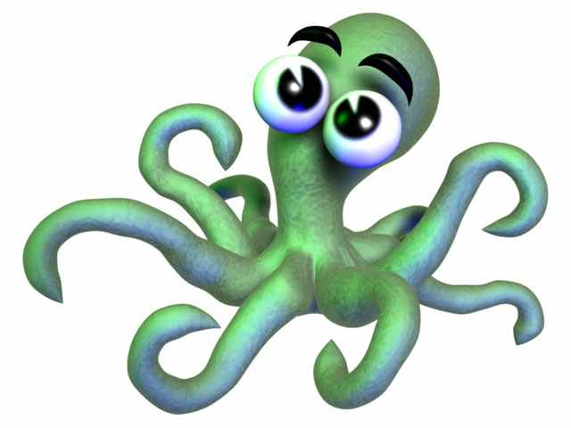
How would you create a Punnett Square for this family?

Slide 7
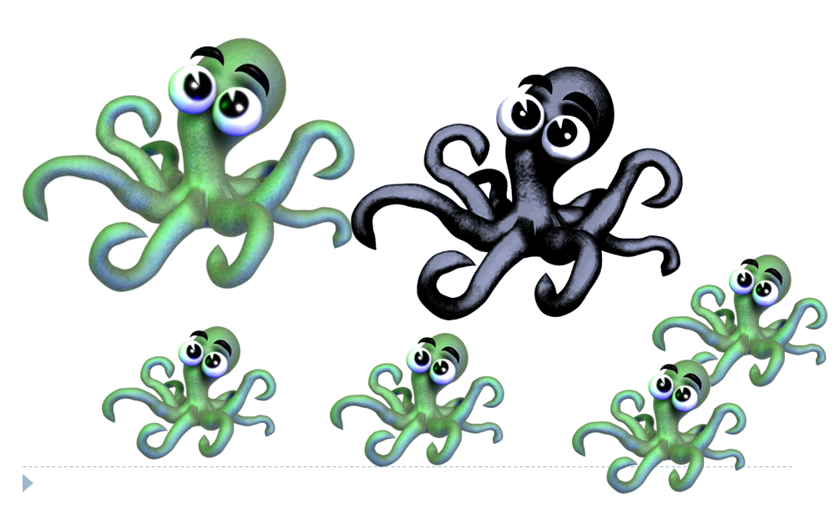
5 Steps of Punnett Square Problems
Step 1: Figure out what is recessive.
Usually the trait that is dominant is more common.
Usually the trait that is recessive is less-prevalent.
In this case, we can tell that purple is recessive and green is dominant.

Slide 8
5 Steps of Punnett Square Problems
Step 2: Determine the genotypes of the parents
One is pretty simple – the purple recessive parent has to have two little letters: aa
The other green parent has only two possibilities – AA or Aa
So we know that one parent is aa and the other is either Aa or AA.

Slide 9
5 Steps of Punnett Square Problems
Step 3: Create the Punnett Squares for each possibility.
Step 4: Select the Punnett Square that reflects what we see for offspring below.
A a
A A
a
a
Aa aa
a
a
Aa Aa
Aa aa
Aa Aa

Slide 10
5 Steps of Punnett Square Problems
Step 5: Confirm that you are correct.
You know that the Punnett Square on the left cannot be correct because ½ the offspring are recessive.
A a
A A
a
a
Aa aa
a
a
Aa Aa
Aa aa
Aa Aa

Slide 11
How would you create a Punnett Square for this family?

Slide 12
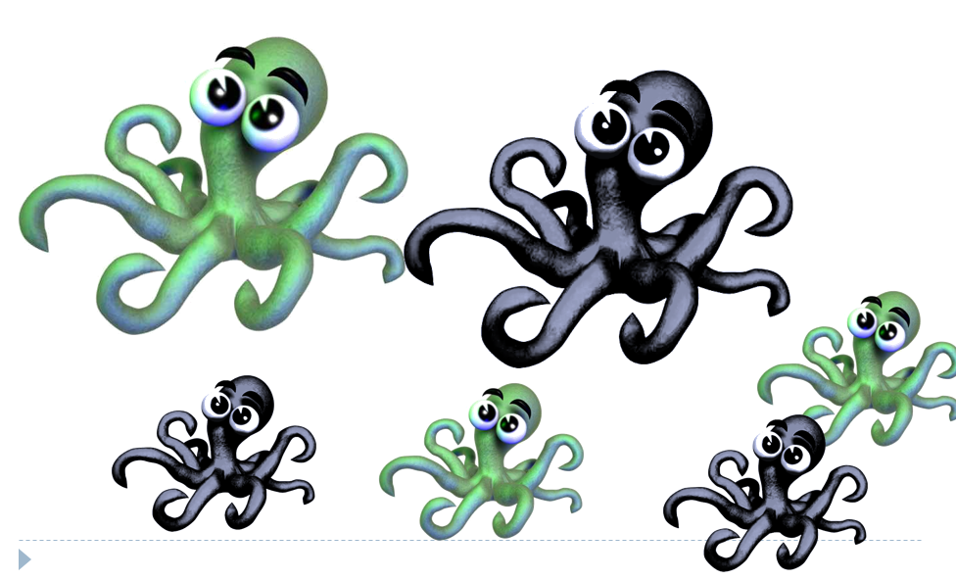
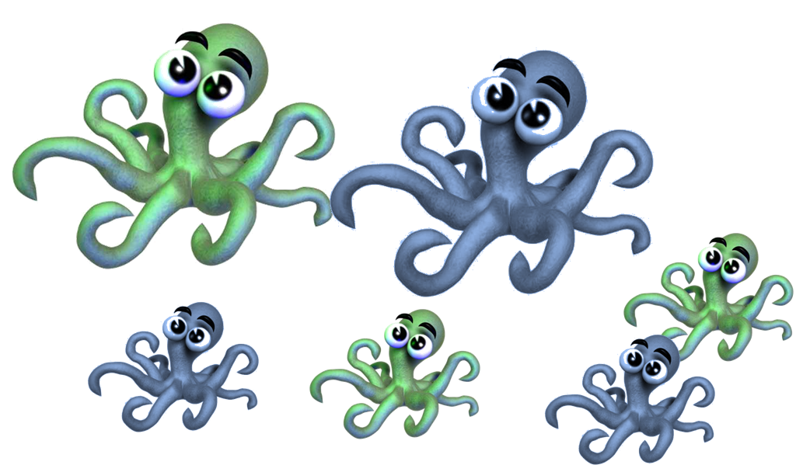
Step 1: Figure out what is recessive
Usually the recessive trait is the less-prevalent trait (not always, but usually).
In this case we know both green and purple are equally common, but we know from before that green was dominant.

Slide 13
Step 2: Determine the genotypes of the parents
We know that the purple parent has to be aa
We know the green parent could either be AA or Aa

Slide 14
Step 3 & 4: Create Punnett Squares for each possibility; pick the correct square
Create Punnett Squares for all parent genotype combo possibilities
You know that the Punnett Square on the left is correct because half are the dominant phenotype and half are the recessive phenotype.
A a
A A
a
a
Aa aa
a
a
Aa Aa
Aa aa
Aa Aa

Slide 15
Step 5: Confirm that you are correct.
Be prepared to explain why the other Punnett Square would not work.
You know that the Punnett Square on the left is correct because half are the dominant phenotype and half are the recessive phenotype. The other has only green offspring
A a
A A
a
a
Aa aa
a
a
Aa Aa
Aa aa
Aa Aa

Slide 16
Personal Test: How would you create a Punnett Square for this family?

Slide 17
Possible Combinations
With simple traits, there are only six possible combinations of parents
AA x AA
AA x Aa
Aa x Aa
AA x aa
Aa x aa
aa x aa
Each one will have the same results for offspring ratios each time.

Slide 18
Offspring Ratios
If we have only recessive phenotypes, we know that both parents are homozygous recessive – aa x aa
If we have half recessive, half dominant phenotypes, we know that one parent is Heterozygous and one parent is Homozygous Recessive – Aa and aa

Slide 19
Offspring Ratios
If we have ¼ recessive and ¾ dominant phenotypes, we know that both parents are Heterozygous – Aa and Aa
If all offspring are the dominant phenotype, we know that the combination of parents must be one of the following:
AA x AA Aa x AA AA x aa
Additional combinations would be necessary to determine which it is (except in the last example, where one parent has the recessive phenotype).

Slide 20
Quiz Objectives
Define an allele, a phenotype, and a genotype.
Describe how homozygous recessive is different from homozygous dominant.
Define heterozygous.
State the genotype of an organism that has the recessive phenotype.
State the genotypes of parents if they have all recessive-phenotype children.
State the genotypes of parents if ¼ of their offspring have the recessive-phenotype.
If half the children of a couple have recessive phenotypes, what are the genotypes of the parents?
If a heterozygous couple has 3 offspring, all with the dominant phenotype, what are the odds their 4th offspring will have the recessive phenotype?

Slide 21
Which calf belongs to which cow?
Which calf was adopted?
Red is recessive. Horns are recessive.
Bull
Berry Cherry Darlene
Unos
Quincy
Tracy
Diane

